Slide 1
Financial Stewardship
2024 Mid-West Annual Meeting
Colin Marquez
Acting Chief Financial Officer and Senior VP
December 11, 2024

Slide 2
Financial Stewardship
Funding Model
Reserve Strategy
Budget Controls
Opportunities

Slide 3
Funding Model

Slide 4
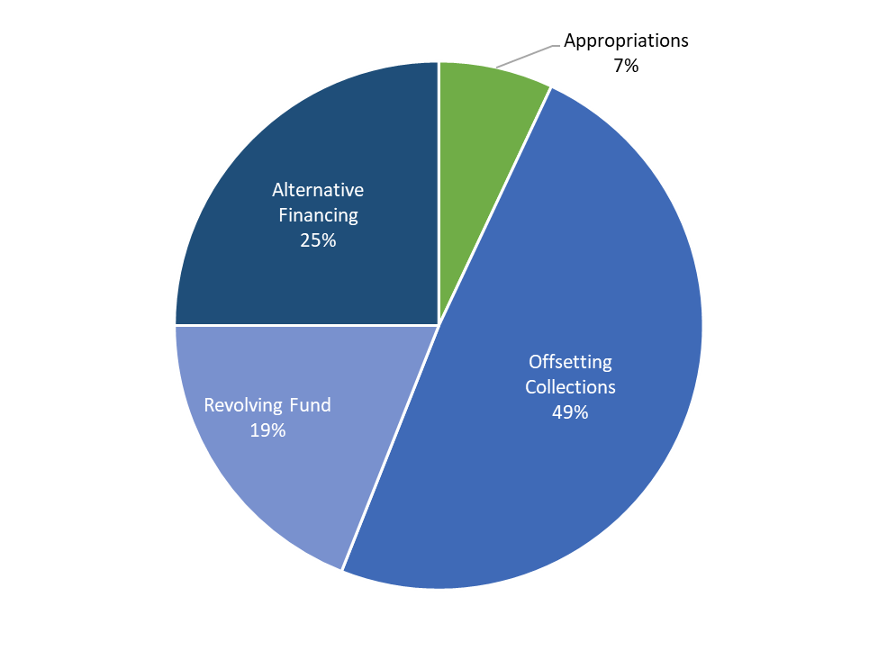
Funding Composition
<10% of funding
Prioritized for capital investment
Repaid with interest
Appropriations
Offsetting Collections
Annual O&M (net zero) and PPW
Part of annual appropriations bill
Colorado River Basins Power Marketing Fund
Funds CRSP and Fort Peck projects
Funds O&M, Capital, PPW
Revolving Fund
Alternative Financing
Requires voluntary customer advances
Requires customer coordination
Funds O&M, Capital, PPW
>90% Funded from Annual Revenues

Slide 5
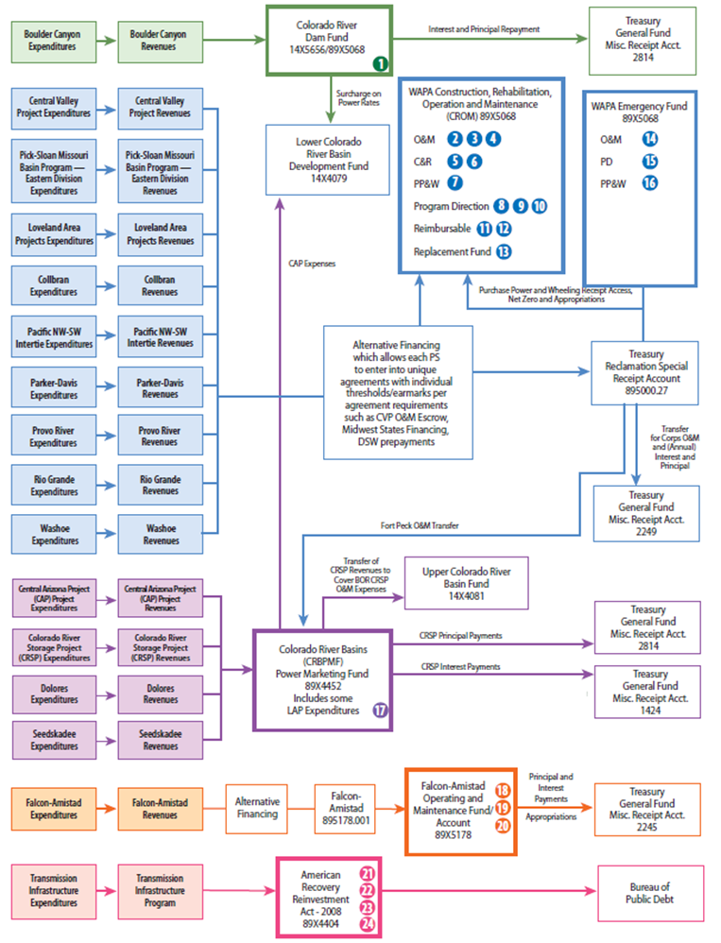
Funding Complexity
Cobbled together authorities
Heavily reliant on receipts
Difficult to navigate
Numerous “Colors of Money”
24 administrative and congressional controls
18 multipurpose water resource and transmission projects
11 rate-setting projects
4 Treasury accounts
4 permanent financing authorities
4 Congressionally determined annual appropriations
11 accounting elements (FERC, USSGL, OMB, Projects)

Slide 6
Reserve Strategy

Slide 7
Managed Reserve Balance Strategy
Sustainable Funding tool to support WAPA’s mission
Annual O&M
Appropriated
(PD / O&M / C&R)
Customer Funded
Capital
Purchase Power & Wheeling
Example
O&M work including salaries, supplies, and equipment
O&M and capital investment to provide reliable, resilient, modernized transmission systems and safeguards
Investments in T-lines, substations, and related structures
Buying power / transmission on behalf of customers when conditions require it
Purpose
Allows WAPA to sustain operations during emergencies, continuing resolutions or lapses in appropriations
Allows WAPA to sustain operations during emergencies, continuing resolutions or lapses in appropriations
Provides funding in advance of starting capital projects and flexibility with schedule / priority changes in collaboration with customers
Improves both WAPA and customer cash management, allowing for continued funding of critical capital projects to continue
Strategy
Retain 25% of annual funding need
Retain 25% of annual funding need
Retain sufficient funding to cover up to 3 years of customer funded capital investments
Retain 3 years estimated funding during drought
*Carrying reserve balances does not impact rates

Slide 8
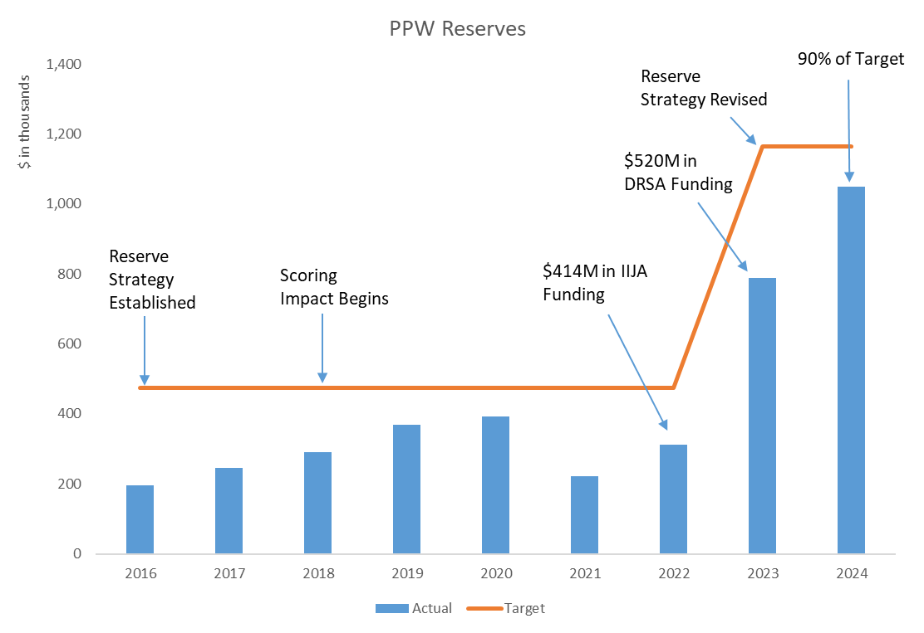
Purchase Power & Wheeling (PPW) FY 2024 Reserve Balances at 90% of Target (CROM Account)
History of PPW Receipt Authority
Instituted at WAPA in 2001
Reserve Strategy established in 2016
Until 2018, was scored at net zero
Since 2018, the scoring treatment has limited WAPA’s access to receipts, impacting reserve balances
Status Update
Received $934M in supplemental funding between FY22 and FY23
Support has led to increased access to receipts since FY23
Reserve Strategy revised from $0.4B to $1.2B
FY24 balance of $1B or 90% of target

Slide 9
Budget Controls

Slide 10
Budget Controls
Budget Guidance
Additions Approval Process
Reporting & Execution Monitoring

Slide 11
Budget Guidance by Category
FTE & Labor
O&M
Capital
PP&W

Slide 12
Additions Approval Process
Requirement Identified
Scrub Data for Offset
Complete Additions Form
Senior Manager Approval
Administrator Approval

Slide 13
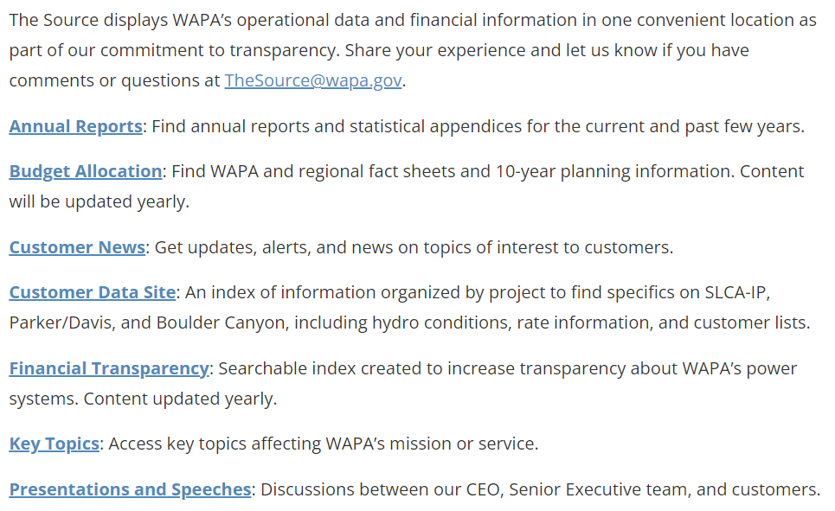
Reporting and Execution Monitoring
Internal
External
Daily
Management Reports
Requirement Level Tracking
Monthly
Financial Dashboard Review
Spend Plan Forecasts
Cash Flow Forecasts
Annually
Budget Formulation
Budget Revalidation
The Source: www.wapa.gov/about-wapa/the-source

Slide 14
Opportunities

Slide 15
Infrastructure Focus and Enablement
Asset
Management
Workload Management
Technology
& Process
Workforce Management
Financial Management

Slide 16
Colin Marquez
cmarquez@wapa.gov
720.962-7434

