Slide 1
How Nuclear Energy Fits Into a New Energy Future
Michelle Zietlow-Miller – Public Engagement Manager of Gateway for Accelerated Innovation in Nuclear (GAIN)
December 11th, 2024
Denver, CO

Slide 2
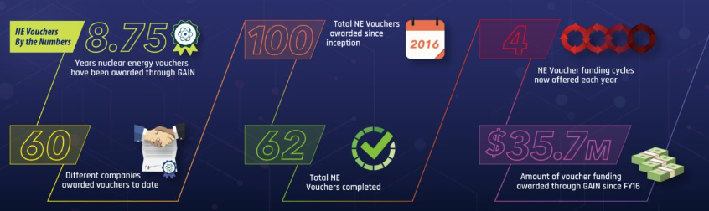
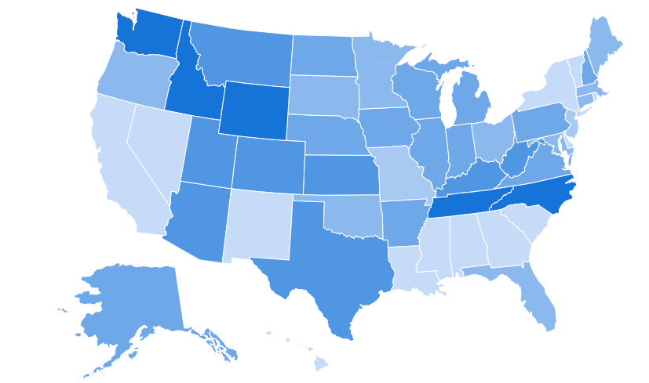

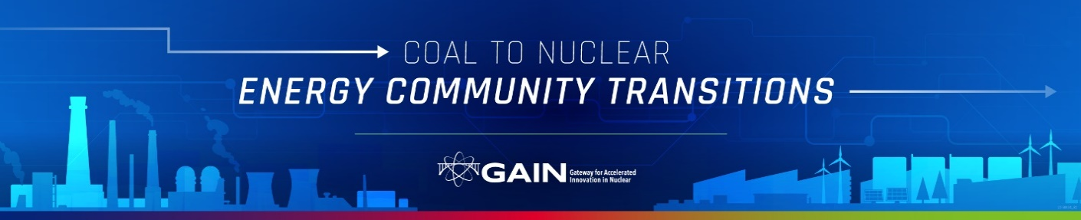
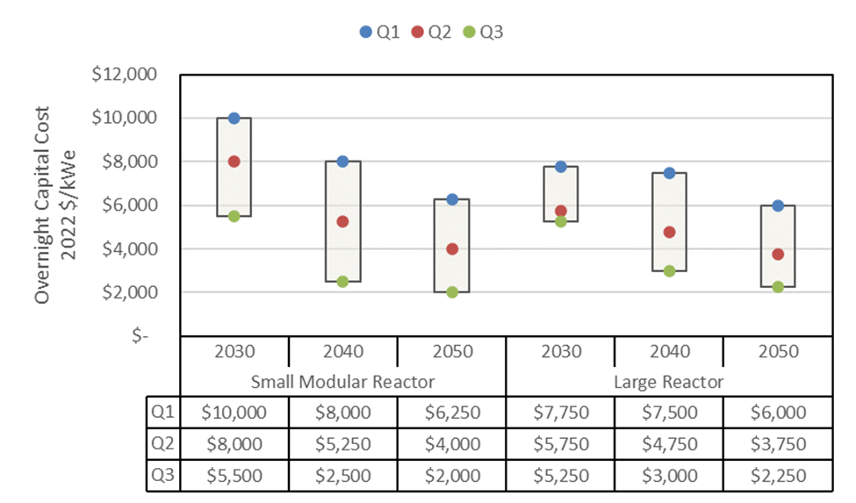
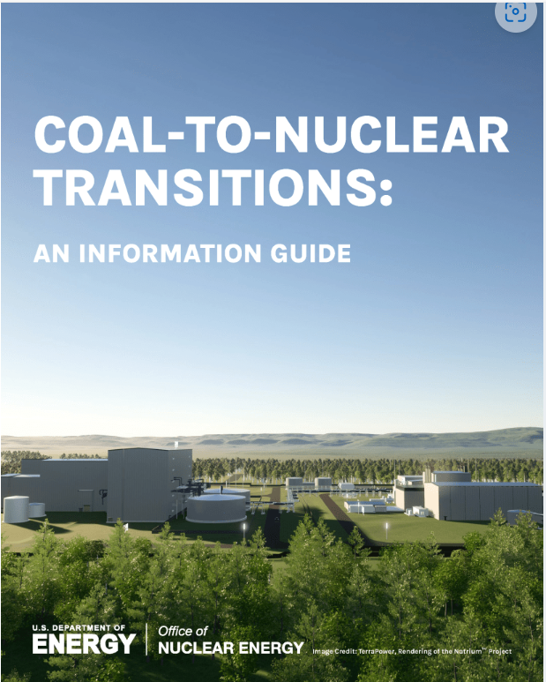
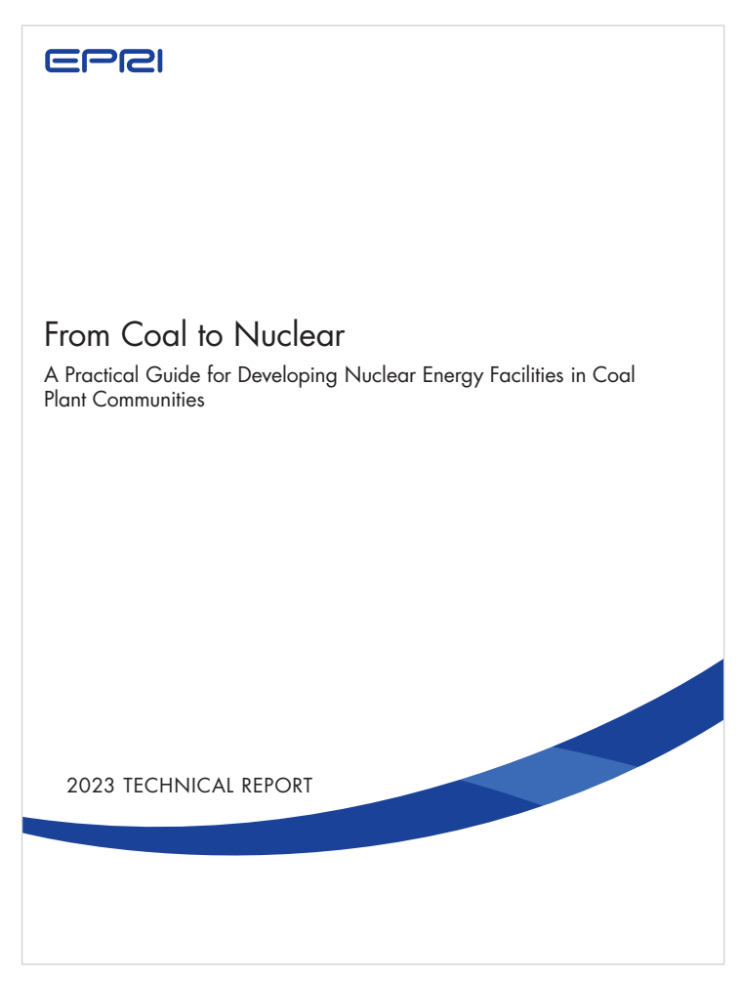
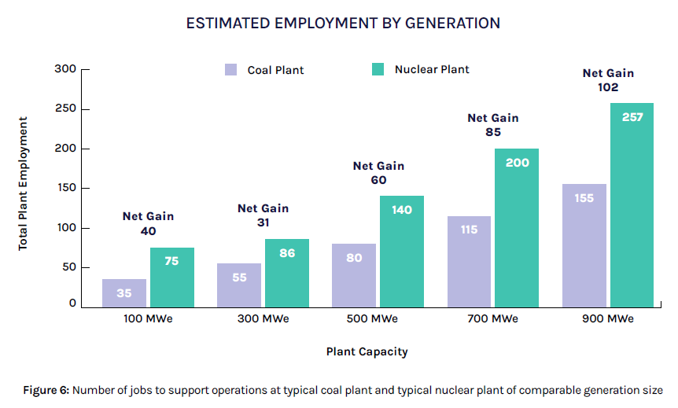
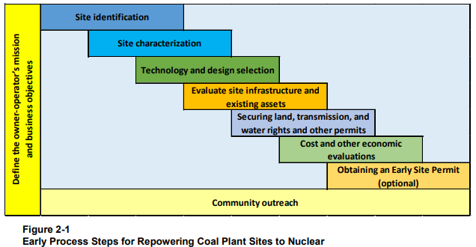
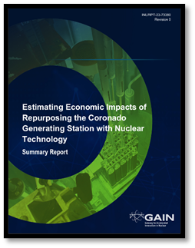
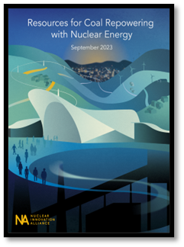
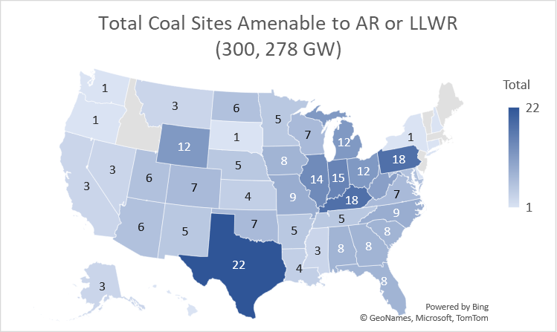
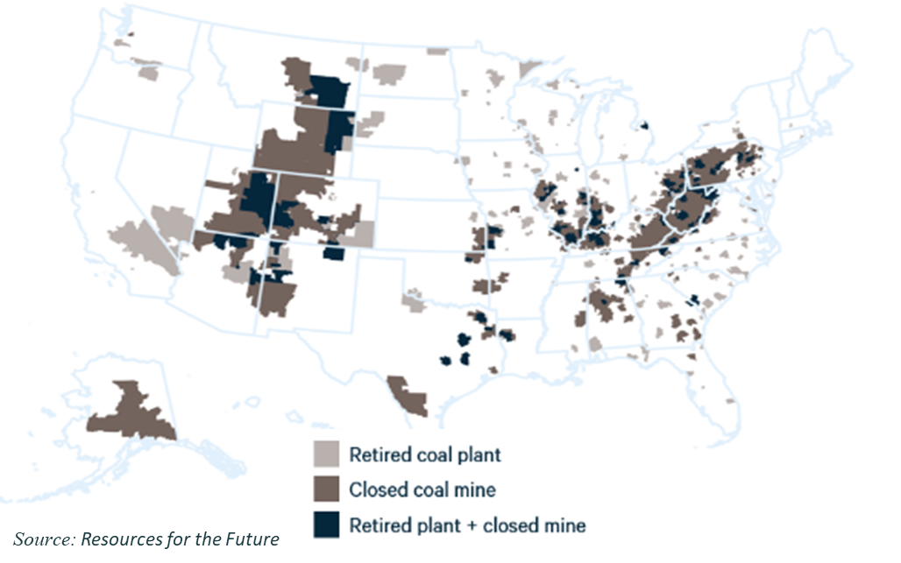

2024 Activities
State and Local Level Outreach
Policymakers, NGOs, Utilities, Regulators, Industrials, Commissioners
Introduce Advanced Nuclear through direct conversation or testimony
Help connect states to financial or technical resources across DOE complex
Looking at state level regs
vouchers
Advanced Reactor Cost
develop relevant cost ranges that could be used for modeling and energy planning using public data
Using “between” of a kind (not FOAK or NOAK)
Future cost curves were based on use of a learning rate and deployment projections.
SMR with 300 MWe, learning rate 9.5%
Large reactor with 1,000 MWe, learning rate 8%
Deployment Projections conservative 12 GW by 2050,
moderate is 34 GW by 2050, advanced is 200 GW by 2050.
gain.inl.gov
Notes:
Gain was originally developed to provide access to the labs via the voucher program. This is represented in the blue box on the top left. GAIN is also working to gain access to legacy documents. Currently we are working on approximately 200 items which have allowed developers to utilize research from the labs to credit modeling and simulation. In the lower left corner is the advanced reactor cost report that gain put together in fall of 2023. This report is between of a kind (not first of a kind or Nth of a kind). This represents work that gain believes is valuable to the industry however there is no leader producing the study so we take on the project to help the industry as a whole. On the right is State and local outreach including coal to nuclear.
The Advanced Rx Cost study evaluated 50 bottom up cost references. Downselected to 35 to form the cost ranges.
It developed cost ranges for a SMR with 300 MWe and a large reactor with 1,000 MWe
The values developed are not first of a kind costs, nor are the NOAK costs. They are an intermediate value that is considered the “between” of a kind (BOAK).
Ranges were mapped to NREL definitions of Conservative, Moderate, and Advanced.
The report also includes information on construction duration, capacity factor, fuel, fixed/variable O&M. ramp rate, and learning rates.
Future cost curves were developed based on use of a learning rate.
Learning rate for large reactors was based on prior experience/observation with processing – Used 8%
Learning rate for SMRs was based on a bottom-up learning rate development from literature – Used 9.5%
Future costs also based on deployment projections. For conservative this was taken to be 12 GW by 2050, moderate is 34 GW by 2050, and advanced is 200 GW by 2050.
Other considerations include potential reduced costs for Coal-to-Nuclear conversions, LCOE calculations, how subsidies affect costs, and non-electric applications.
It should be noted that this is the beginning of a larger effort. This is a statistical look at advanced reactor costs. With the framework now setup, more efforts need to be undertaken for bottom-up cost generation and incorporation of world costs once nuclear projects get underway.
Takeaways
Initial 2030 Owner Capital Cost (OCC) values show that there is a difference between SMR and large reactor costs. With SMRs being more expensive on a $/MW basis. This is for overnight costs due to economies of scale and higher uncertainties. Once financing and construction duration are accounted for, along with higher learning, these costs start to converge.
The first OCC values do not include the effect of learning based on a standardized design deployment. Due to the smaller size of SMRs, learning can accumulate more quickly for the same GWe of nuclear deployment. This means that costs decline more rapidly as deployment picks up.
The report, and its underlying data and methodology, are sufficiently transparent as to allow users to adjust and project different cost scenarios based on differring assumptions. OCC values and their evolution are provided below .

Slide 3
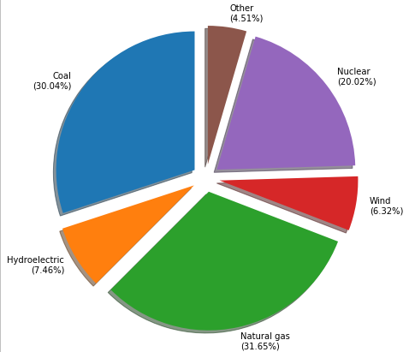
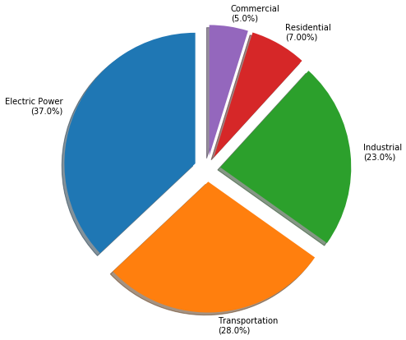
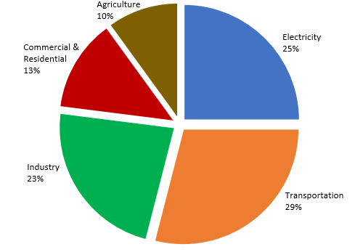
The Challenge of a Carbon Free Future
Generation Energy Consumption
Generation Energy Consumption GHG Emissions
Source: EIA and EPA
Notes:
These charts illustrate challenges to meeting net zero emissions by 2050.
Here’s the way we normally look at energy: how do we generate it (supply by fuel source) and how do we use it (Demand). Now the complicating factor is the emissions from those activities shown here
The main difference between the middle pie chart and the one on the far right – electric power consumption 37% of total but only contributes to 25% of emissions. That directly speaks to the progress has been made with renewables, and low hanging fruit is still available given flat demand.
Transportation: 29%
Technology exists or is in development, but adoption will require:
electrification of public transport and personal vehicles and/or
heat intensive production of carbon neutral fuels and fuel cells
Industry: 23%
Some processes can be electrified or only require low temperature heat
Others will require high quality industrial steam or high temperature heat – we need to figure out how to supply this in a fashion that works for both sides (generation and industrial customer)
Agriculture: 10%
Will require carbon free 400-500 °C to produce clean ammonia
Commercial & Residential: 13%
Will require electrification of heating systems or district heating with carbon free heat source

Slide 4
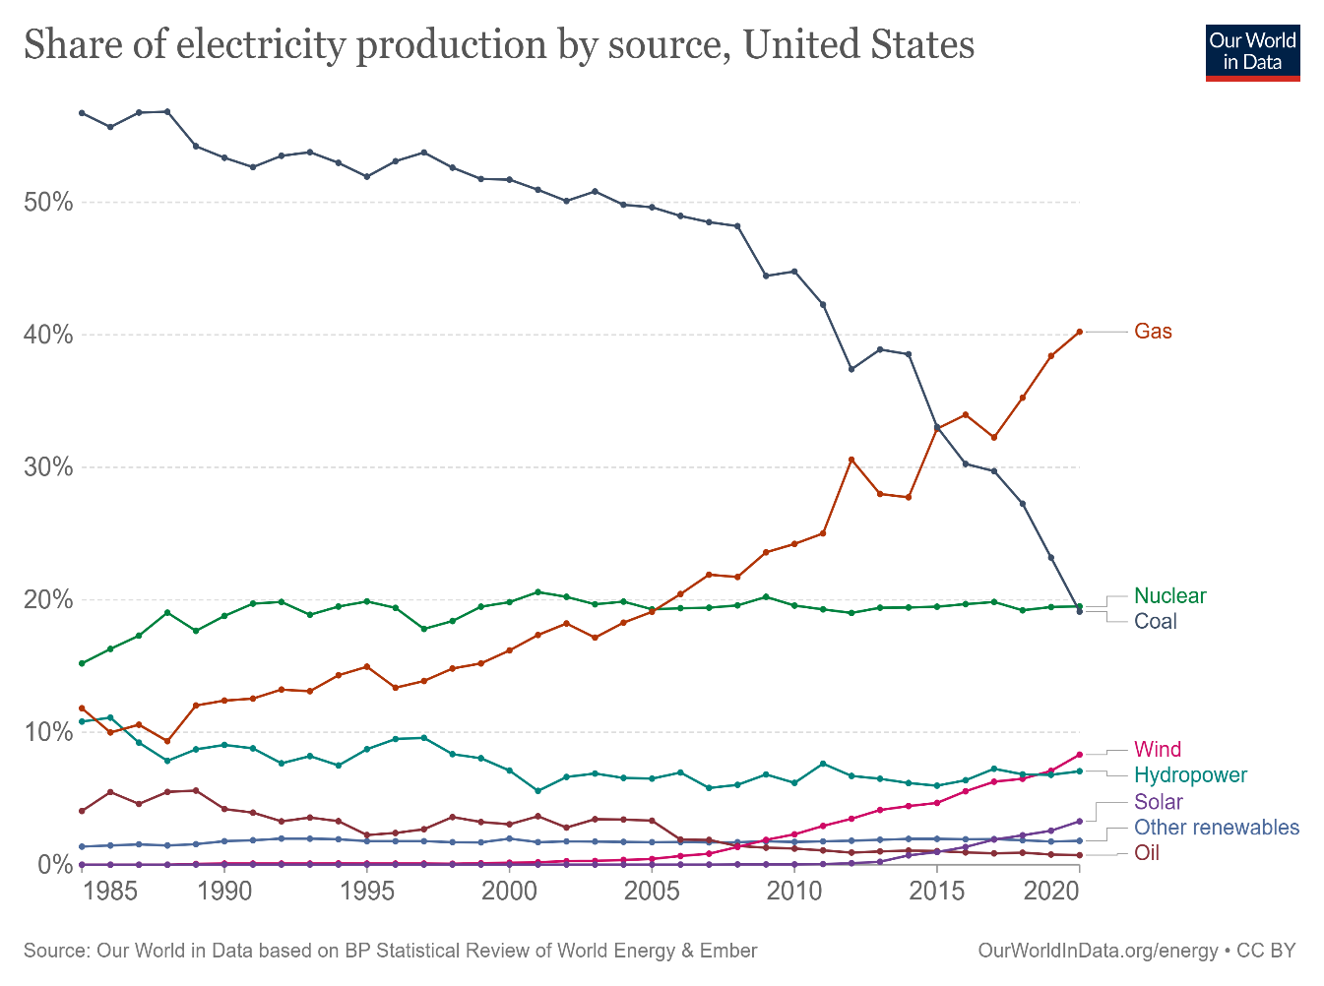

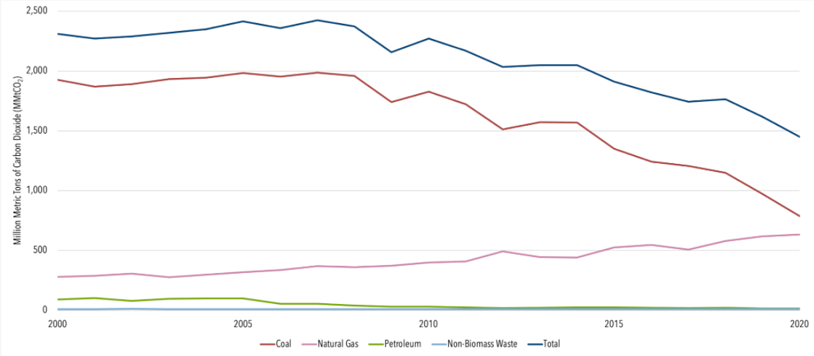
What has really changed for electricity?
Source: Monthly Energy Review EIA 2021
Notes:
On the left hand side, you have electricity generation by fuel type since 2000trends since 1985 and on the right, you have the resulting carbon emissions
Decrease in Coal
Offset by Increase in Gas
Overall Less Emissions (blue line on right hand chart)
Increases in Wind
Increases in Solar
Other Clean Generation Sources ~steady
However renewables are not available 100% of the time – solar is only available when the sun is shining, Wind is only available when the wind is blowing, and hydro is based on the flow and tides. To balance the renewables and provide base-load power where renewables are not available will require dispatchable carbon-free electricity. Options for dispatchable base load include gas plants with carbon recapture utilization and storage, or nuclear.

Slide 5
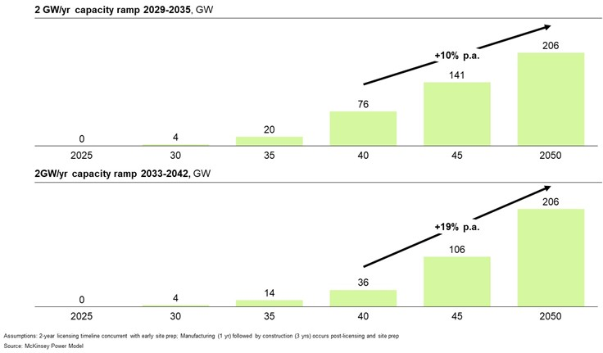
Required Nuclear Buildout – 200 GW by 2050
Annual industrial capacity additions:
2 GW per year 2029 – 2034
Ramping to 13 GW per year from 2035 – 2050 to achieve 200GW by 2050
Requires an additional 275,000 workers; currently 100,000 workers
Source: DOE Pathways to Commercial Liftoff, Advanced Nuclear report
Notes:
Required Nuclear Buildout So how do we get there?
To achieve ambitious U.S. decarbonization goals by 2050, some ask why these goals cannot be met with wind and solar alone. As penetration of renewables grows, issues with power generation variability, interconnection congestion, and transmission constraints increasingly necessitate a firm, reliable, zero-carbon power generation source that nuclear is uniquely positioned to offer. That is why most energy growth studies conclude that approximately 200GW needs to be added by 2050 to achieve deep decarbonization goals.
What does that scale-up look like?
If 2 GW per year of industrial capacity can be added starting in 2029, the required annual capacity addition caps at 13 GW per year from 2035 through 2050. This sounds hard – but we have done this before. Throughout the 1970s and 80s, the US averaged about 5 GW per year of new nuclear capacity with individual years approaching 10 GW. So this buildout is achievable.
And let’s take a moment to celebrate the completion of Vogtle Units 3 and 4 – the first domestic deployment of the Westinghouse AP-1000 design. The high upfront costs of this first-of-a-kind nuclear project are a down payment on catalyzing a robust U.S. nuclear sector. Much broader than the success of one plant, investing in Vogtle has laid the foundation to jumpstart the advanced nuclear industry in the U.S. – establishing supply chains and training a new generation of workers.
The Vogtle project has had significant job creation benefits. With more than 9,000 construction jobs at peak and 800 permanent jobs available once the units begin operating, Vogtle is currently the largest jobs-producing construction project in the state of Georgia.
Beyond this project, it has helped train a new generation of workers in the U.S. with the skills to build future nuclear plants. These supply chain and workforce investments will enable not only increased domestic production of nuclear power, but will also support the export of U.S. nuclear technology.
DOE Liftoff report:
Advanced Nuclear As a carbon-free, firm power generating resource, nuclear can play a critical role in complementing the buildout of variable renewables and providing a significant portion of the additional clean, firm capacity required in all decarbonization scenarios. System modeling indicates achieving net-zero in the U.S. by 2050 requires adding on the order of 550–770 GW of additional clean, firm power. These same models indicate advanced nuclear is likely to be the economic option for at least 200 GW of this capacity addition assuming expected overnight capital cost reductions, comparing favorably with other clean, firm options (e.g., renewables paired with long duration energy storage, fossil with carbon capture, geothermal). Deploying ~200 GW of nuclear capacity in the U.S. could require ~$700B in capital formation by 2050, with $35-40B required by 2030. Challenges with transmission expansion, interconnection, land-use intensity, and other factors limiting renewables buildout are likely to make nuclear an even more attractive option. New deployment of advanced reactors at scale, however, will depend heavily on taking action toward building a committed orderbook of 5-10 projects by 2030; and achieving predictable construction timelines and cost profiles, by incorporating lessons learned from Units 3 and 4 at the Alvin W. Vogtle Electric Generating Plant, two Westinghouse AP1000 pressurized water reactors.

Slide 6
Current State of the Nuclear Industry
The existing fleet of 94 nuclear reactors at 54 sites provide ~20% of US electricity generation and almost half of domestic carbon-free electricity.
Prior to 2021 12 units prematurely closed, and all units would only operate to their original 40-year license
As of 2024 the value of our existing assets has been recognized and there has been increasing investment to support our clean energy needs
  To date 6 Units have approved license extension to 80 years
  84 have licenses that will expire prior to 2050
Power uprates totaling ~2-8 GW could add near-term capacity to existing reactors. Preliminary analysis shows there may be room for ~60-95 GW of new nuclear at existing sites.
Source: Subsequent License Renewal Filings For U.S. Nuclear Power Plants (nei.org)
Notes:
Currently the U.S. has 94 operating reactors with Vogtle Units 3 and 4 online. The graph shows the impact of climate change and the need for clean energy on the retirements on our existing fleet. Prior to 2021 12 units were prematurely closed and all unit’s would only operate to their original 40 year license. As of 2024 the value of our existing assets has been recognized by states and utilities and there has been increasing investment to support subsequent license extensions and extended power uprates on our existing fleets which were not economical just 3 years ago. To date 6 units have approved license extension to 80 years and the orange line shows how extending our entire fleet to 80 years will ensure we have clean energy available through 2050. This will allow us to continue utilizing our current nuclear workforce to support clean energy and look for ways to support their continued safe operation.

Slide 7

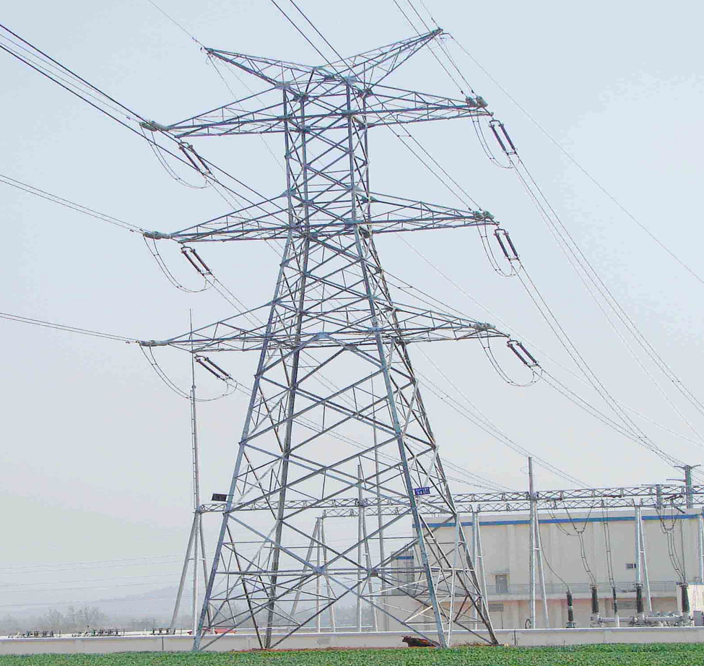

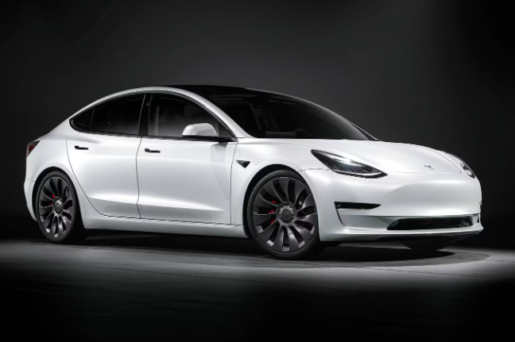
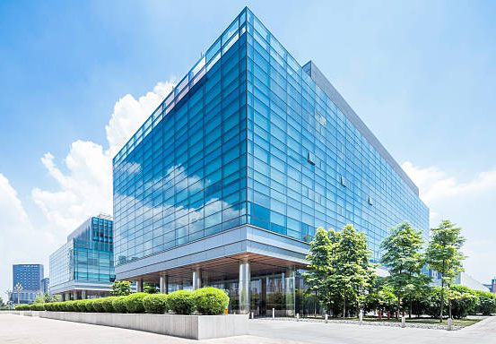
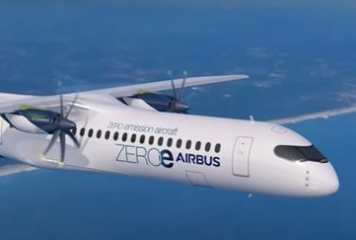
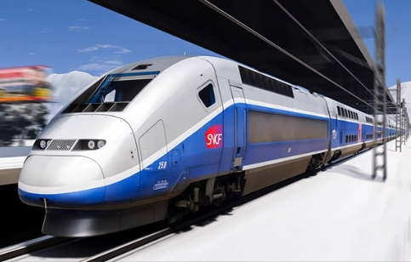

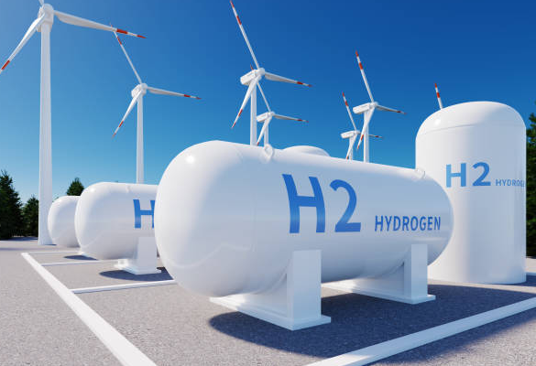
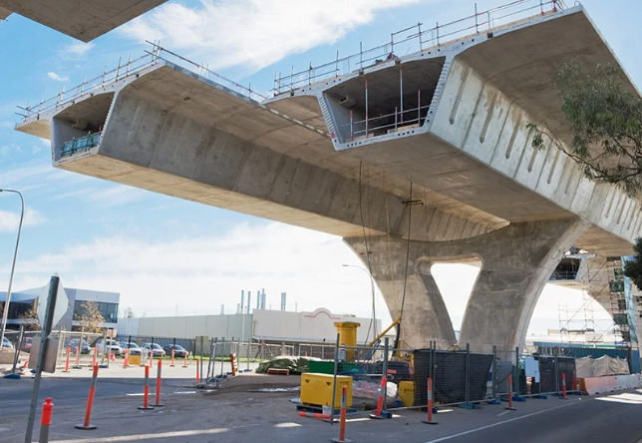
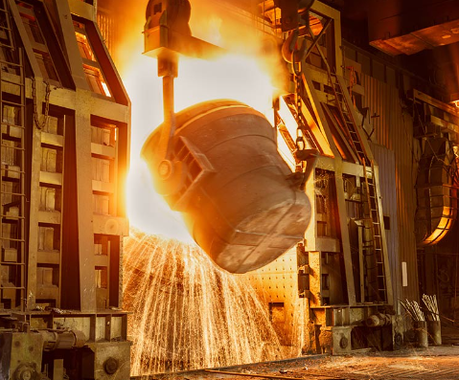
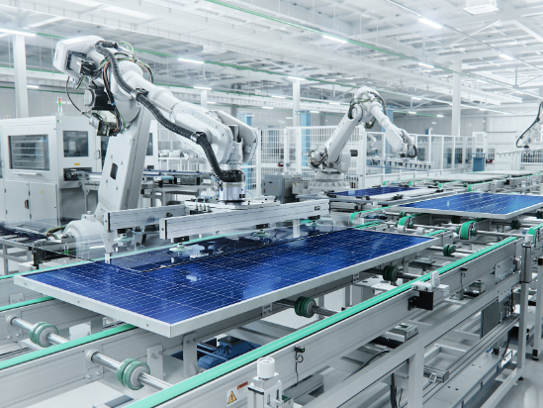
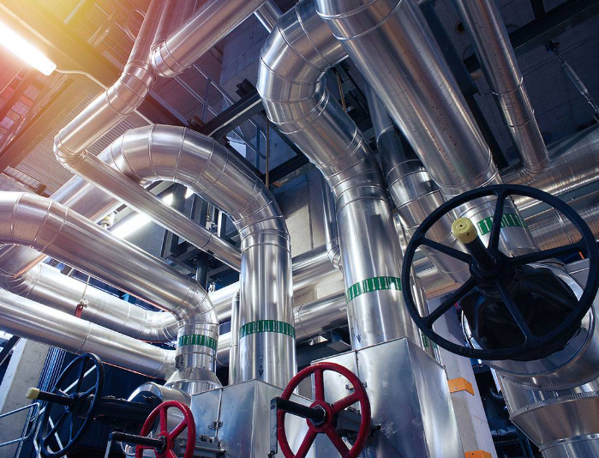
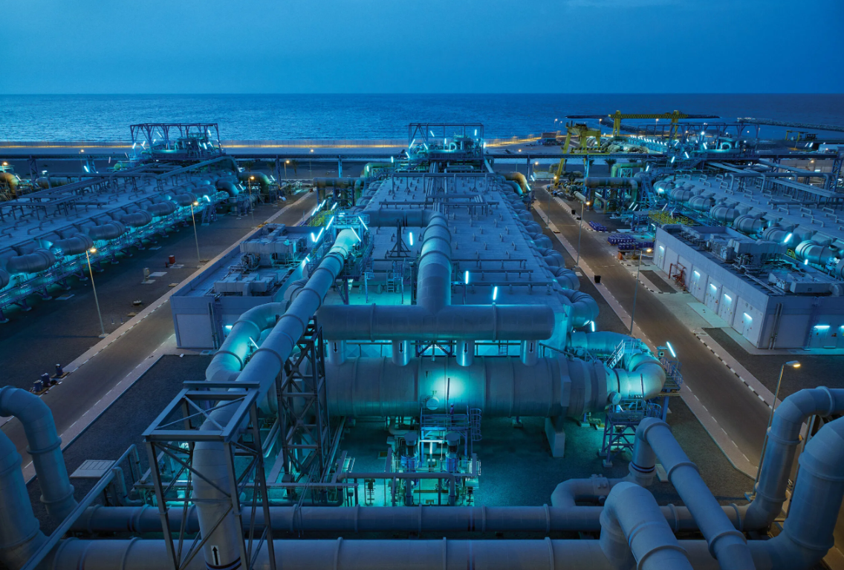
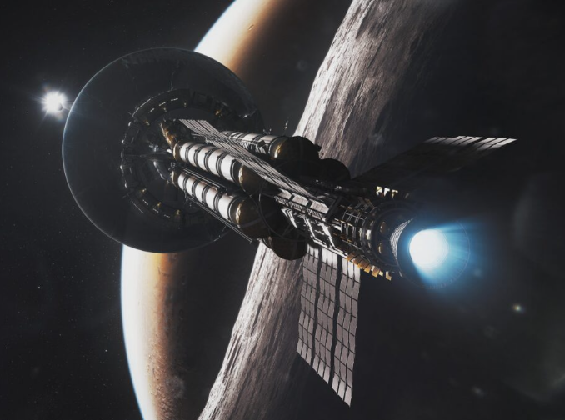
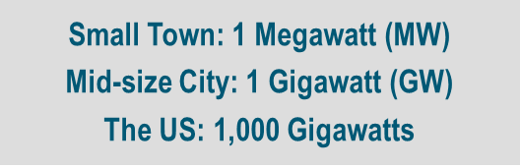
Advanced Nuclear Versatility
Spectrum of Sizes and Options
Variety of Outputs
Multitude of End Uses
Micro
(Few MW)
Mini
(10s of MW)
Small
(100s of MW)
Homes
Vehicles
Businesses
Electricity
Aviation
Rail
Shipping
H₂ Hydrogen
Concrete
Steel
Factories
Large (1,000+ MW)
Process Heat
Desalinization
Space
Notes:
Advanced Nuclear comes in a variety of options ranging from a few MW's, to 100's of Meggawatts. Our current fleet are all Large sizes operating at 1000's of meggawatts.
This diversity allows communities to consider various options based on their needs.
There are various reactor technologies that will be discussed momentarily, however that's not the leading effort
Our current leading efforts are looking at the "end uses" of the energy which may impact the technology choice that is desired based on the temperature range required.
Various sizes offer various options for use.

Slide 8
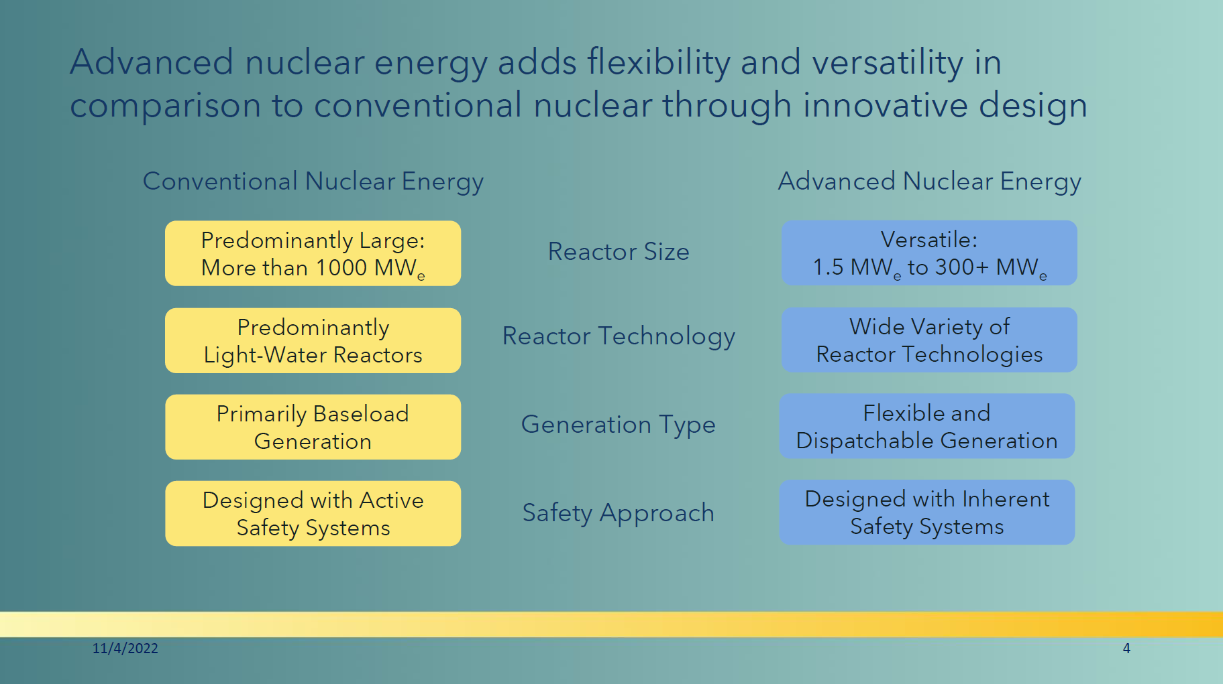


Slide 9
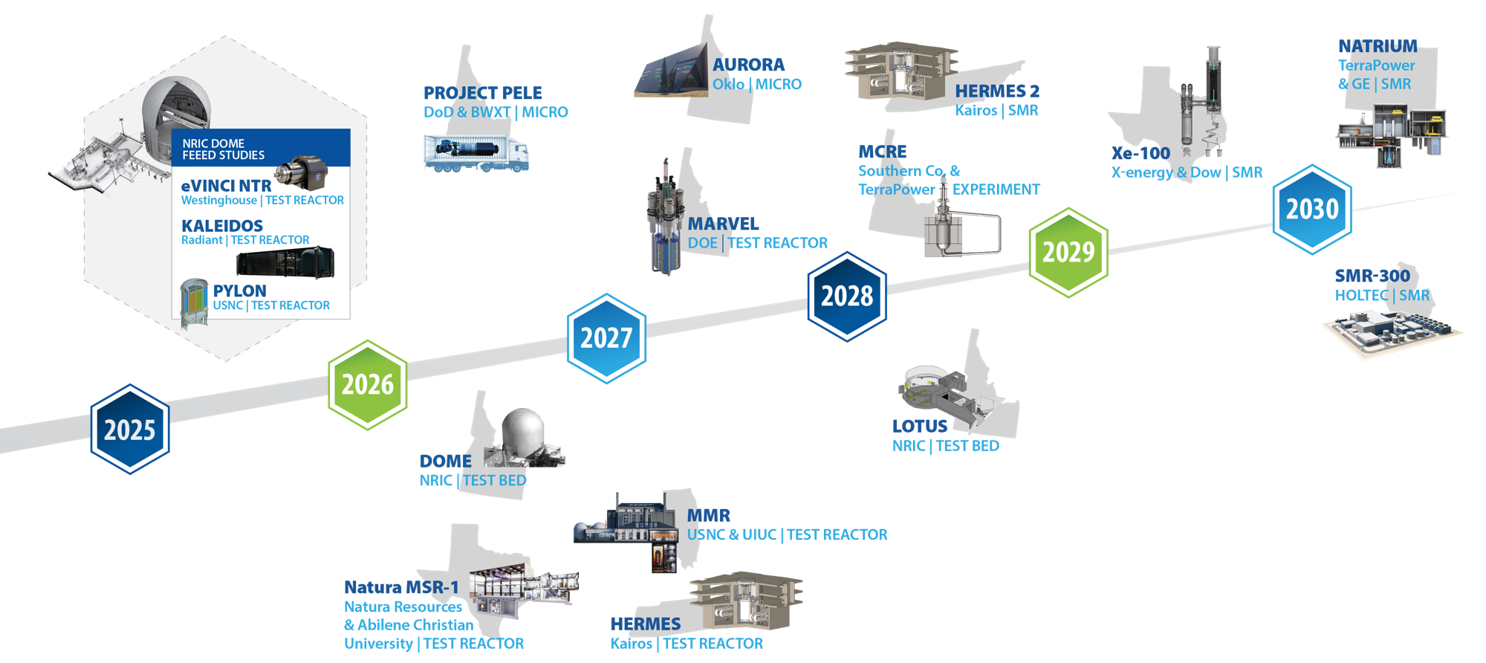
Accelerating advanced reactor demonstration and deployment
Notes:
22-GA50114-R89_FEED*
Criteria for timeline inclusion: Reactors that can meet any 3 of the following 4 criteria should be included on the timeline
• The company is part of a cost sharing government award with a reactor as the direct outcome of that cost share project
• There is an identified and concurred on site (note necessarily a site permit or agreement, but a clearly identified site that both the company and the site location acknowledge as the site)
• There is an NRC regulatory engagement plan or similarly robust level of pre-licensing engagement with the NRC (minimum is the formal submission of something)
• INL engagement of some sort or an agreement with another National Lab
Notes:
Inclusion in the timeline is limited to reactors to be sited in the United States
Timeline dates are those publicly identified by the individual companies
MARVEL – 100 kWth, 20kWe
Pele – 5 MWth, 1 MWe
Aurora – 4 MWth, 1.5 Mwe (but Oklo may be re-branding to their larger version)
MCRE – 150 kWth (not generating energy)Xe-100 – each module 80 Mwe (can be scaled to a ‘four-pack’ up to 320 MWe)
VOYGR – each module 77 Mwe (up to 12 modules, so up to 924 MWe)
SMR-160 – 525 MWth, 160 MWe
Natrium – 840 MWth, 345 Mwe (variable output (up to 500 Mwe short-term with molten salt storage)

Slide 10
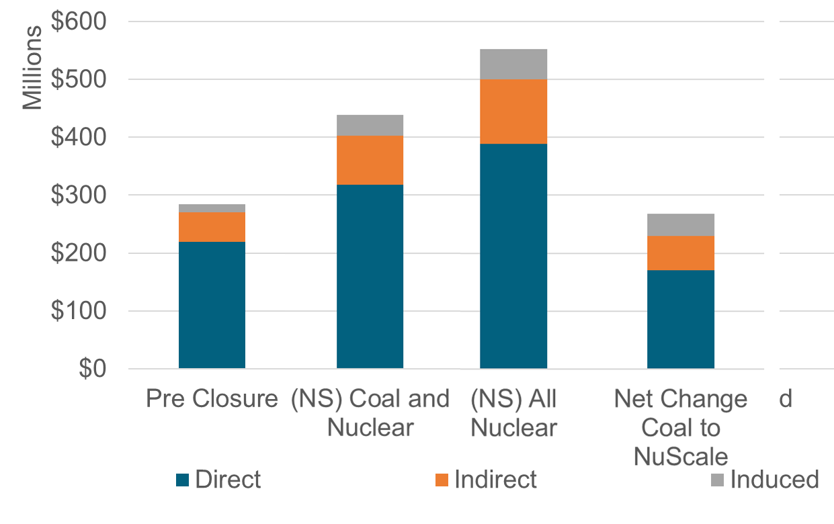

80% of Evaluated Coal Sites Suitable for Advanced Reactor
2022 DOE Report: Investigating Benefits and Challenges of Converting Coal Power Plants to Nuclear Power Plants
C2N: 653 Net-Change in Jobs
$102 M in new Labor Income
$275 M New Economic
Activity
Nuclear/Coal Operations Supply Chain Activity Household Spending
Estimates on overnight capital cost savings from repurposing viable coal infrastructure range from 15% to 35% ​
Source: 2022 DOE Report: Investigating Benefits and Challenges of Converting Coal Power Plants to Nuclear Power Plants
Notes:
Coal to Nuclear is another option to support our decarbonization goals. In fall 2022, doe published a comprehensive study to understand how many coal sites may be suitable for a transition to either advanced reactor. Based on that study 80% of the evaluated coal sites were found suitable for an advanced reactor. In addition the study found overnight capital savings from repurposing viable coal infrastructure range from 15% to 35% making this an advantageous choice for existing coal communities.
City of Colorado Springs - Martin Drake; Ray D Nixon
Platte River Power Authority - Rawhide
Public Service Co of Colorado - Comanche (CO)
Public Service Co of Colorado - Hayden
Public Service Co of Colorado - Pawnee
Tri-State G & T Assn, Inc - Craig (CO)

Slide 11
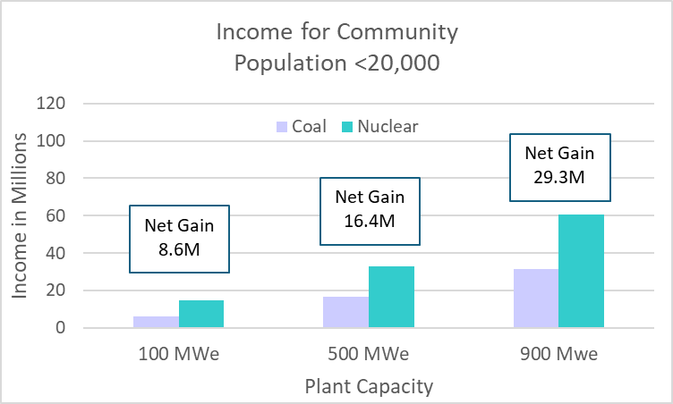
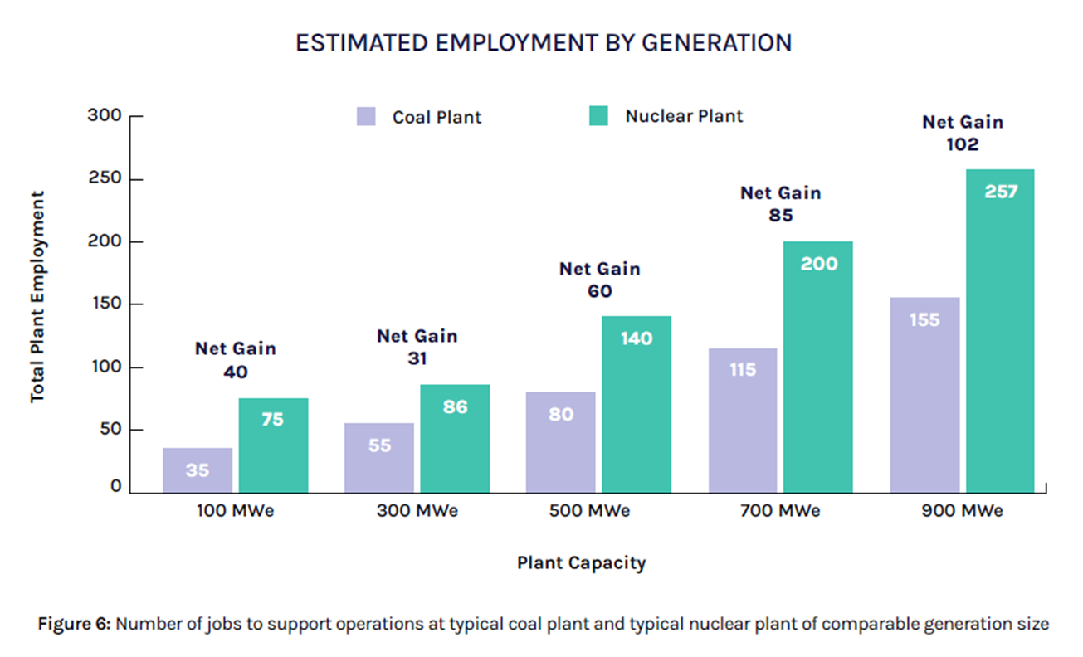
What does nuclear power conversion offer a community?
Nuclear can bring lasting jobs to a plant for 40-80 years
There are both direct jobs created as well as indirect and induced jobs
Many other renewable technologies only bring construction jobs
Nuclear has a multiplier of ~1.5
For every $100 of electricity produced, $50 of economic activity occurs in suppliers and support industries
Source: DOE April 2024: COAL-TO-NUCLEAR TRANSITIONS: AN INFORMATION GUIDE
Notes:
Discuss the lasting jobs that nuclear power plants bring which can continue to fuel a communities economy for 40 to 80 years and potentially create new jobs due to spending of those that are employed.

Slide 12
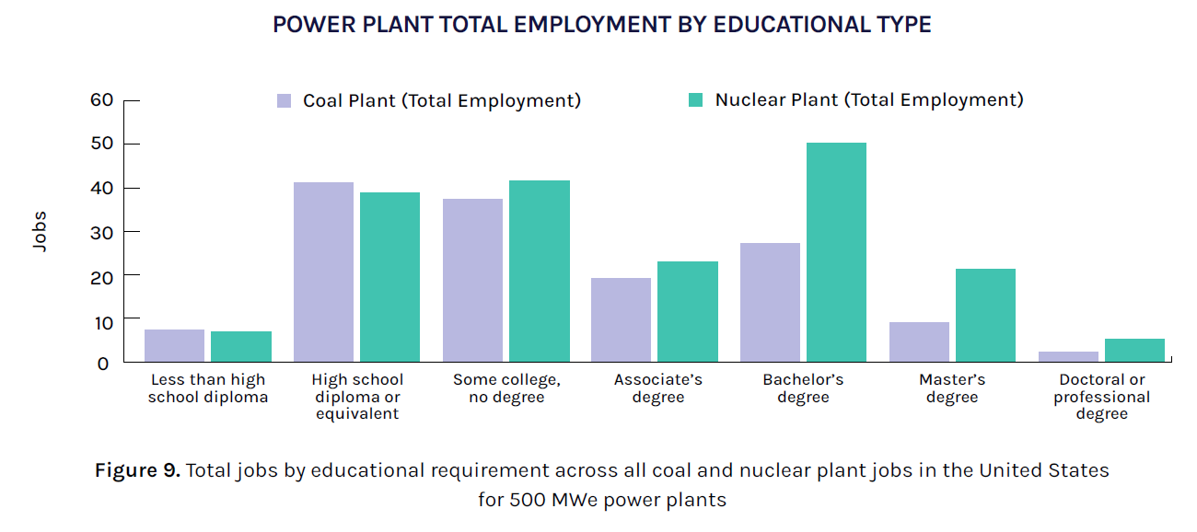
Overlap in Job Types and Education Levels
Comparing occupation codes shows the similarity in roles from each power plant type.
45 percent of the added nuclear jobs share identical occupation codes with the coal plant
72 percent of the added share similar occupation codes.
This implies that many occupations at the CPP have the educational background to work at the NPP.
NOTE: Analysis does not account for nuclear, industry-specific training.
Source: DOE April 2024: COAL-TO-NUCLEAR TRANSITIONS: AN INFORMATION GUIDE
Notes:
Highlight how coal jobs compare to nuclear jobs

Slide 13
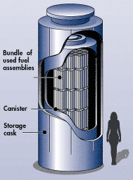
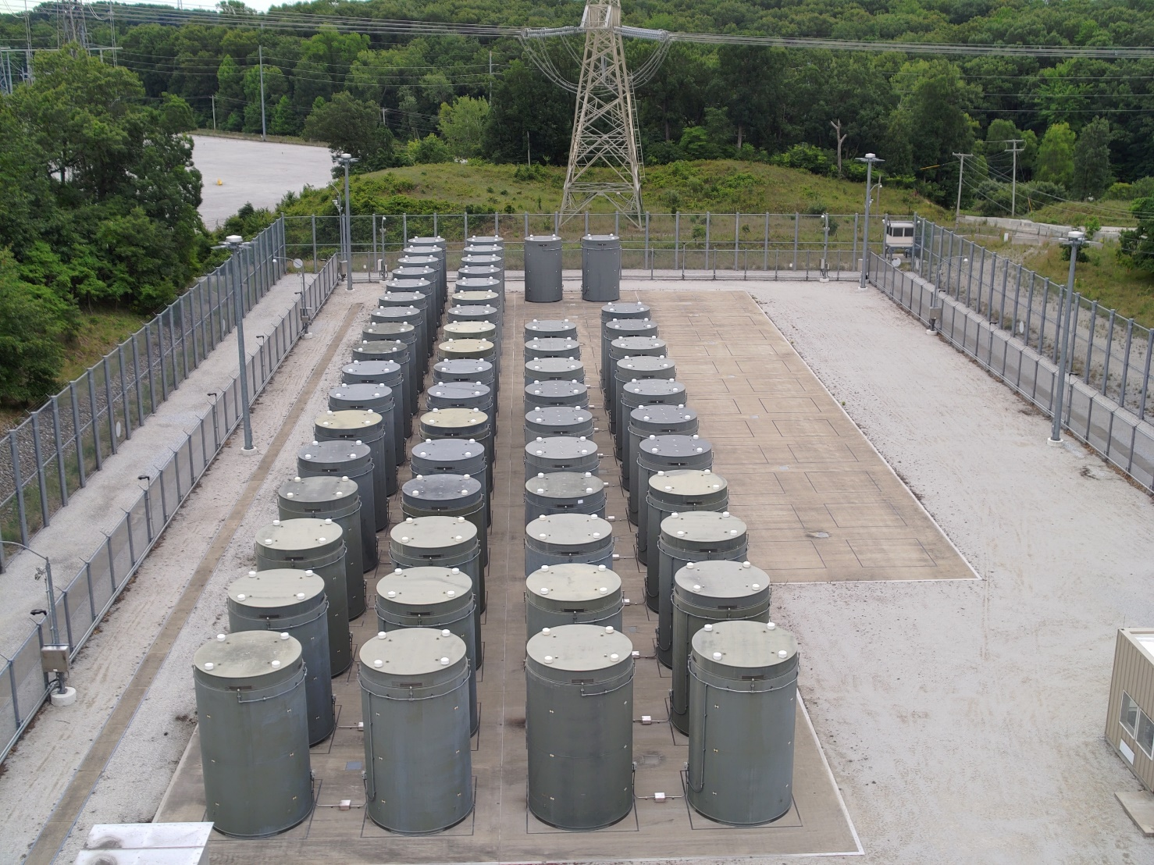
On-Site Storage of Used Fuel
Source: https://www.nrc.gov/waste/spent-fuel-storage/diagram-typical-dry-cask-system.html
The 57 used fuel casks hold all the fuel from 49 years of the DC Cook Plant in Michigan operations. Both units at DC Cook are still operating.
Notes:
Utilities are using dry storage to manage their spent fuel onsite.
Fuel that is removed from a reactor is first stored in pools of water for cooling.
After a few years in the pool, the fuel has cooled and its radioactivity decreased enough to allow it to be removed.
Moving spent fuel into dry casks frees up space in the pool to store spent fuel newly removed from the reactor.
Dry casks typically have a sealed metal cylinder to contain the spent fuel enclosed within a metal or concrete outer shell to provide radiation shielding. Each canister is designed to hold approximately 2-6 dozen spent fuel assemblies, depending on the type of assembly. Water and air are removed. The canister is filled with inert gas, and sealed (welded or bolted shut).
In some designs, casks are set vertically on a concrete pad or below grade within a concrete pad; in others, they are placed horizontally.
Dry cask storage is safe for people and the environment.

Slide 14
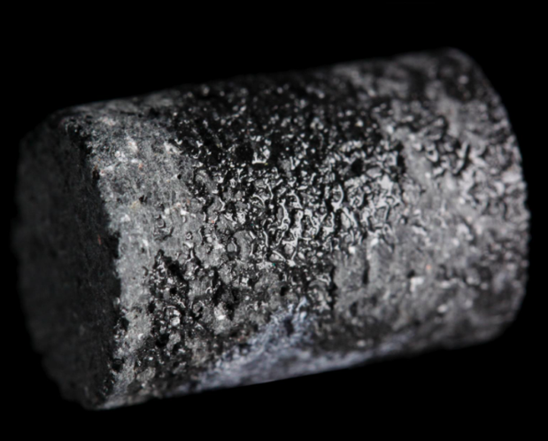
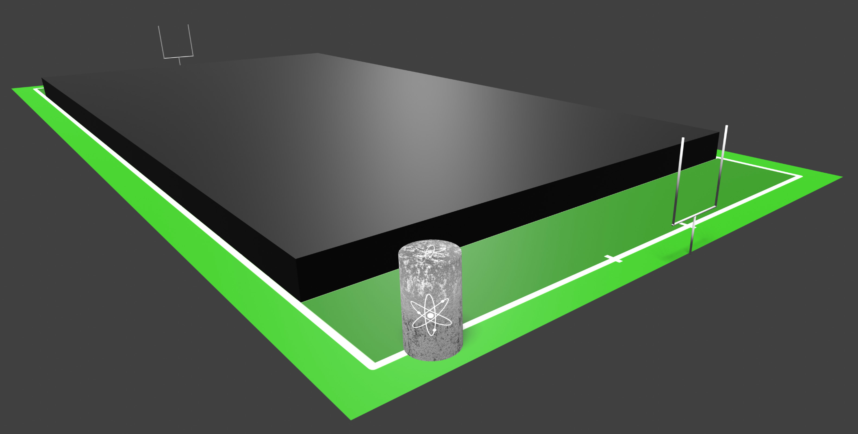
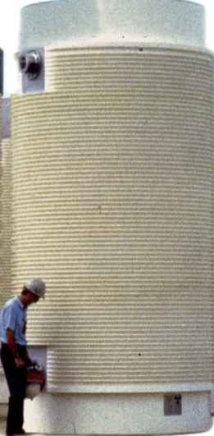
Waste/Spent Nuclear Fuel (SNF)
SNF is a solid material composed of uranium and fission products
The total amount of commercial SNF accumulated in the US since the first such reactor started up in 1957 would fit in an area the size of a football field stacked 10 yards high
An SNF pellet (about the size of a gummy bear)
Notes:
1 in the pool ; 2 on concrete pad
Oklo: https://www.powermag.com/oklo-readying-to-deploy-commercial-scale-nuclear-fuel-recycling-facility/
EBR-II (Experimental Breeder Reactor II): https://www.neimagazine.com/news/newsus-doe-seeks-to-make-haleu-from-ebr-ii-used-fuel-11121968
Kids clothes – 95%

Slide 15
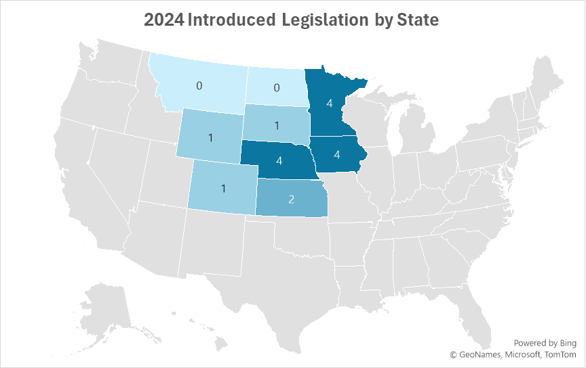
2024 State Nuclear Legislation
Montana and North Dakota did not have legislative sessions in 2024.

Slide 16
Regional Interest in Nuclear
ND Interim Committee wrapped with further proposed feasibility study legislation to introduce in 2025
Xcel Colorado announcement on possible reactor for replacement of Comanche
Wyoming appropriations bill included $2 million for University of Wyoming
NPPD finished Phase 1 of feasibility study and will continue with community engagement
Renewed NextEra and public interest in Duane Arnold restart
Northwestern Energy looking at possible reactor sites in South Dakota

