Slide 1
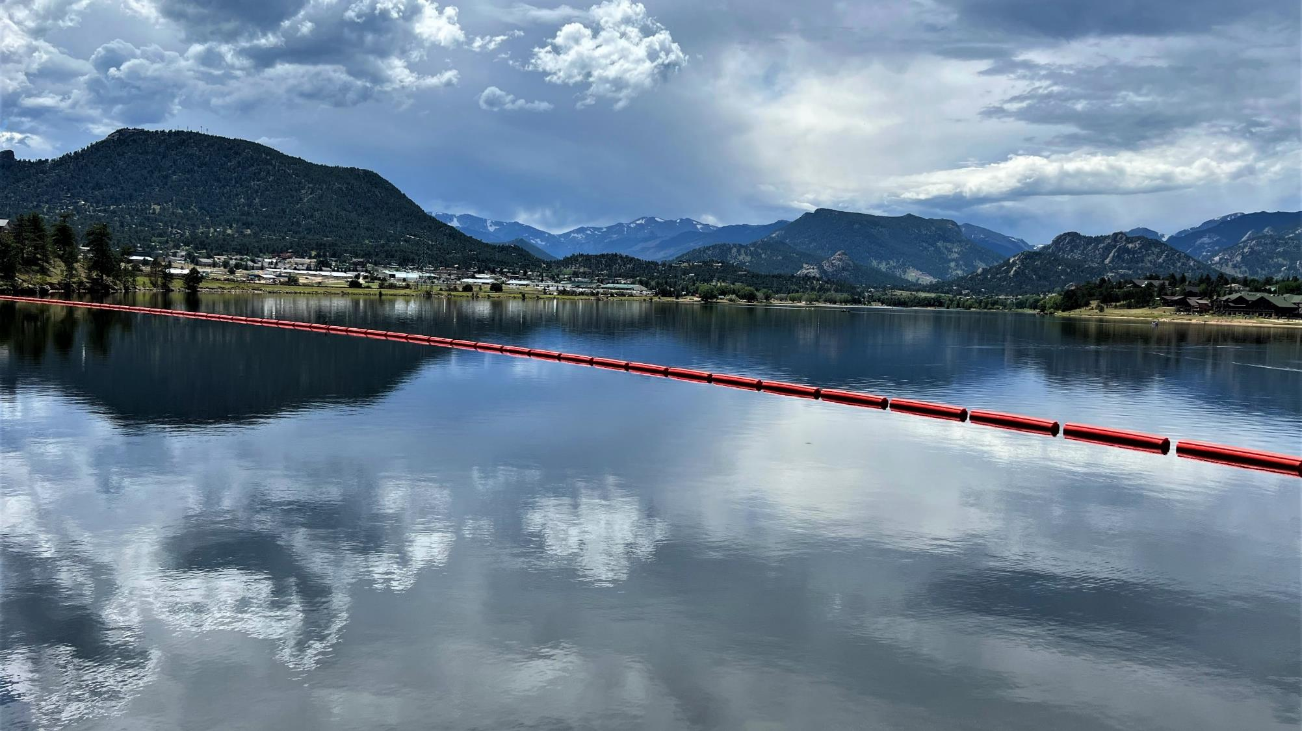
Mid-West Electric Consumers Association
December 12, 2023
Jeff Rieker – Eastern Colorado Area Manager

Slide 2
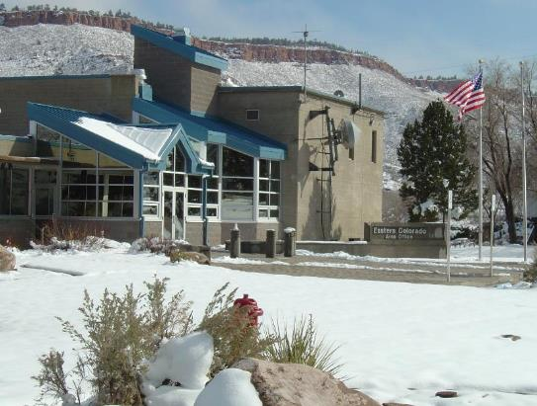
Overview
Eastern Colorado Area Office
Colorado-Big Thompson Project
Fryingpan-Arkansas Project
Current Activities, Updates, and Initiatives

Slide 3
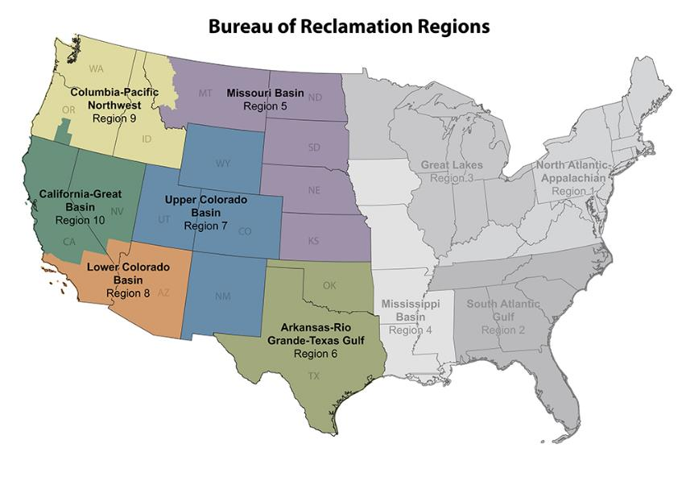
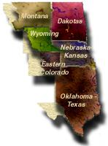
Eastern Colorado Area Office

Slide 4
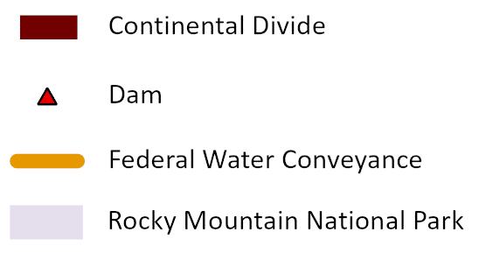
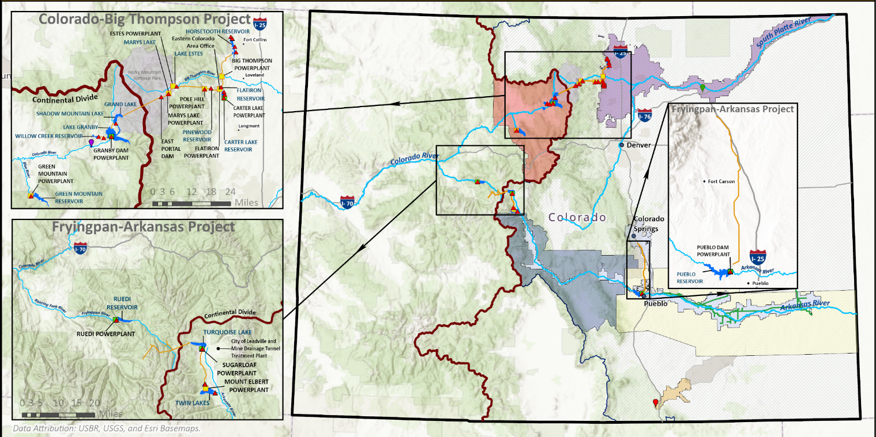
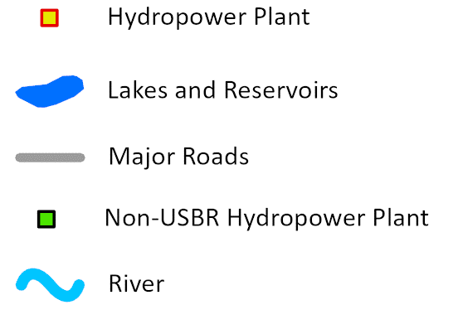
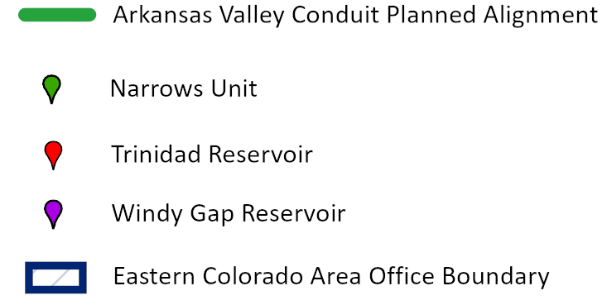
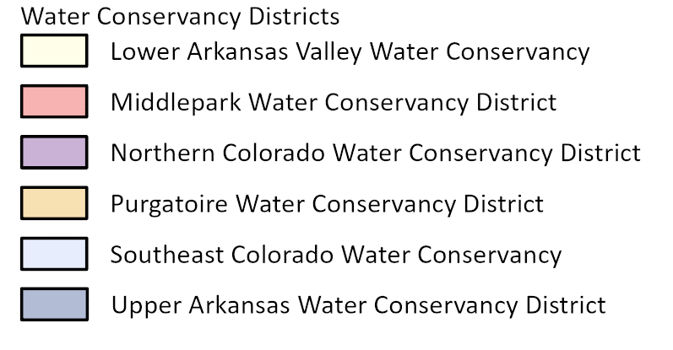
ECAO at-a-glance

Slide 5
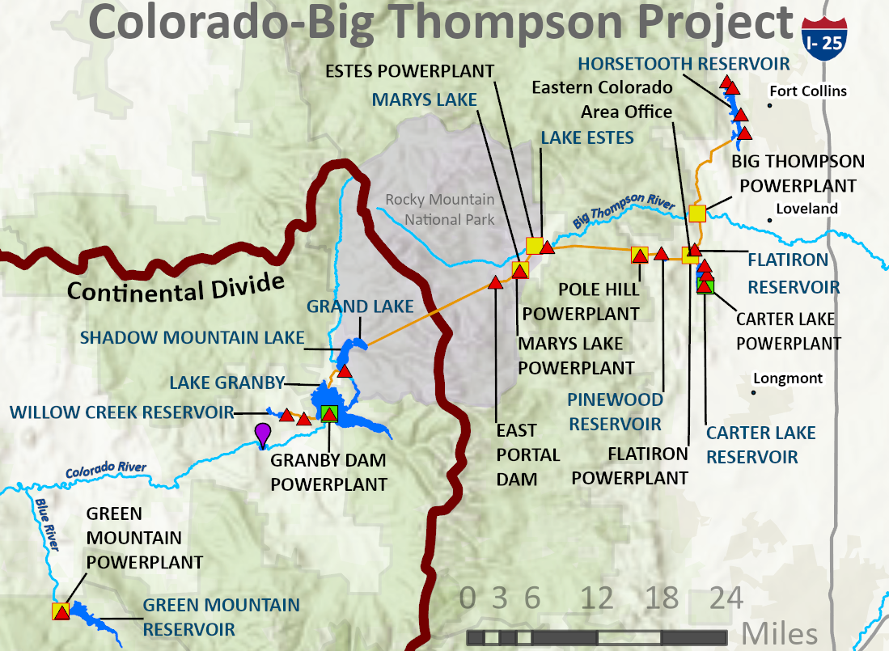
Colorado-Big Thompson Project

Slide 6
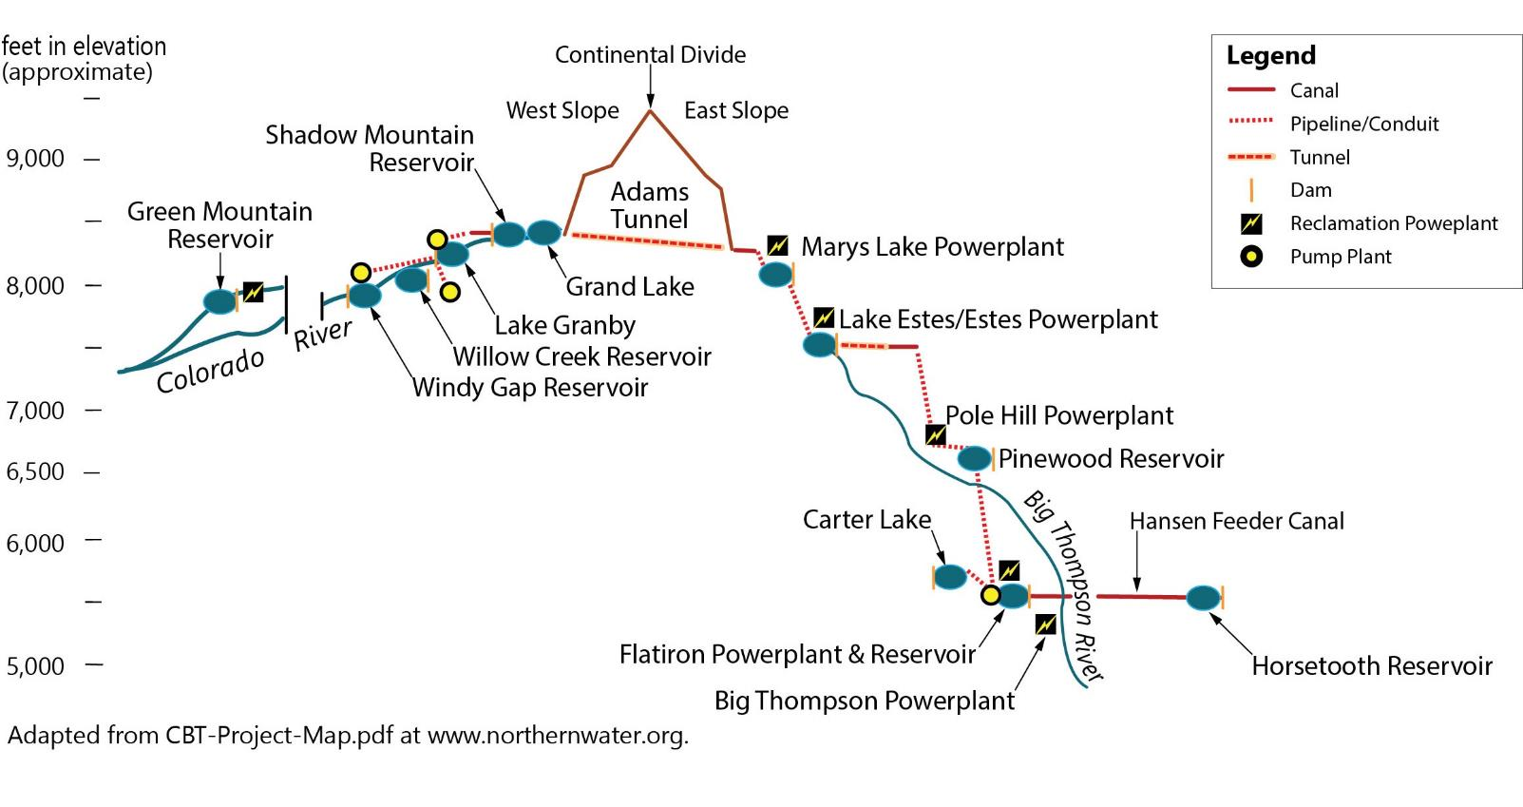
Colorado-Big Thompson Project

Slide 7
C-BT Power Generation Facilities
Green Mountain – Two units, 26 MW
Marys Lake – One unit, 8.1 MW
Estes – Three units, 45 MW
Pole Hill – One unit, 38.2 MW
Flatiron – Three units (one pump-generator), 94.5 MW
Big Thompson – One unit, 4.5 MW

Slide 8
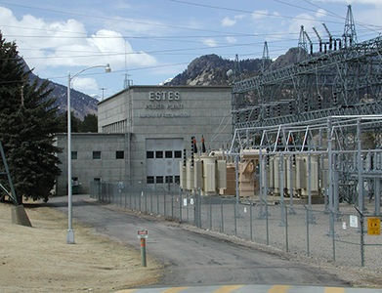
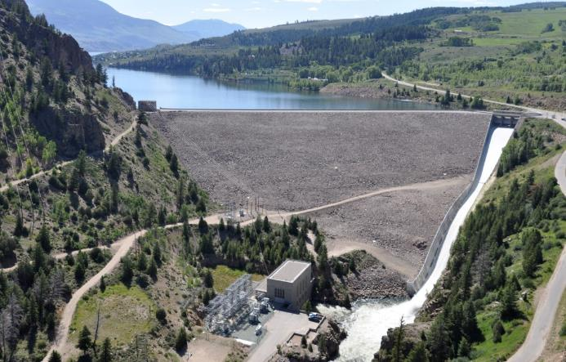
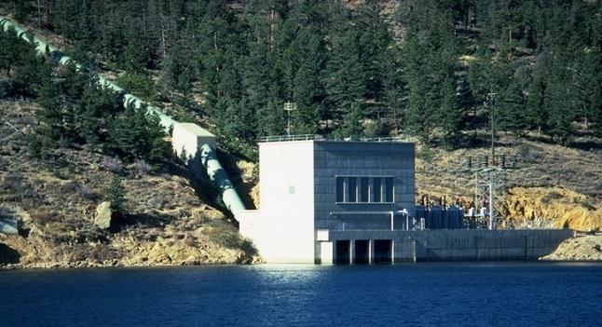
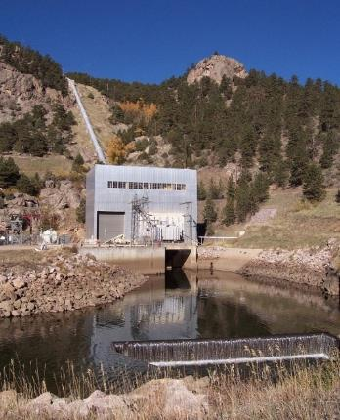
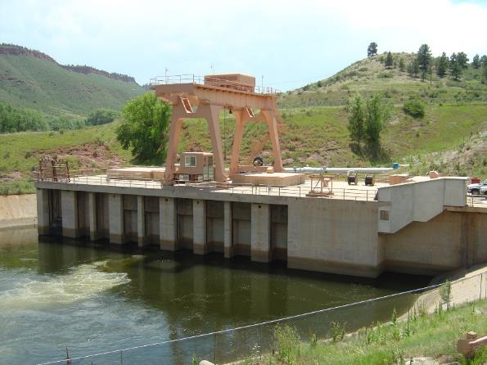
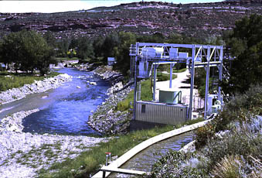
C-BT Power Generation Facilities

Slide 9
Major Project Activities – C-BT
Mary’s Lake Turbine Runner Replacement
East Portal Spillway Repair
Green Mountain Dam Penstock Coating

Slide 10
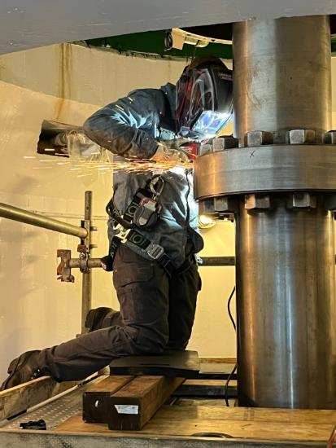
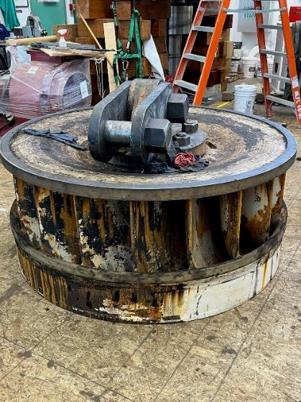
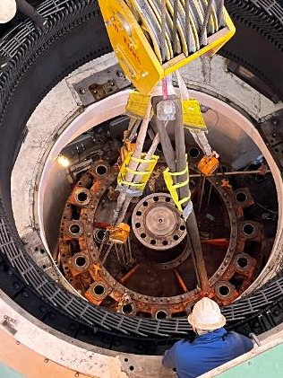
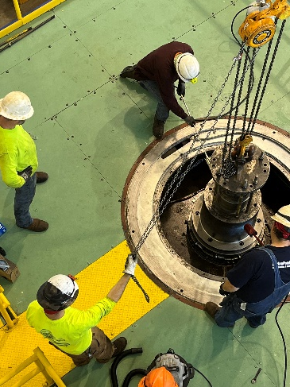
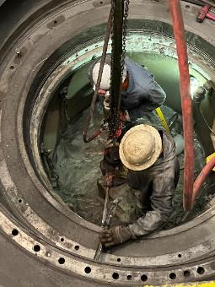
Colorado-Big Thompson Project Activities
Significant work during the winter 2023 C-BT outage

Slide 11
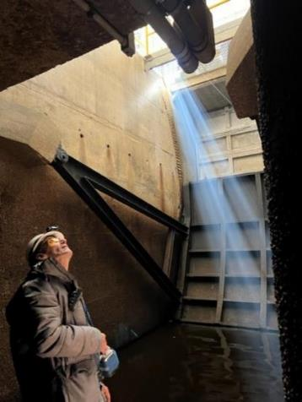
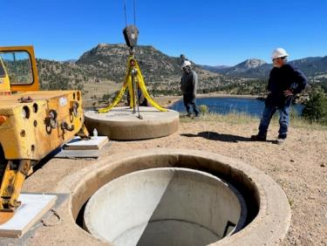
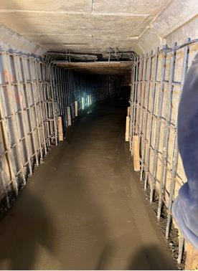
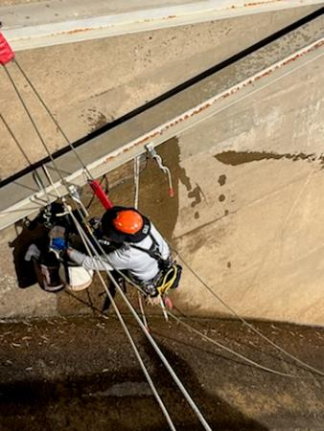
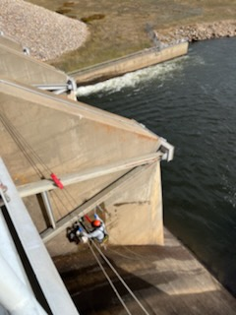
Colorado-Big Thompson Project Activities
Significant work during the winter 2023 C-BT outage

Slide 12
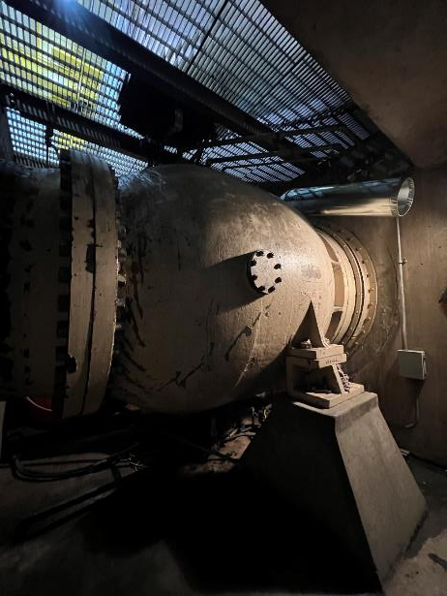
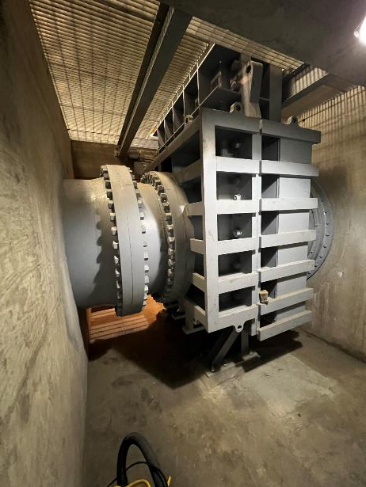
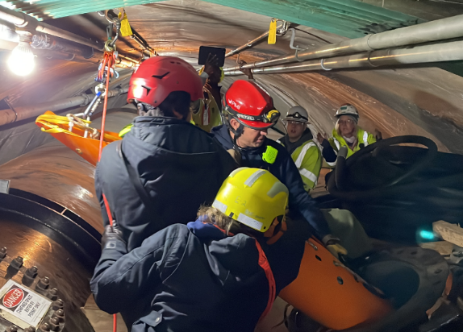
Colorado-Big Thompson Project Activities

Slide 13
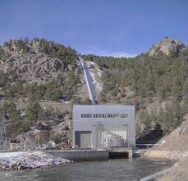
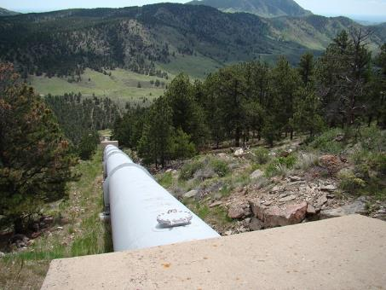
Electric Utility Cost Group Recognition
Routine Operations and Maintenance Costs ($1000) per Megawatt (MW)
30-100 MW Peer Group
~ 100 Plants

Slide 14
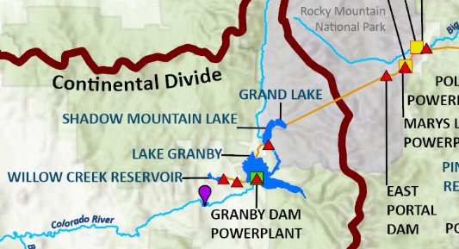
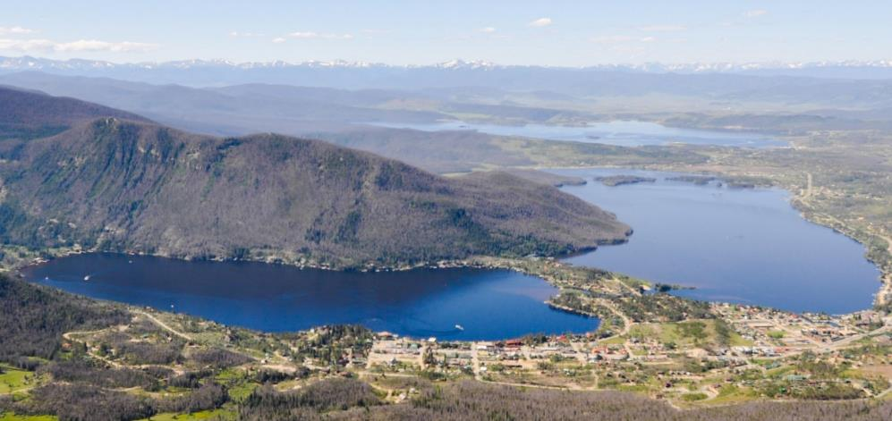
General Updates
Grand Lake Clarity
Colorado River

Slide 15
ECAO at-a-glance

Slide 16
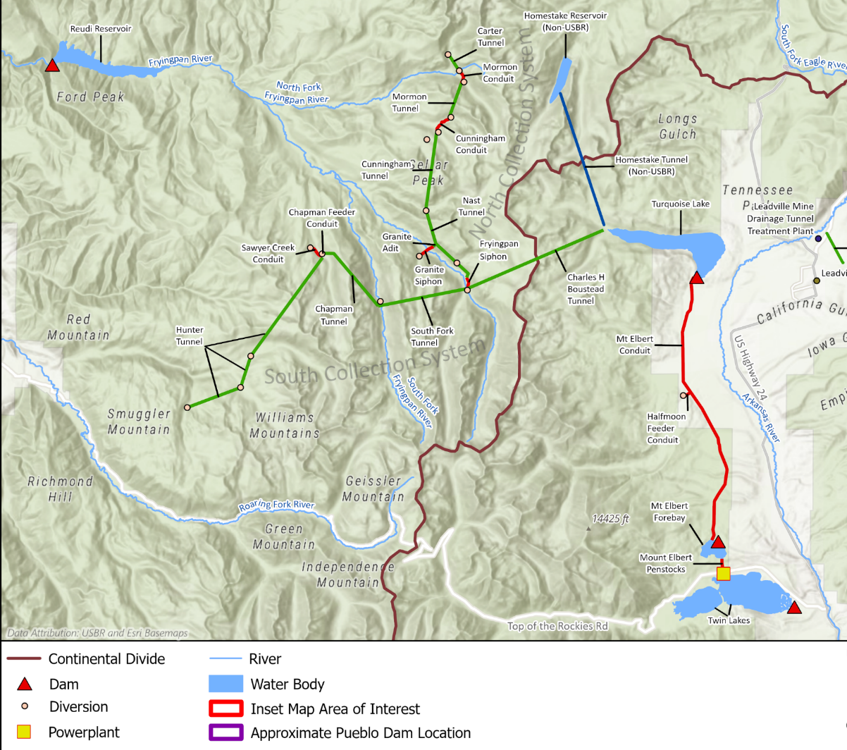
Fry-Ark Mountain Facilities
2
1
Ruedi Dam and Reservoir
North Side Collection System
South Side Collection System
Charles H. Boustead Tunnel
3
4

Slide 17
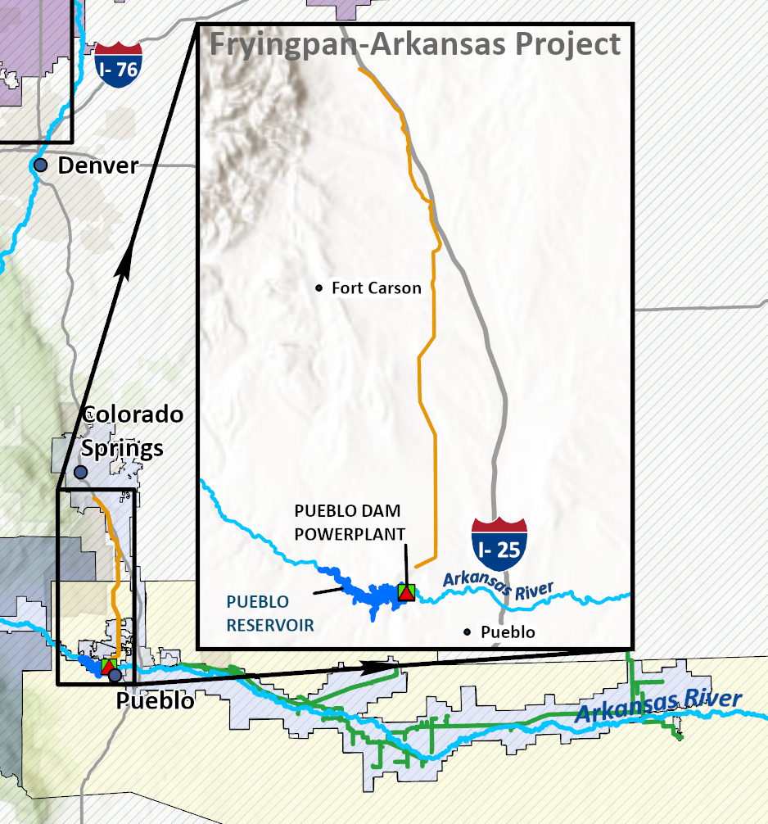
Fry-Ark Storage and Distribution Facilities

Slide 18
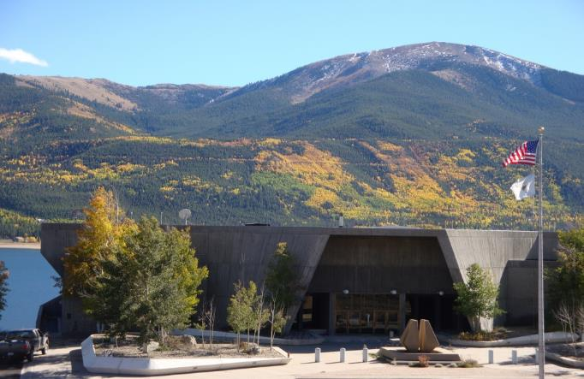
Fry-Ark Power Generation Facilities
Mt. Elbert – Two units (pump-generators), 200 MW

Slide 19
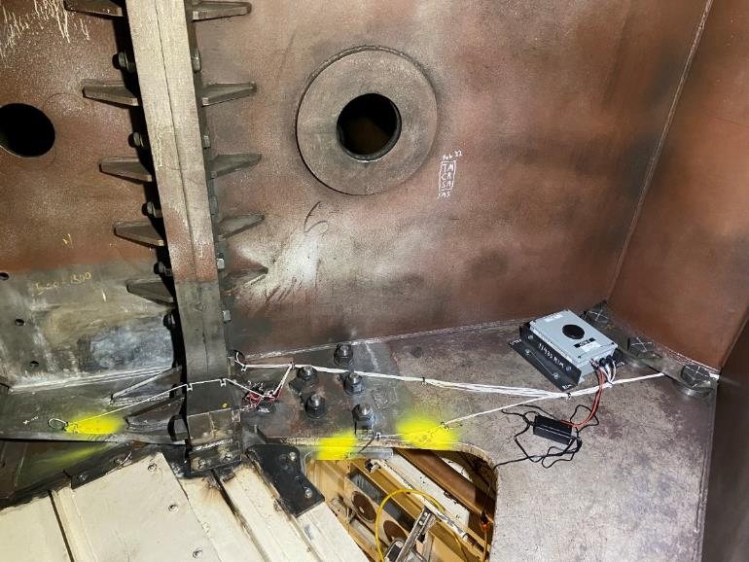
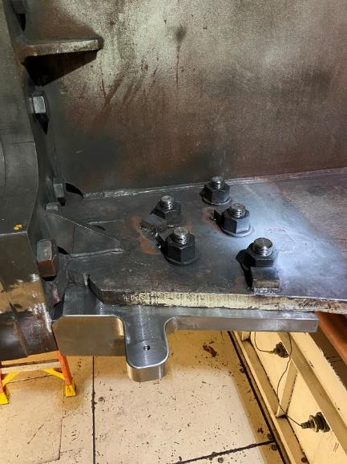
Major Project Updates – Mt. Elbert
Unit 1 Crack Repair
  Temporary repair complete, unit online
  Permanent repair contracting process underway

Slide 20
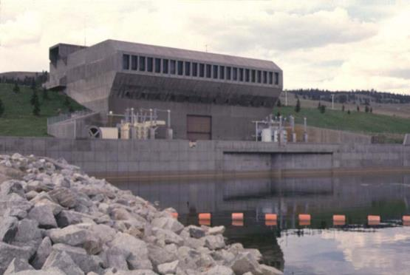
Major Project Updates – Mt. Elbert
Rehabilitation Project
  Complete
    Asbestos cleanup
    Penstock-2 fire and backup cooling water supply
    U-1 Rotor Crack Evaluation/Temporary repair
    230 KV Oil filled Cable testing
    Bridge Crane Overhaul
    Collection System Actuator Replacement
  In progress
    Mechanical Shaft Seals
    Cooling Water System Replacement
    SFC Input Output Switchgear Upgrade
    Protective Relays / Annunciation

Slide 21
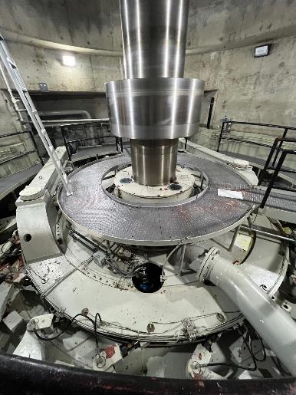
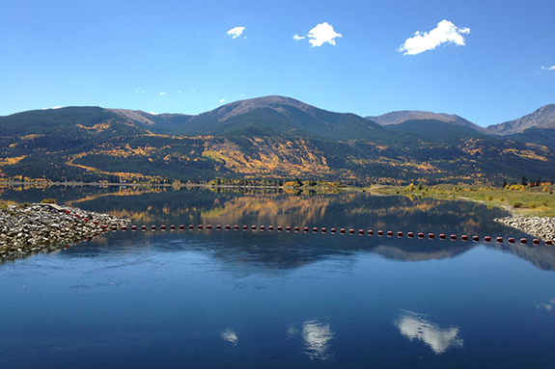
Electric Utility Cost Group Recognition
Routine Operations and Maintenance Costs ($1000) per Megawatt (MW)
Hybrid/Pumped-Storage Peer Group
~ 10 Plants

Slide 22
Focus and Initiatives
3 Focal Points:
  Project Accomplishment
  Budget Development and Implementation
  Producing Value
Highlighted Initiatives
  Emphasis on project management principles
  Budget formulation schedule realignment
  Maintenance schedule realignment

Slide 23
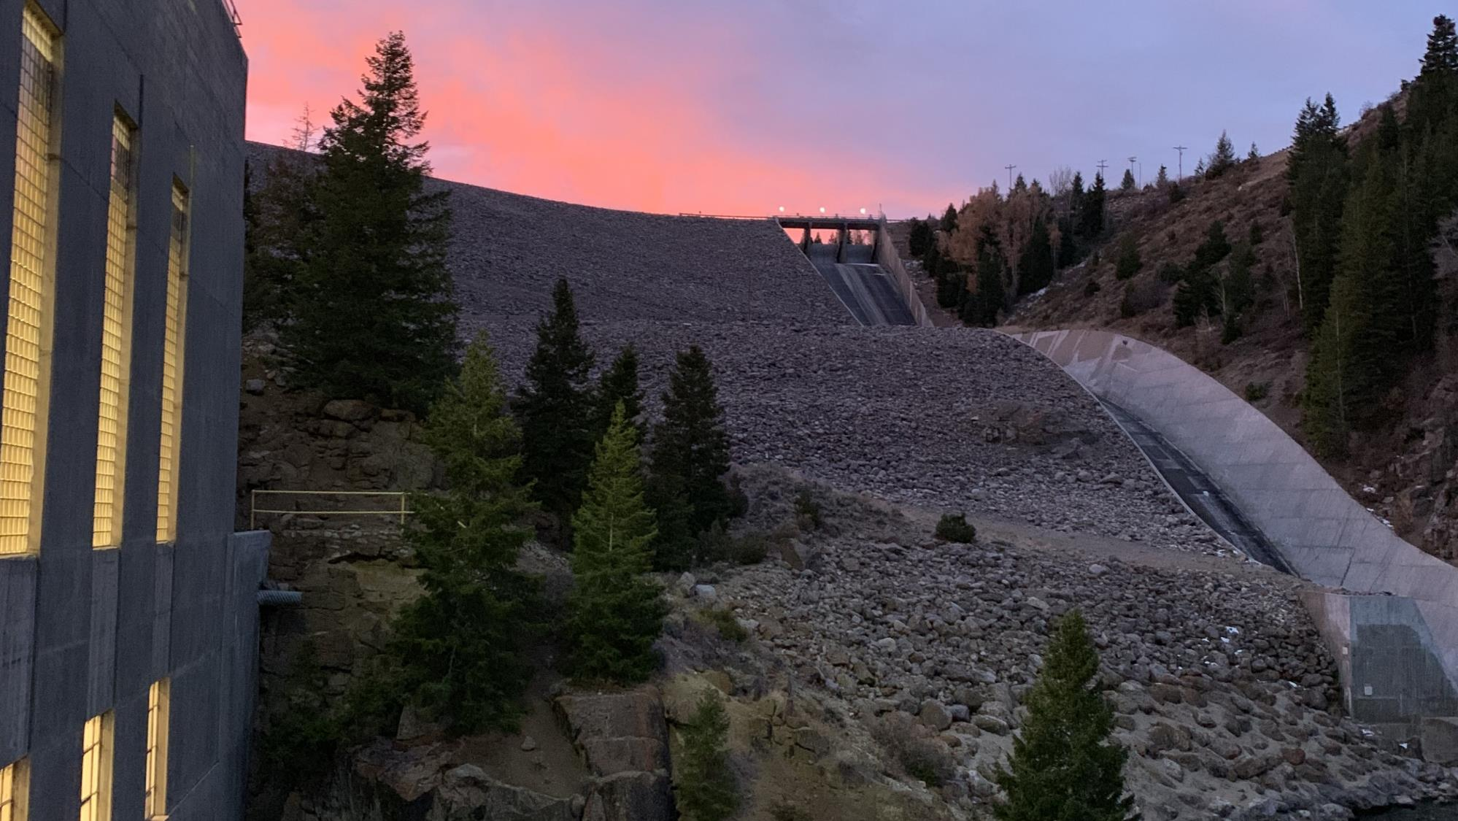
Jeff Rieker – Area Manager
jrieker@usbr.gov

