Slide 1
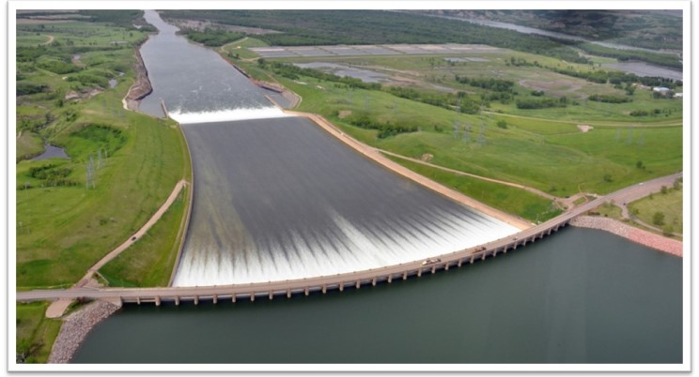
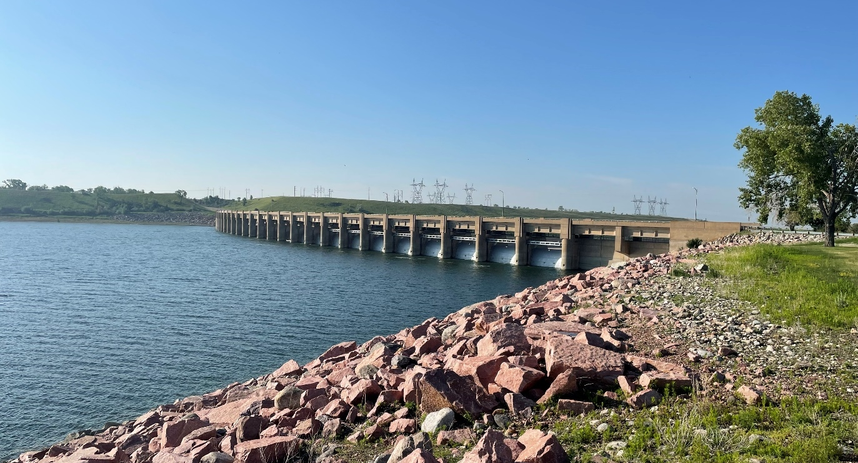
GARRISON Dam Spillway Modification PRoject
Omaha District
Jeff Greenwald – Project Manager

Slide 2
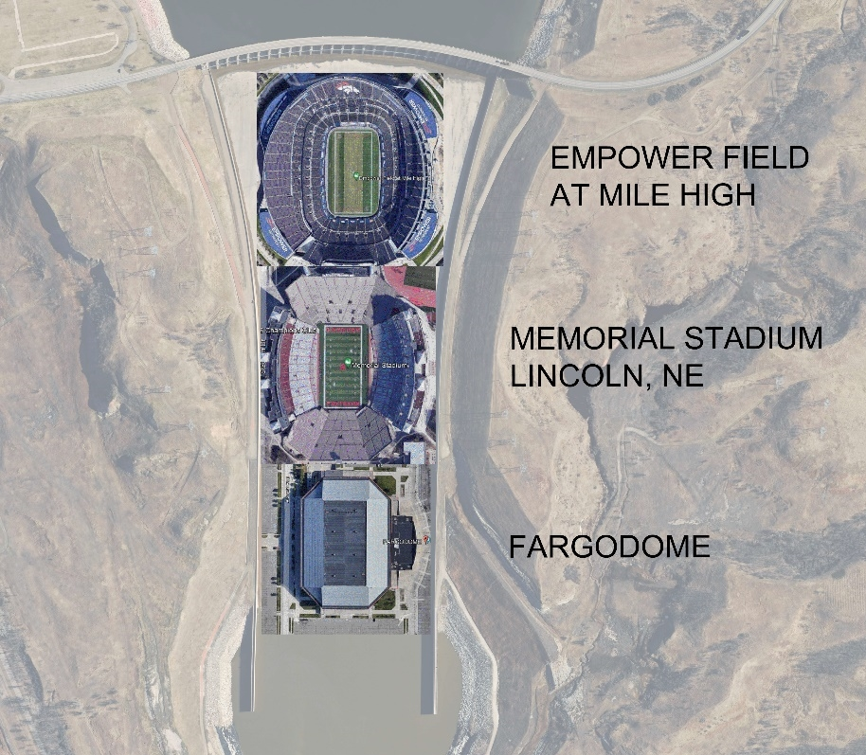
Project overview

Slide 3
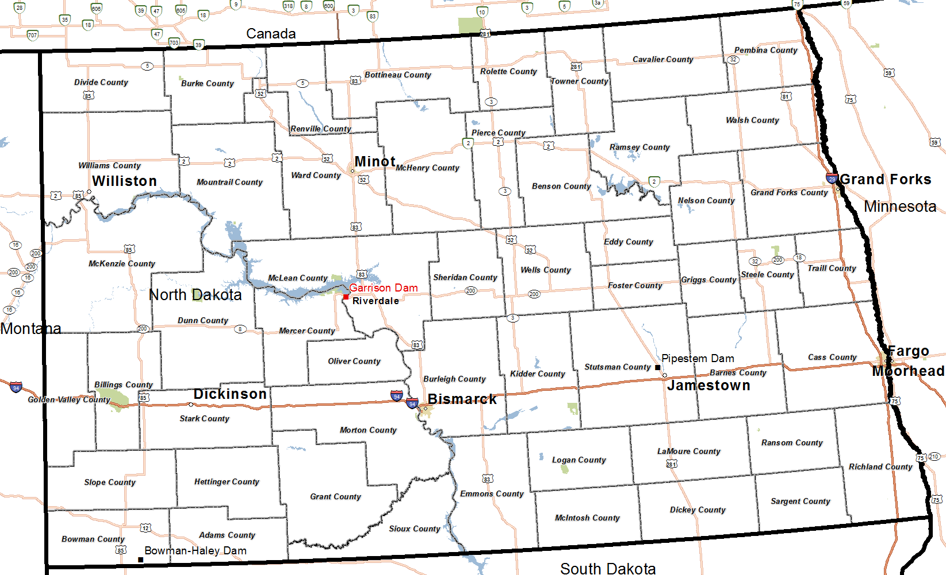
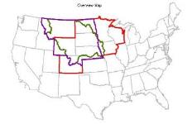
Garrison Dam and Project Location
Garrison Dam
North Dakota
Cottonwood Creek Dam

Slide 4
Garrison Dam and Project Overview
Project Authorization:
  The Garrison Dam - Lake Sakakawea Project was authorized by the Flood Control Act (approved 22 December 1944) as part of the general comprehensive plan for flood control and other purposes in the Missouri River Basin.
The authorized purposes include:
  Flood risk management
  Hydroelectric power
  Water supply
  Water quality control
  Irrigation
  Recreation
  Navigation
  Fish and wildlife

Slide 5
Garrison Dam cost-sharing
The Western Area Power Administration (WAPA) is responsible for marketing and transmitting power and are assessed a portion (43.78%) of any joint activities, dam safety included, for repayment to the treasury.
More favorable cost-sharing applied based on:
  Section 1203 of WRDA 1986.
  Section 1139 of WRDA 2016.
  Special cost-sharing for modifications to dams resulting from new hydrologic or seismic data or changes in state-of-the-art design criteria.
The recently completed Dam Safety Modification Study (DSMS) requested a reduced cost-share from ASA(CW) for WAPA because the modifications are needed based on new hydrologic data and changes in state-of-the-art design.
Cost-share reduction could result in WAPA share reduction to ~7% from 43.78% of project costs.

Slide 6
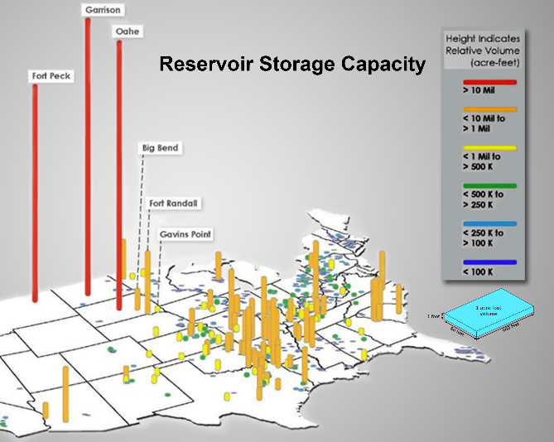
Reservoir Capacity Overview
  Garrison Dam (largest Mainstem dam).
  Largest reservoir operated by USACE.
  Third largest reservoir in the U.S.
  Garrison total capacity.
  23.5 MAF (top of flood pool).
  34.4 MAF (top of dam).
  19.4 MAF (current pool)*

Slide 7
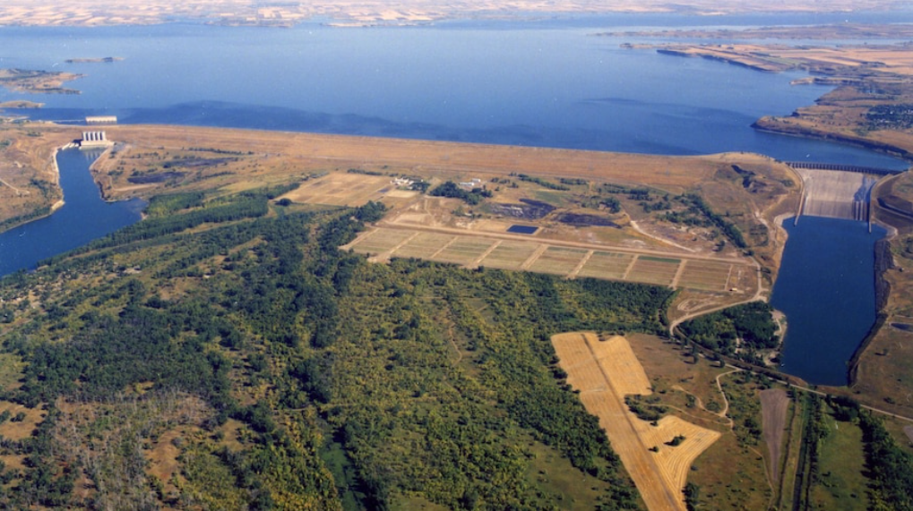

Garrison Dam
Length of dam: 11,300 ft (including spillway)
Maximum height: 210 ft
Embankment fill: 66,500,000 cy
Length of reservoir: 178 miles (1340 miles shoreline)
Proposed modifications focused on spillway
Notes:
This aerial photo looking back to the north shows Lake Sakakawea impounded behind the dam. The reservoir at maximum pool would extend upstream approximately 178 miles. The dam is over 11,000 feet long with the spillway located on the left abutment (photo right) and the powerhouse/outlet works is located on the right abutment (photo left). The dam has a maximum height of 210 feet. The proposed modifications are focused on addressing risk driving potential failure modes in the spillway.

Slide 8
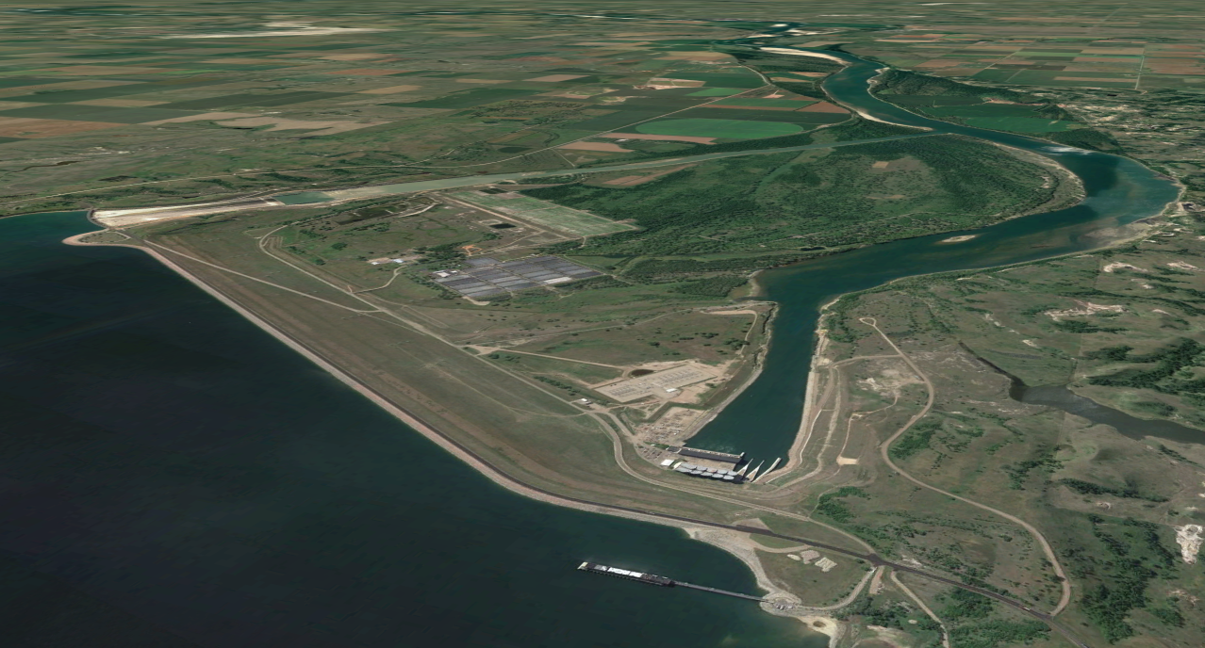
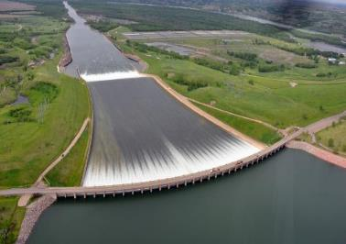
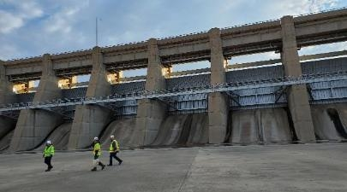
Garrison Dam Project Features
Project Office (Riverdale)
Former Pilot Channel
Spillway Bridge
Spillway Chute
Spillway Stilling Basin
Maintenance Facility
Former River Channel
Missouri River
Relief Well Channel
Lake Sakakawea
Tailrace
Switchyard
Main Embankment
(66.5M CY)
Powerhouse
Crest Road
(Highway 200)
Regulatory Tunnels
Powerhouse
Cut Slopes
Intake Structure
8

Slide 9
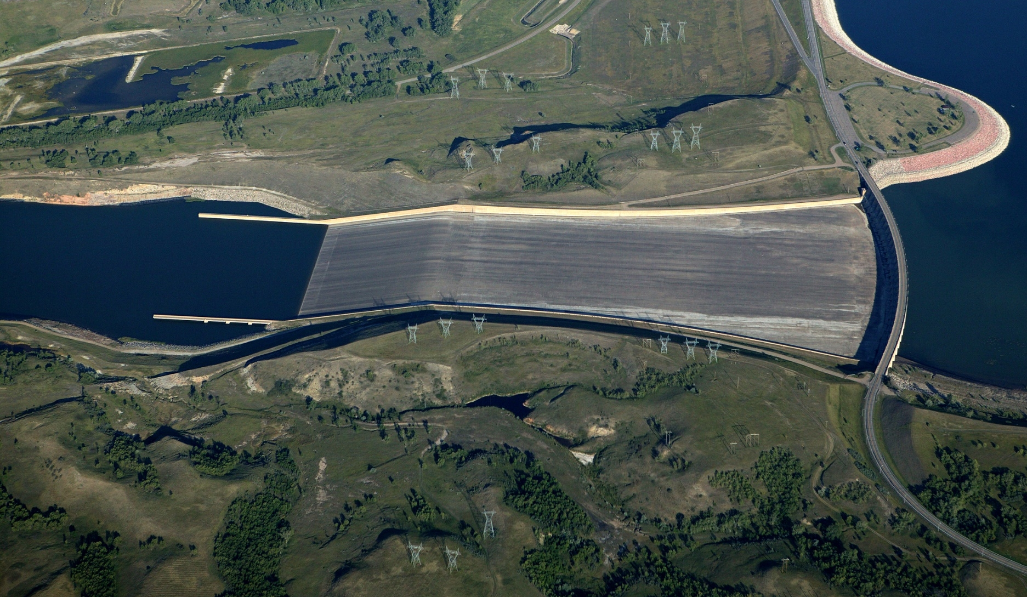
Project Features SPILLWAY
Crest Structure
  28 Tainter gates
  (40’ x 29’)
  Top of Gates
  EL 1854 ft LPD
  Gated Ogee Weir crest
  EL 1825 ft LPD
  Width – 1,336 feet (including piers)
Upper chute – 0.75% slope, converges to 800 ft width
Lower chute – 20% slope
Stilling basin – 200 ft long with baffle blocks and end sill
Design Discharge Capacity 827,000 cfs EL 1859 ft LPD
Approach Channel
Stilling
Basin
Lower
Chute
Upper
Chute
Flow
Spillway Bridge

Slide 10
Dam safety risks

Slide 11
How does the corps Manage Risk?
  U.S. Army Corps of Engineers risk management process:
Potential Deficiency Identified Requiring Further Evaluation
Potential Deficiency Identified Requiring Further Evaluation
Selection of Alternatives to Reduce Risk to an Acceptable Level
We are here
  ROUTINE DAM SAFETY PROGRAM
  PERIODIC ASSESSMENT
  ISSUE EVALUATION STUDY
  DAM SAFETY MODIFICATION STUDY
  PLANNING, ENGINEERING, AND DESIGN
Every 10 Years
Issue Confirmed to Warrant Further Action
Construction
Public Safety is the #1 Priority in the Corps Dam Safety Program

Slide 12
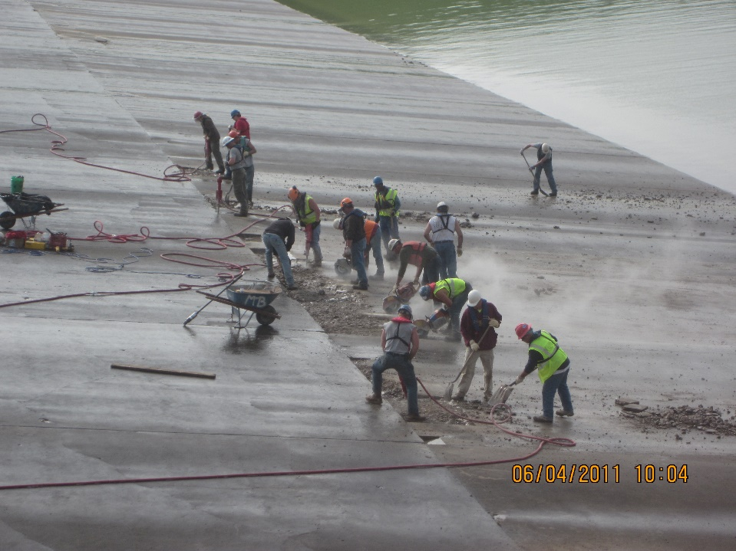
Garrison Dam Risk Assessment Timeline
  Screening for Portfolio Risk Analysis (SPRA) in 2006 resulted in Dam Safety Action Classification (DSAC) 4 rating.
  2011 record system runoff/inflows, inaugural spillway flow.
  Detailed visual, physical, and geophysical assessment of chute slab and stilling basin.
  Comprehensive inspection of the spillway underdrains.
  Inspection and evaluation of the west abutment and west terrace underseepage control features.
  Poor performance of drainage system observed during spillway discharges (manhole covers removed resulting in pressurized drainage system and damaged subdrain pipe)
  2013 Periodic Assessment.
  Reclassified to DSAC 2 primarily due to severity of incremental consequences.
  2016 Issue Evaluation Study (IES).
  Findings confirmed there are dam safety risk concerns.
  DSAC 2 classification confirmed/upheld in April 2020.
  PMF Updated – increased peak pool and spillway discharge (reasonable high PMF). 1.15M cfs at El. 1871.4 feet LPD.
  2020-2023 Dam Safety Modification Study (DSMS).
  July 2023 – Start of Preconstruction Engineering & Design (PED).
2011 - Emergency repairs conducted after initial release of ~30,000 cfs, prior to peak release of ~60,000 cfs
DSMS = Dam Safety Modification Study
PED = Preconstruction Engineering and Design
DSAC = Dam Safety Action Classification
IES = Issue Evaluation Study
PMF = Probable Maximum Flood
PFM = Potential Failure Mode
RMP = Risk Management Plan
DSAC 4
2011 Flood Event, Inaugural Spillway Flow
DSAC 2
DSMS Complete
Dec 2008
June-Aug 2011
Apr 2015
May 2023
SPRA
PA
IES
DSMS
PED
May 2006
Jun 2013
Apr 2016
Aug 2020
June 2023
2006 | 2007 | 2008 | 2009 | 2010 | 2011 | 2012 | 2013 | 2014 | 2015 | 2016 | 2017 | 2018 | 2019 | 2020 | 2021 | 2022 | 2023

Slide 13
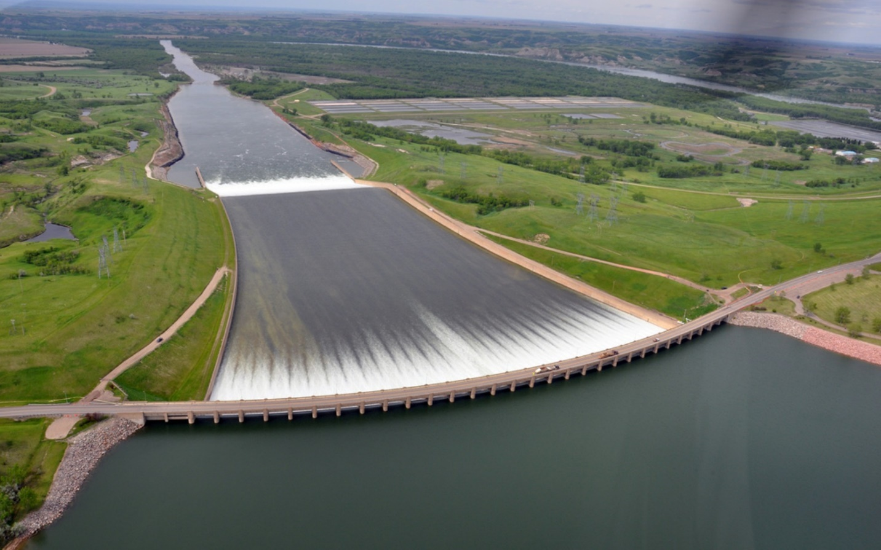
Why are we here: Address Dam Safety Risks
2011 Flood Control Releases
  Significant life safety risk exists at Garrison Dam (i.e., Risks that are not tolerable)
    DSAC 2 – High Risk. Six actionable spillway failure modes
    Consequences of uncontrolled release are very significant
    Issues associated with existing drainage system confirmed after 2011 releases
    Issues associated with hydraulic performance after Probable Maximum Flood (PMF) increased ~40%.
    Overtopping issues/stilling basin stability issues.
  Recommended Plan for Modification for Pre-Construction Engineering and Design (PED) Phase
  Structural modifications to crest structure, spillway gate retrofits, a new concrete overlay on top of existing slab, drainage system replacement, armoring areas outside/adjacent to chute walls, and stilling basin improvements.
    Modified spillway will be able to safely pass new PMF
  Smaller scope items:
    New spillway gate deicing system and intervention measures.
    New line of subdrains on west abutment above powerplant (small-scope item, likely separate contract from spillway work)
Notes:
This is a dam safety project. The project is a DSAC 2. There are six actionable failure modes in the spillway and the consequences of a failure are very high.
In 2011 when the spillway was operated for flood control for the first time there were issues with the drainage system identified. Lost two manholes of 27 in spillway chute.
Two of the actional failure modes related to drainage system.
USACE conducted multiple risk assessments leading up to the mod study after that. The PMF was updated which resulted in a 40% increase in the maximum spillway discharge.
Four of the actional failure modes related to the increases in hydraulic loading.

Slide 14
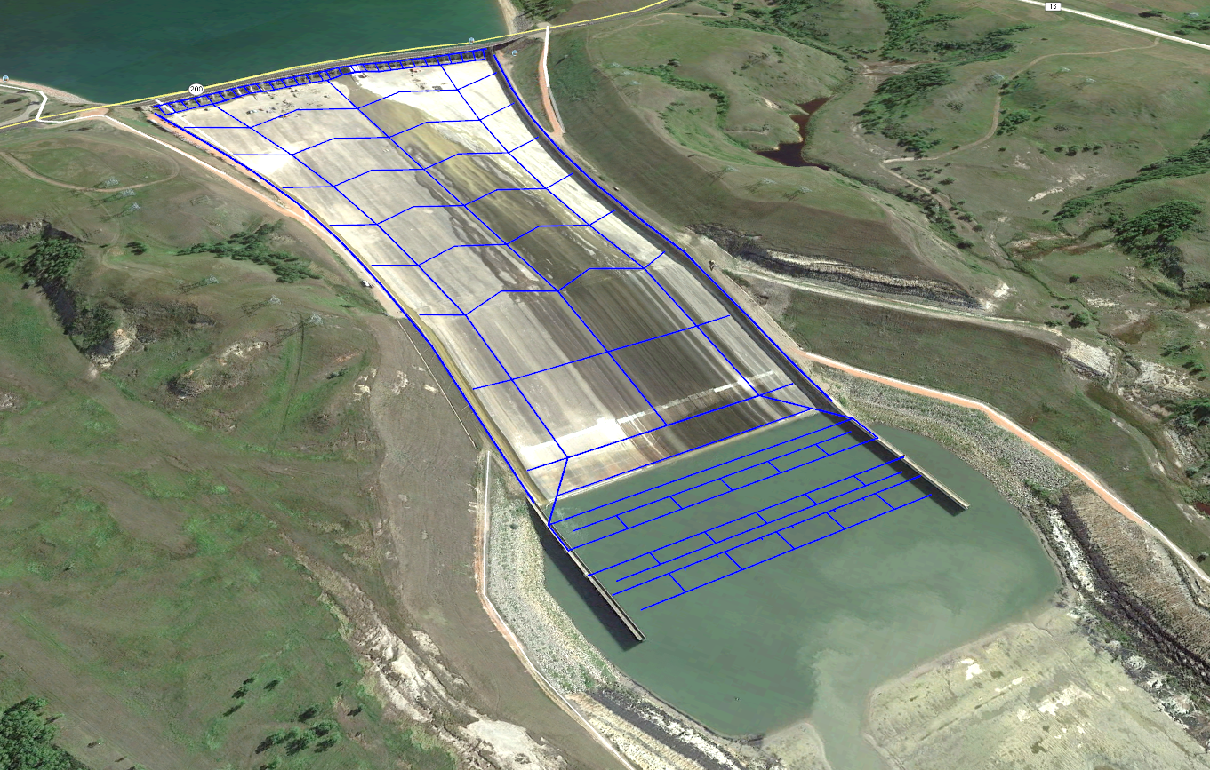
Spillway Risk Driving Potential Failure Modes
PFM 37 – Spillway gate failure
PFM 7 – Hydraulic jacking of chute slab due to manholes
PFM 7C – Hydraulic jacking of chute slab due to drain defects
PFM 41 – Overtopping of spillway abutment monoliths
PFM 42 – Overtopping of spillway chute walls (PFM 42)
Hydraulic Jump
PFM 8 – Hydraulic jacking of the lower spillway chute and stilling basin slab due to uplift

Slide 15
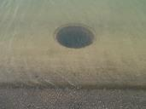
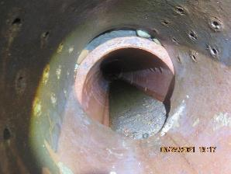
Spillway drain concerns (PFM 7 and 7C)
Open spillway manholes would allow flow into drainage system (over-pressurize)
Damaged drain-pipe allows frost blanket material into drain
Void under slabs could become large enough to cause collapse, exposing end of slab to high velocities
Manhole cover removed during spillway releases - 2011
Typ. spillway manhole covers
Drain Defects

Slide 16

Lower spillway chute and stilling basin uplift concern (PFM 8)
Existing lignite layers exacerbate the potential for undesirable hydraulic pressures during high flows.
These hydraulic pressures can result in enough force on the bottom of the spillway concrete in the lower chute to heave a slab.
Hydraulic Jump
Notes:
The next slide talks about the lower spillway chute and stilling basin uplift concerns:
The existing lignite layers exacerbate the potential for undesirable hydraulic pressures under the SB slab during high flows. This is due to these lignite layers being hydraulically connected to the d/s TW pool; which can be up to 80 feet during design events.
These hydraulic pressures can result in enough force on the bottom of the spillway concrete in the lower chute to heave a slab.

Slide 17
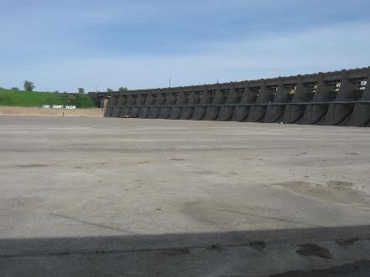
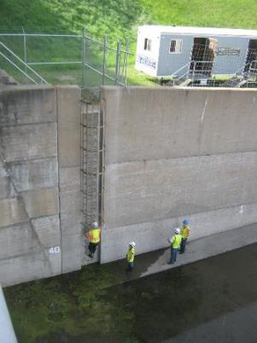
Overtopping of spillway chute walls concern (PFM 42)

Slide 18
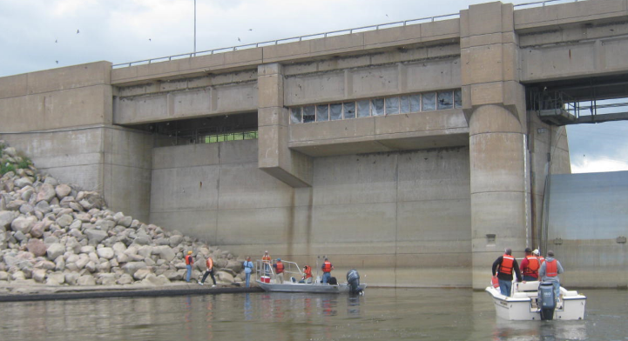
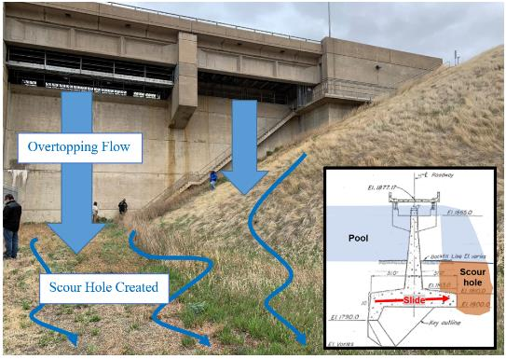
Overtopping of spillway abutment monoliths concern (PFM 41)
New peak pool elevation would result in overtopping of the abutment monoliths at elevation 1862 LPD.
Could result in scour downstream of monolith.
Looking downstream
Looking upstream

Slide 19
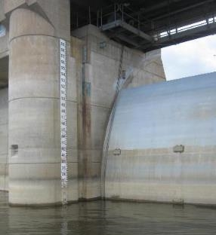
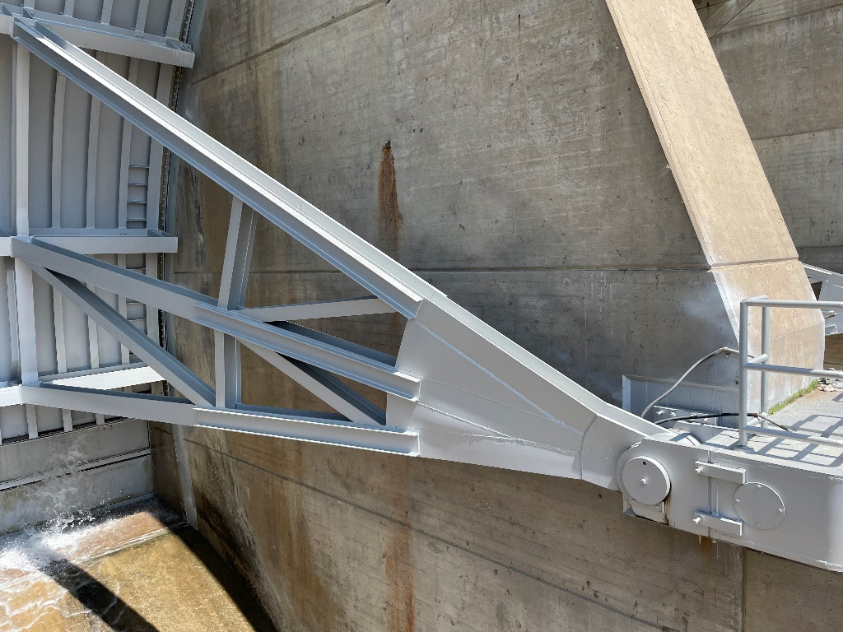
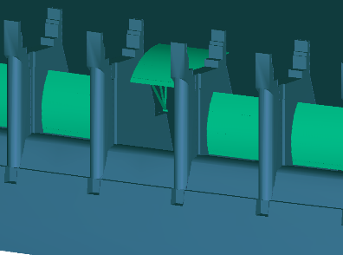
Spillway gate failure concern (PFM 37)
New maximum pool elevation would overtop the Tainter gates.
The connection of the gates to the piers would be overstressed and could fail.
Image of crest structure with potential failure point circled in red
Upstream side of Tainter gate
Downstream side of gate and trunnion hub

Slide 20
proposed modifications and Schedule

Slide 21
Recommended Plan
Measures 37-1, 37-4
Trunnion hub modifications and construct concrete wall/beam between piers to deflect nappe, reduce load on gates
(Addresses PFM 37 – Spillway gate failure)
Measures 7-4, 7C-3
Replace drainage pipes, abandon old VCP pipe network, 2.5’ CRC overlay
(Addresses PFM 7 – Hydraulic jacking of chute slab due to manholes and PFM 7C – Hydraulic jacking of chute slab due to drain defects)
Measure 41-1
Seal abutment monoliths
(Addresses PFM 41 – Overtopping of spillway abutment monoliths)
Measure 42-2
Armor entire area behind walls
(Addresses PFM 42 – Overtopping of spillway chute walls)
Hydraulic Jump
Measure 8-1
RCC overlay with concrete cap (from 2.5 ft up to 16 ft thick)
(Addresses PFM 8 – Hydraulic jacking of the lower spillway chute and stilling basin slab due to uplift)
Minor features not shown: The recommended plan also includes a new line of drains on the west abutment and new spillway gate deicing features.

Slide 22
PED Schedule
Jan 2026. 35% Design Complete.
Fall 2026. Integrated Design and Construction Contract Award.
Mar 2028. 65% Design Complete.
Feb 2029. 95% Design Complete.
Aug 2029. 100% Design Complete.
2029 – 2035. Anticipated Construction Duration.
*Proposed dates are approximate and subject to change*

Slide 23
Questions

Slide 24
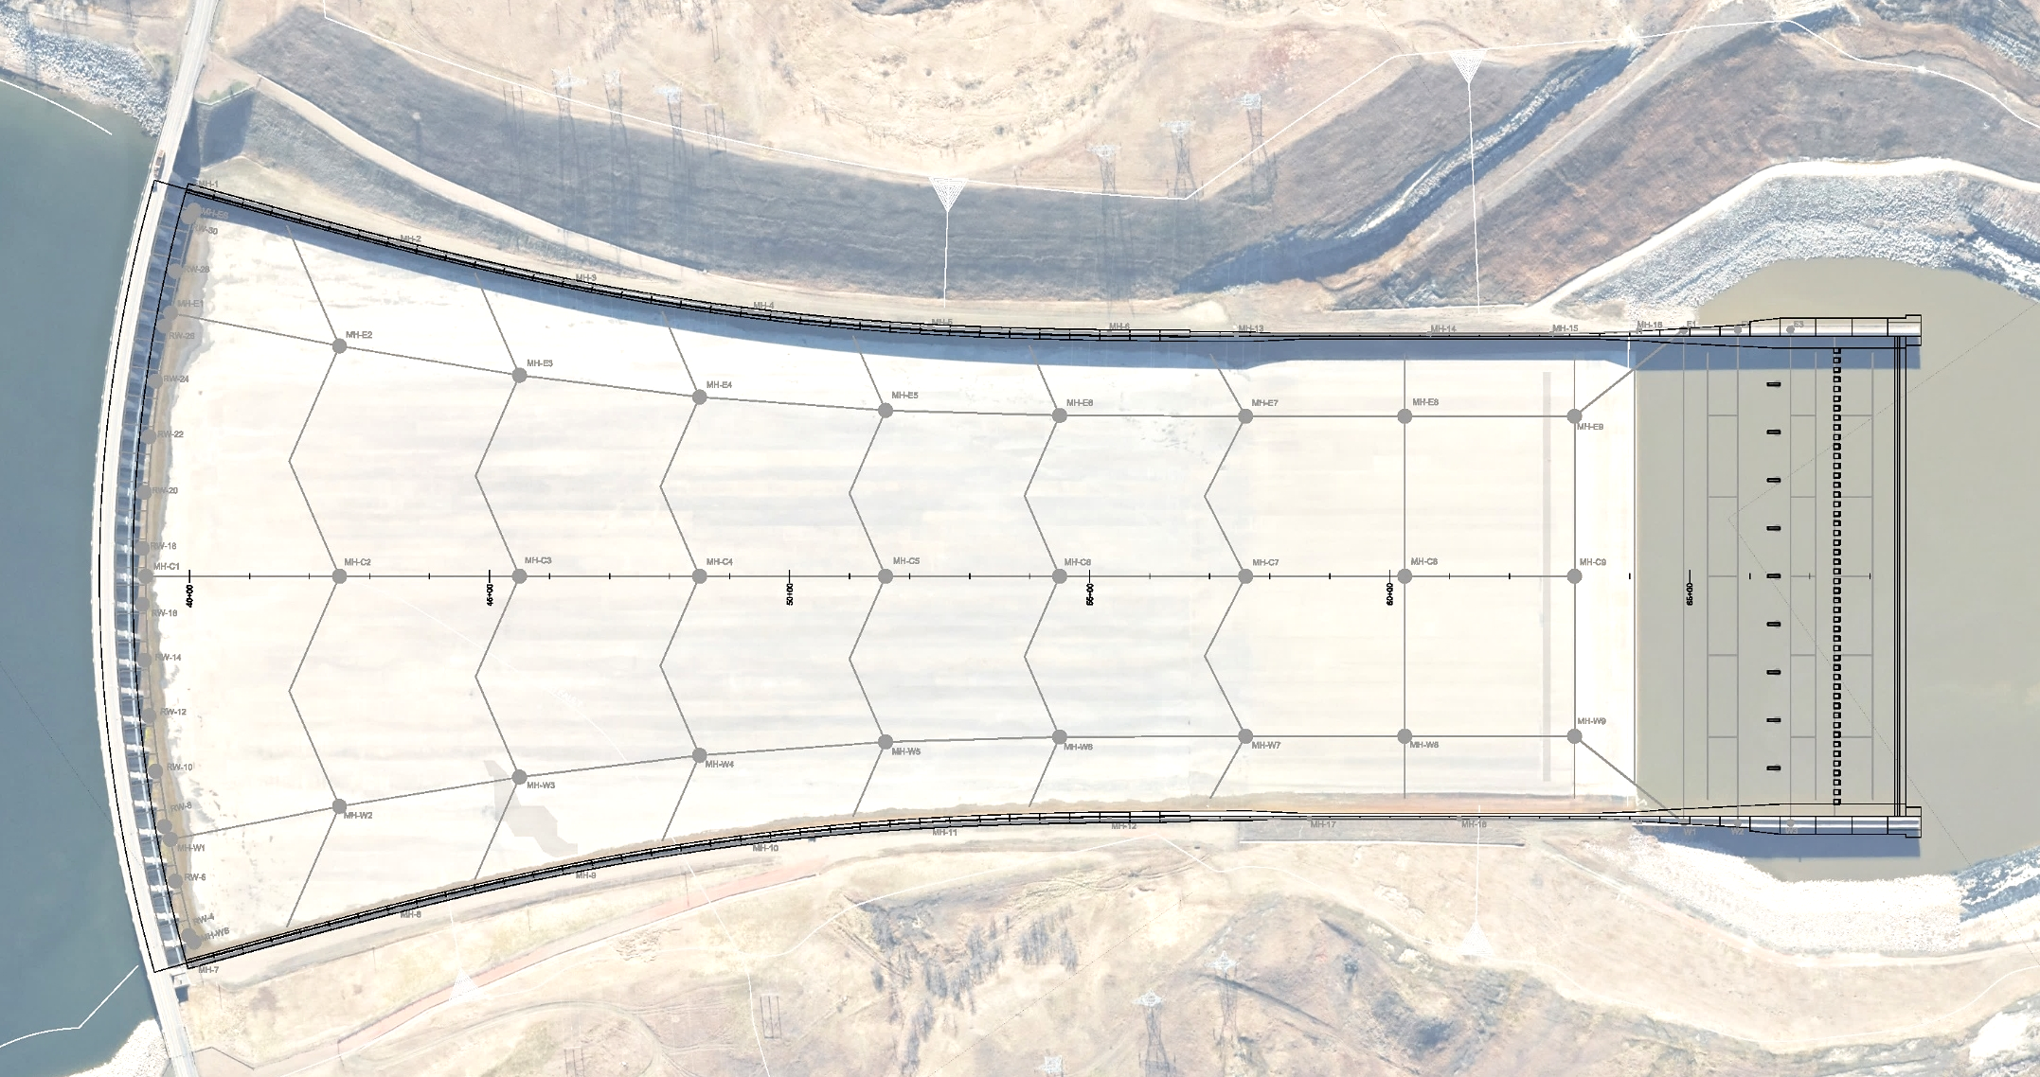
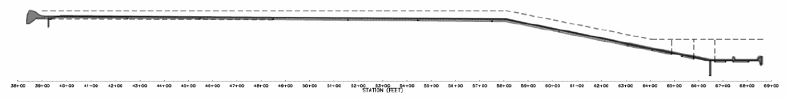
RECOMMENDED PLAN OVERVIEW
REPLACE DRAINAGE SYSTEM, CHUTE OVERLAY, ARMOR BEHIND CHUTE WALLS, DEFLECT NAPPE FROM GATES, MODIFY TRUNNION HUB
# | LOCATION | TASK
1 | UPPER CHUTE & UPSTREAM HALF OF LOWER CHUTE - DRAINS, Sta 40+00 to 63+00 | DRAINAGE REPLACEMENT, CRC OVERLAY
2 | DOWNSTREAM HALF OF LOWER CHUTE AND STILLING BASIN, Sta 63+00 to 69+00 | OVERLAY (RCC WITH CRC CAP), LARGER BAFFLE BLOCKS MOVED DOWNSTREAM, LARGER END SILL
3 | CHUTE WALLS | ARMOR BEHIND CHUTE WALLS
4 | ABUTMENT MONOLITHS | SEAL SPILLWAY ABUTMENTS
5 | SPILLWAY GATES | CONSTRUCT BEAMS TO DEFLECT NAPPE, TRUNNION HUB MODIFICATIONS
SEAL
MONOLITHS
31 - 33
STA 40+00
STA 45+00
STA 50+00
STA 55+00
STA 60+00
STA 63+00
STA 69+00
CONSTRUCT DEFLECTOR BEAMS BETWEEN PIERS TO DEFLECT NAPPE, MODIFY TRUNNION HUB CONNECTIONS
NEW
LATERAL
DRAINS
ABANDON
EXISTING DRAINS
RETAIN
EXISTING DRAINS
CONCRETE ARMOR BEHIND CHUTE WALLS
NEW COLLECTOR GALLERY
4 ACCESS
MANHOLES
PER GALLERY
NOTE- DOWNSTREAM NEW LATERALS TO BE CO-LOCATED WITH EXISTING LINES 8 AND 9. SHOWN OFFSET HERE FOR CLARITY.
OVERLAY (UP TO 16 FT THICK); NEW, LARGER BAFFLES; LARGER END SILL
OVERLAY (2.5 FT CRC)
SEAL MONOLITHS
1 - 3
WEIR EL 1825
SLAB EL 1802
0.75% SLOPE
20% SLOPE
TOP OF WALL
ACCESS SHAFTS
REPLACE RELIEF WELL DRAINS
NEW COLLECTOR GALLERY
1 2 3
TYPICAL TW EL 1670
500 ft
STILLING BASIN EL 1620
OVERLAY
G-02
63+00

