Slide 1
Mid-West Annual Meeting
Western Area Power Administration
Tina Ko
Chief Operating Officer
December 13, 2023

Slide 2
COO Program Areas
Reliability Compliance
Safety and Occupational Health
Security and Emergency Management
Enterprise Portfolio Management
Project and Asset Services
Technical Services/Aviation
Design and Engineering

Slide 3
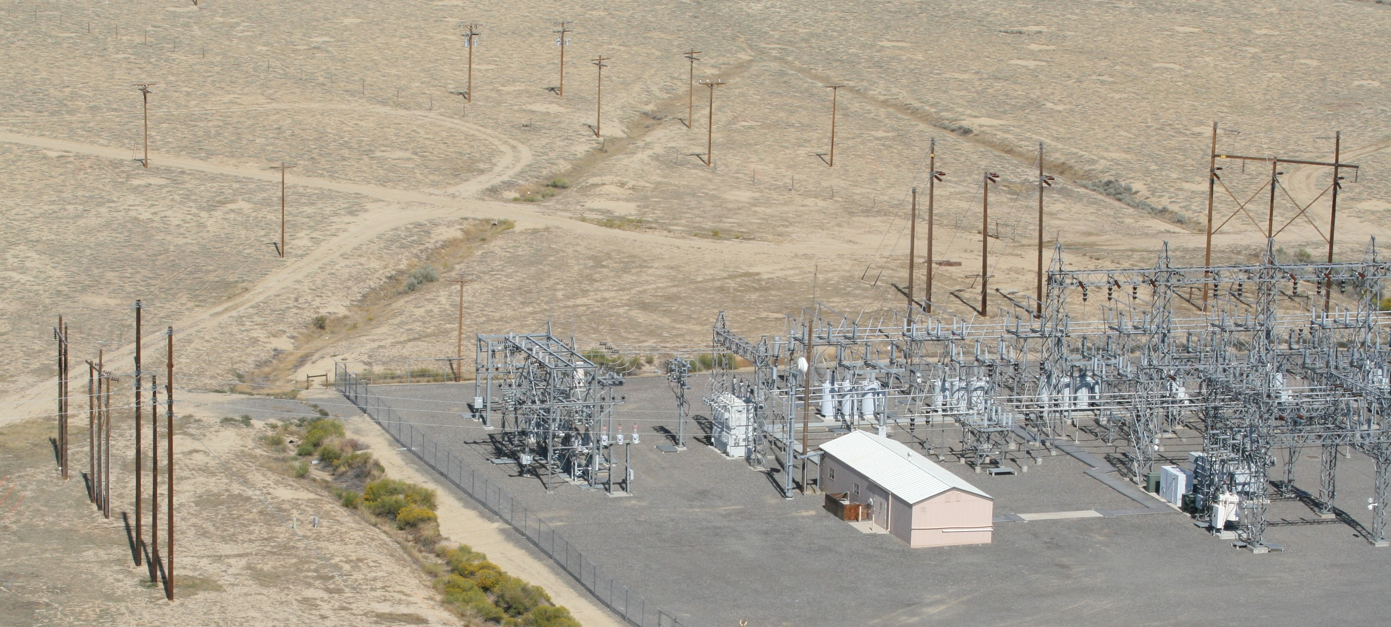
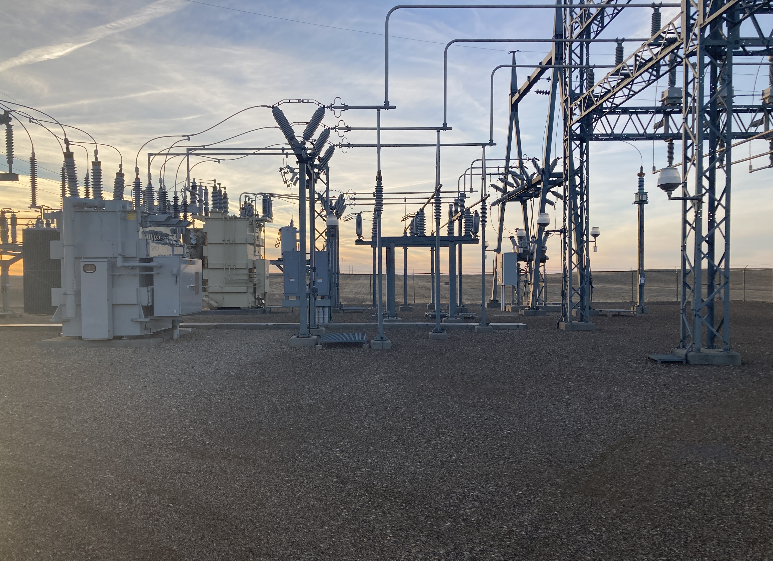
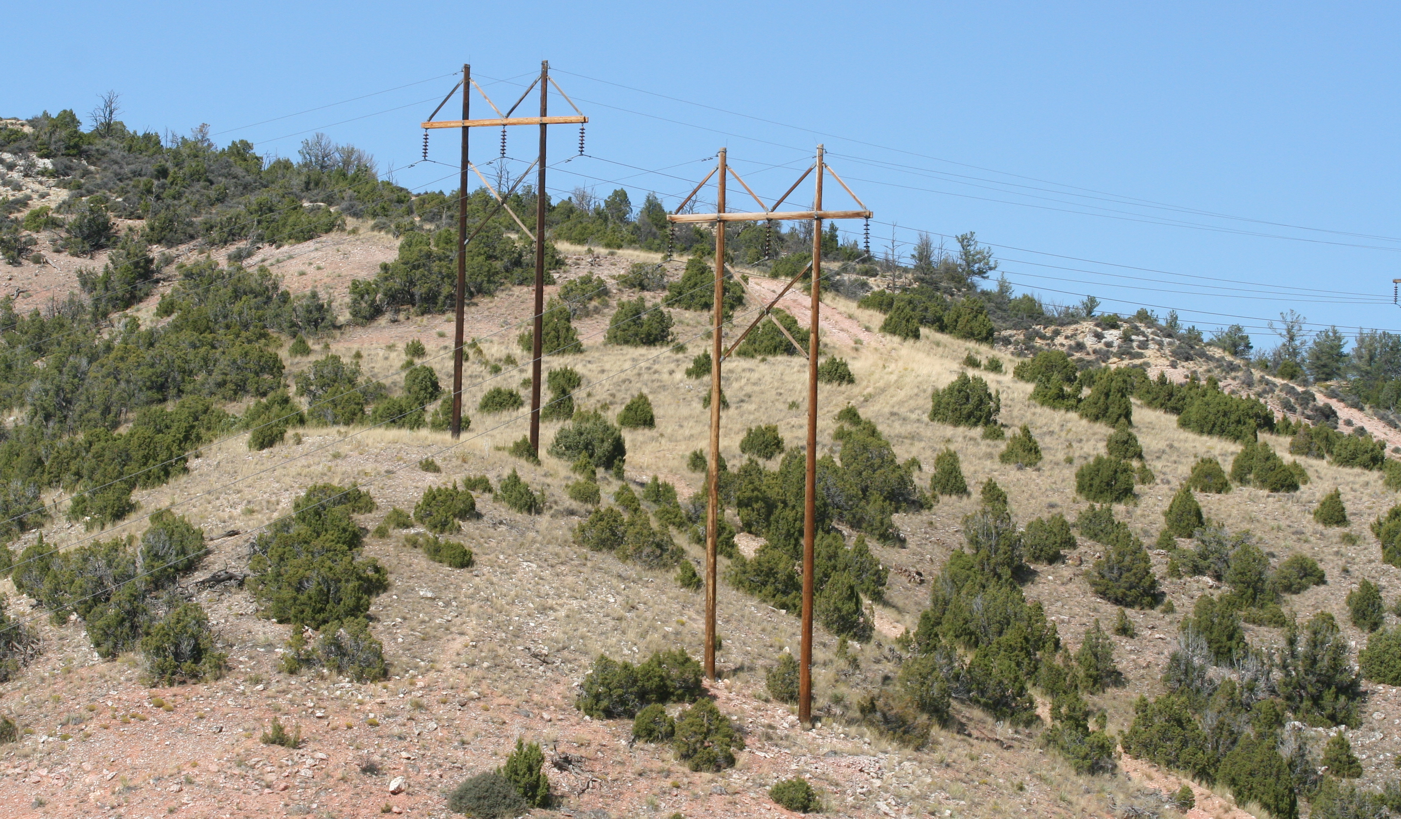
Focus on Reliability
Existing Eagle Butte Substation
Existing Lovell-Yellowtail No. 1 and No. 2
Notes:
Talking Points:
HQ Engineering is a central design office serving all of WAPA’s regional offices that delivers substation and transmission line designs. The electrical, civil, and system control groups provide the construction specifications and drawings for substation projects; some examples are shown on this slide.
Typically, the regions provide system planning, project management, and construction management to work with HQ Engineering on WAPA’s construction projects. HQ Engineering also retains technical expertise to develop the specifications and ratings for WAPA’s high-voltage equipment such as power transformers, circuit breakers, shunt capacitors and reactors.
Improved system reliability is one of the primary benefits of projects on this slide.
For example, in the Eagle Butte project, converting to a ring bus addresses a single contingency event that would otherwise de-energize the low-side cooperative feeds. The ring bus allows separate connections to the power transformers that feed the low-side transmission lines. Additional protective relaying equipment will aid in isolating the minimum amount of equipment during a system fault.
For the Stegall project, replacing end-of-life oil breakers and disconnect switches will improve system reliability and reduce maintenance costs. Installing new remote terminal units (RTUs) and protective relays in the new control panels will also provide more capability and improve reliability.
HQ Engineering also provides the construction specifications and drawings for transmission line projects as seen on this slide.
HQ Engineering uses the PLS-CADD program and 3D LiDAR to improve the accuracy and completeness of the design. Tower height clearances can actually be measured using some of the visualization software.
The Glendo-Lusk Rural Tap project includes removing and replacing 35-miles of single pole H-frame structures. Transmission line engineers were intentional in designing some of the structures to minimize outages during construction.
For another project, the existing Lovell to Yellowtail No. 1 line was commissioned in 1956 and the #2 line was commissioned in 1966. Phase 3 of this project includes rebuilding 15-miles of the existing No. 1 and No. 2 lines on new wood H-frame structures on the Crow Indian Reservation. Telecomm engineers designed the fiber optic ground wire installation to augment the microwave path and establish a reliable communication system between Lovell and Yellowtail.

Slide 4
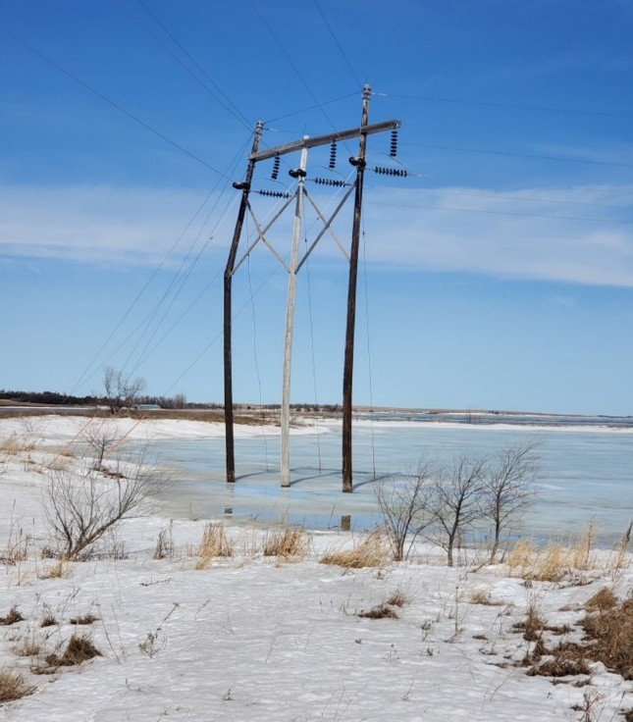
Responding to Storm Damage
4
Notes:
Talking Points:
HQ Engineering also partners with our regional offices to provide engineering solutions for storm damage and unique power system conditions.
For example, in March 2022, HQ Engineering provided a quick turnaround design to address storm damage on the Bristol-Summit line for the South Dakota Maintenance Office.
The outside leg of the three pole 115kV structure broke, which was also in water.
The replacement structure had to move forward in-line as a permanent solution. The adjacent structure then became a running angle which required additional engineering analysis.

Slide 5
5

Slide 6
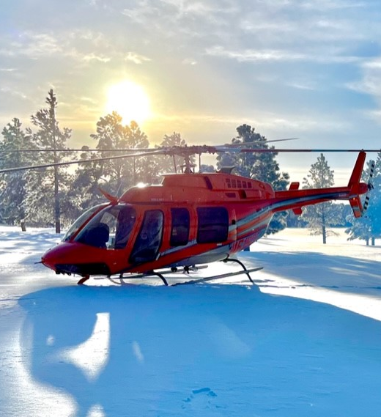
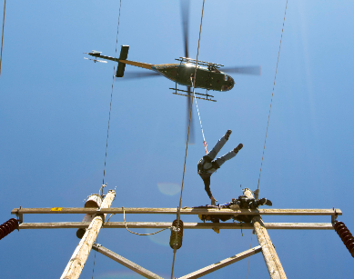
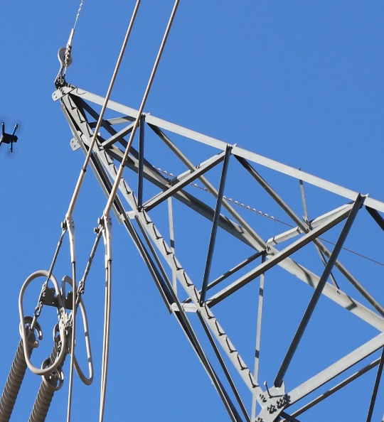
WAPA’s Aviation Program
6

Slide 7
* Video has no sound
Notes:
Glen Canyon-Flagstaff 345KV had a trip problem near the Glen Canyon sub and a fault could not be identified from a ground inspection.
Jason Wientjes, A WAPA Lineman/UAS operator deployed his UAS to inspect 4 structures for flashed insulators.
He Identified a flashed bell within 10 minutes with minimal risk and no structures were climbed by WAPA personnel.

Slide 8
DO WHAT IS RIGHT. DO WHAT IS SAFE.
We are public servants who act with integrity, stand up for what is right and demonstrate courage when acting in the best interests of our customers and communities they serve. We are safe in all of our actions and consider safety in all our planning.

Slide 9
Tina Ko
tko@wapa.gov
720.471.3682

