Slide 1
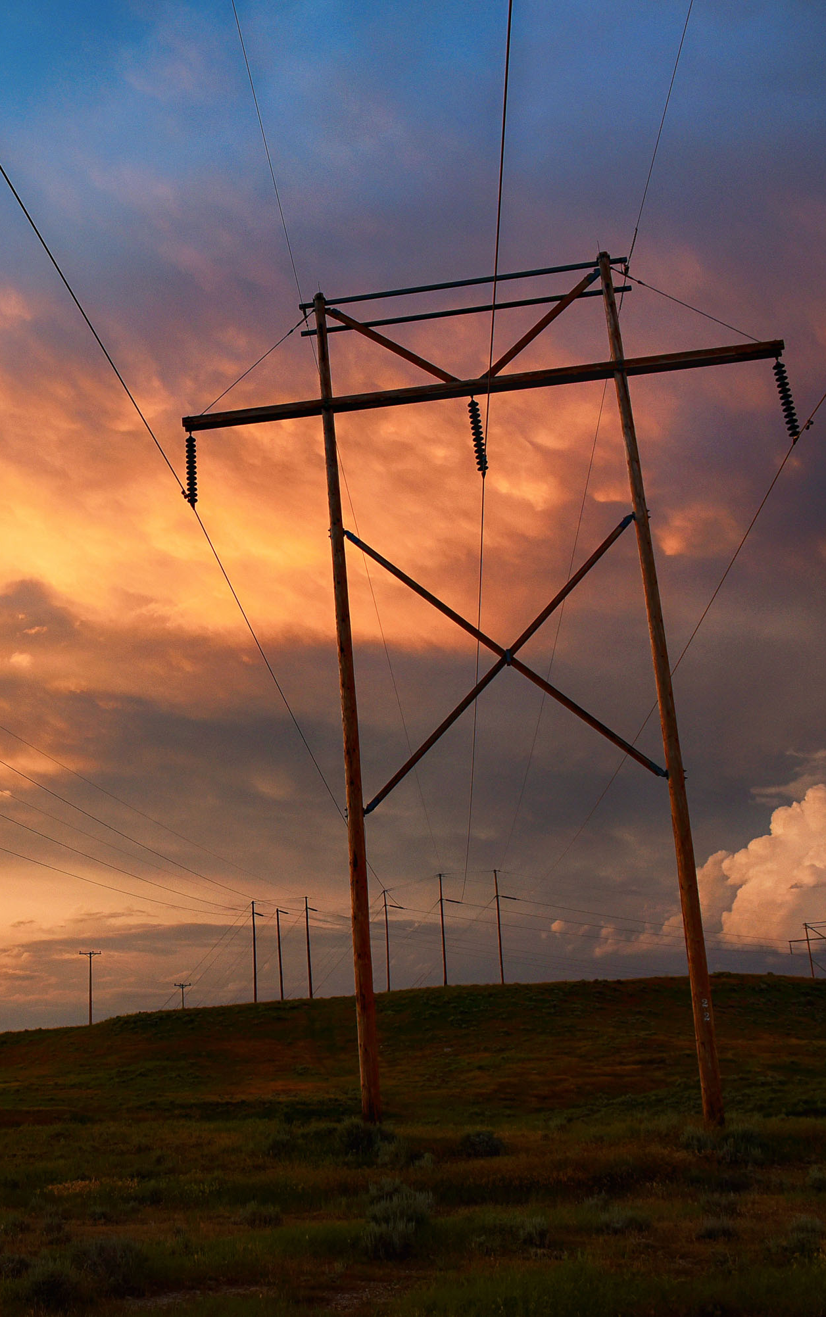
WAPA Financial Strategy
Michael D. Peterson
Senior VP and Chief Financial Officer
Mid-West Electric Consumers Association
Annual Meeting
Dec. 7, 2021

Slide 2
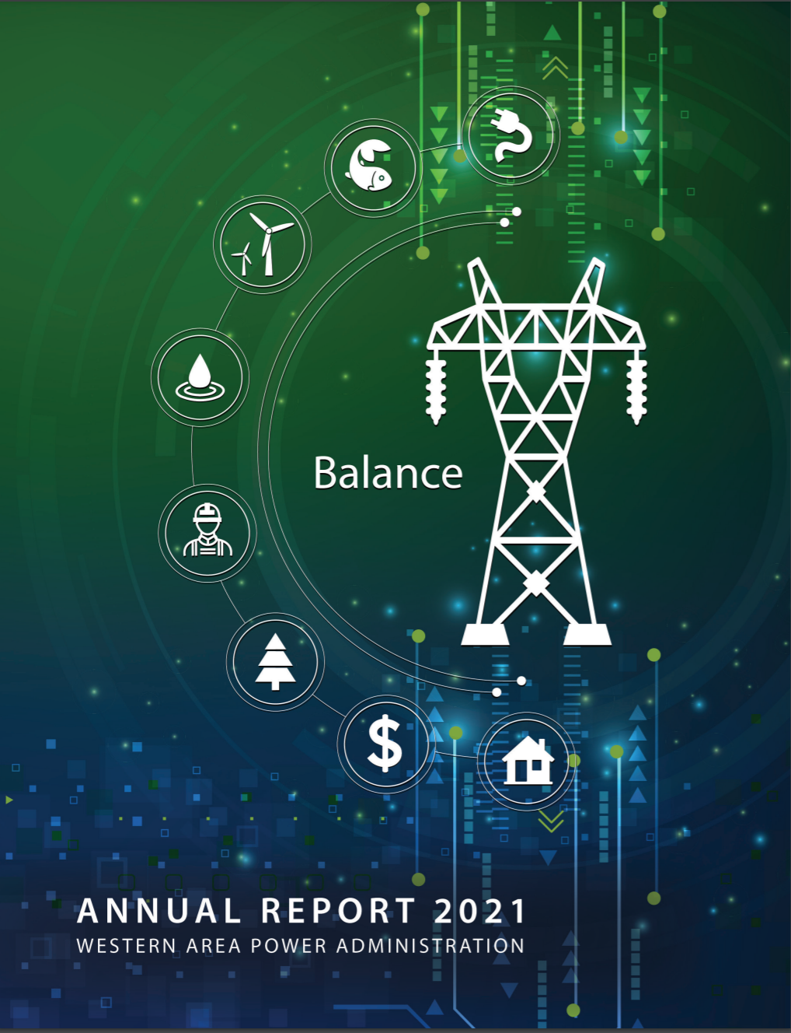
Discussion topics
Audience participation is welcome, so please interject
Strategic considerations for maintaining reliability while minimizing expenditures
Drought = challenges ahead
Distinction between spending and investing
The Consequence Ratio
Finance and budget updates
FY21 – Annual report published, commercial reporting & external audit (KPMG) on track
FY22 – Year of the continuing resolution? Maybe.
FY23 – WAPA budget submission approved by DOE, under review by OMB, embargoed
FY24 – 10-year capital plan finalized, development of labor and discretionary budgets underway
Managing in an environment of rising prices and volatility
Inflation
WAPA’s value proposition
Purchase Power & Wheeling

Slide 3
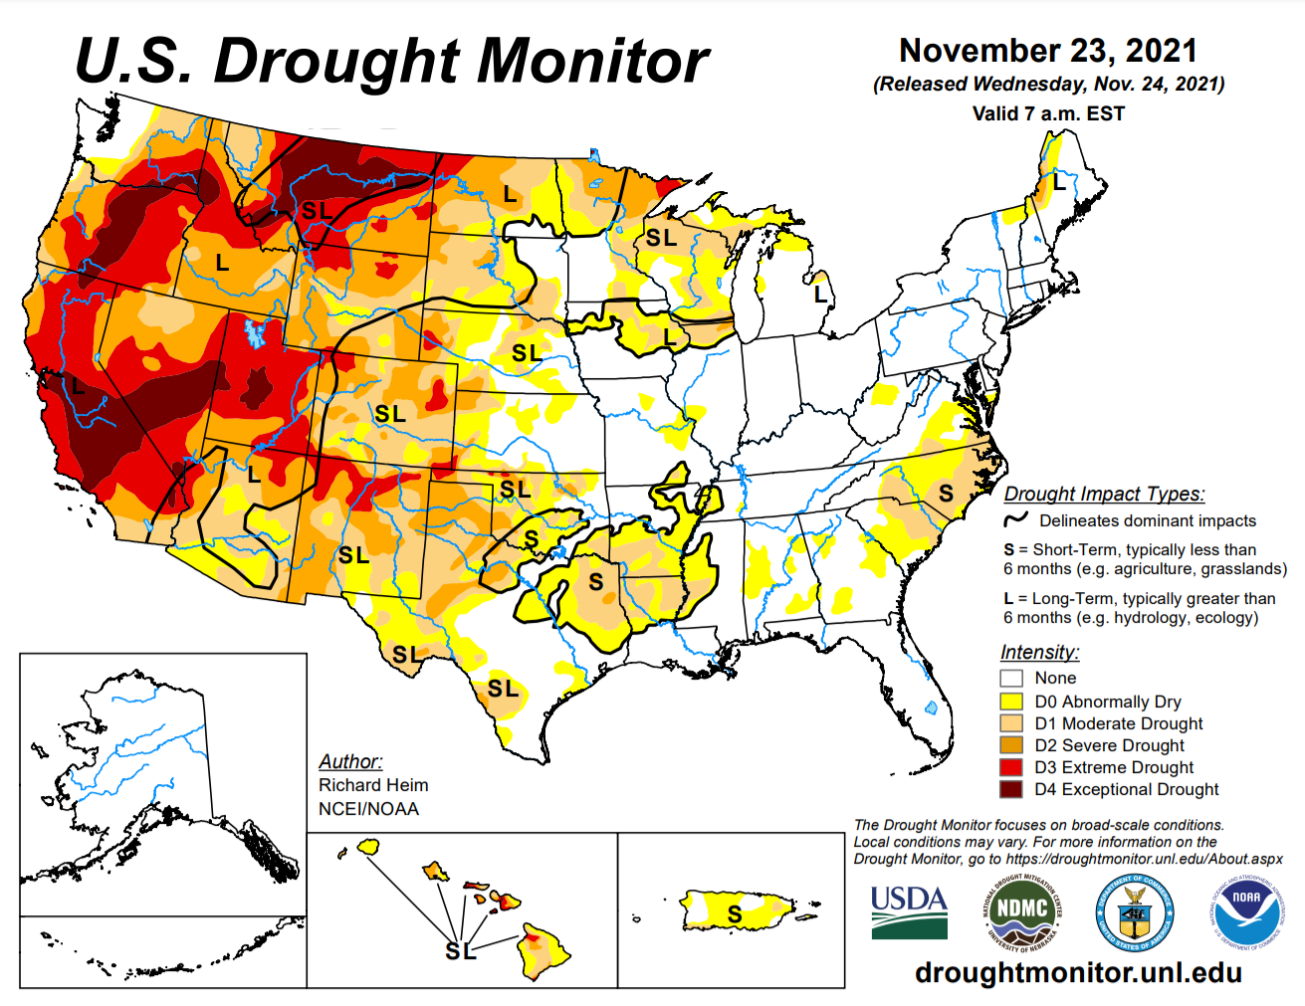
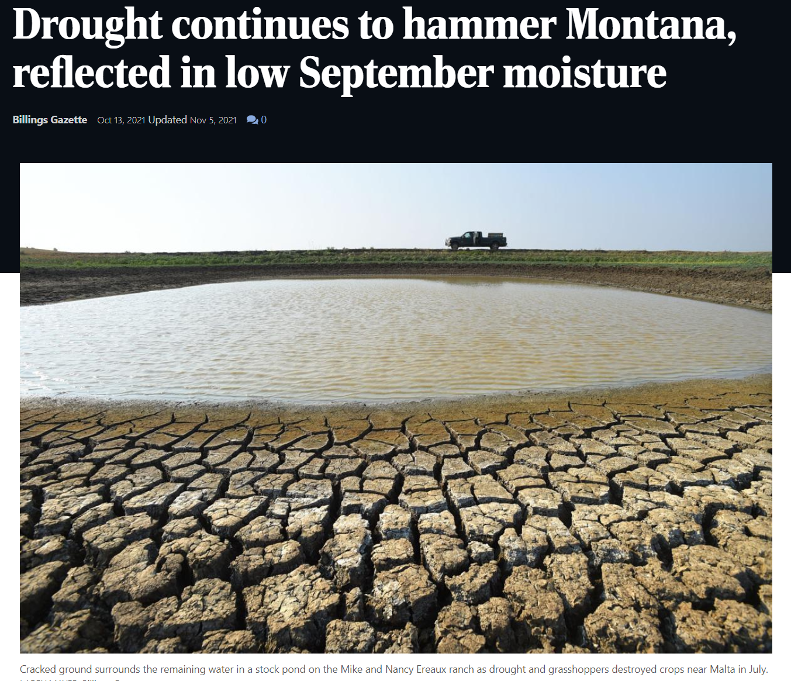
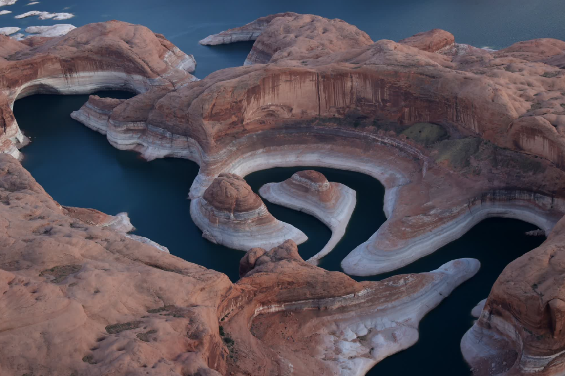
Drought = challenges ahead
Drought conditions projected across all WAPA power systems

Slide 4

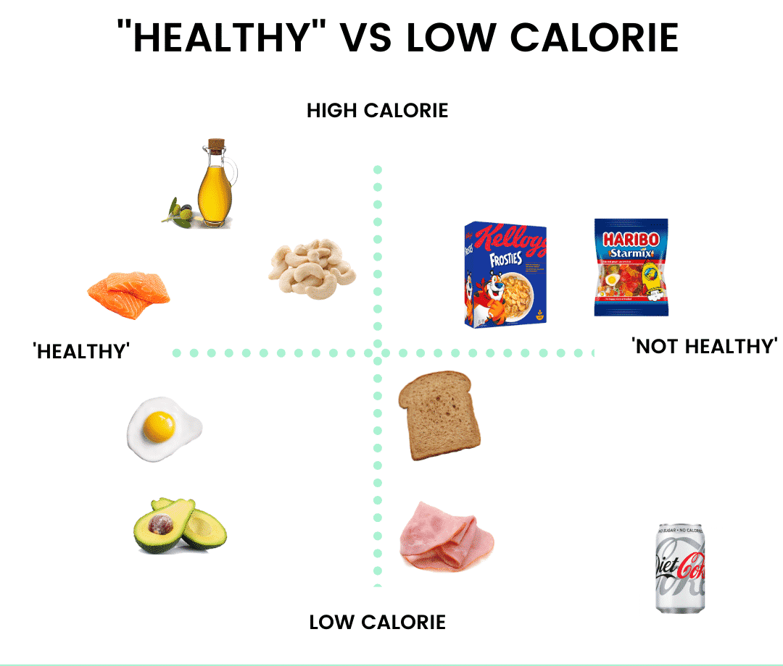

Distinction between spending and investing
Spending consumes value, while Investing creates value
?
Transmission Line
Substation
Helicopter
Networking event in Vegas
Over-the-top T&E
New phones every year
Fire extinguishers
High voltage signage
Security harnesses
Outsourced printing
Dual monitors
Paperclips
?

Slide 5
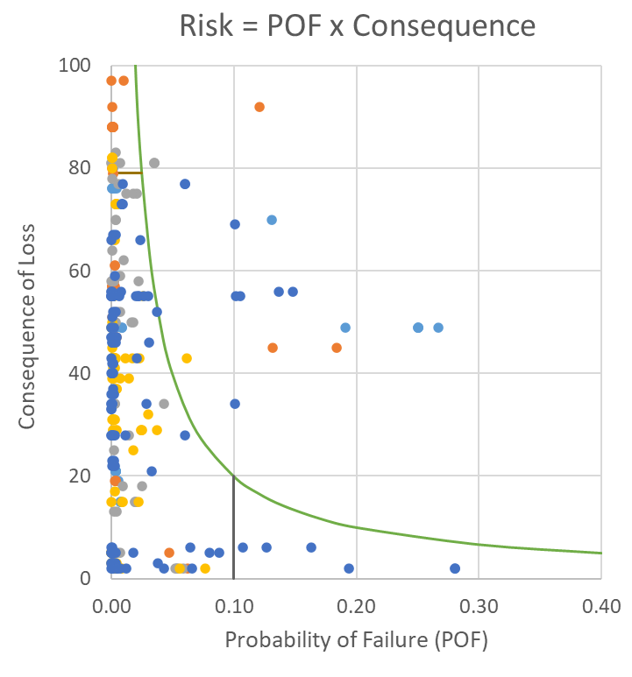
The consequence ratio
Probabilistic risk assessment of the negative impact of asset failure
Probability of failure (POF)
  Unique assessment per asset, established by WAPA’s Asset Management Team
  Determined by the health (condition) of a specific asset and its failure history
Consequence of loss
  Relative scoring of the negative impact to customers, the public, and/or WAPA if an asset fails
What is considered?
  Asset failure means the asset is unavailable for service
  MW impacts are determined with only the asset under evaluation out of service (N-1)

Slide 6
The consequence ratio
Probabilistic risk assessment of the negative impact of asset failure
How is the consequence ratio applied to budgeting for life cycle management assets?
  The consequence ratio aids in budget prioritization by approximating the inherent risk of run-to-failure results attributable to exceeding LCM targets
  EXAMPLE: Consider a $100 tire with an LCM target of 50k miles, and a 2:1 Consequence Ratio
    Cost of running the tire to failure (eg: 75k miles) = $200 (tire + tow)
    Cost of replacing the tire at 50k miles = $100 (tire)

Slide 7
Stages of a budget
Formulation, approval and execution

Slide 8
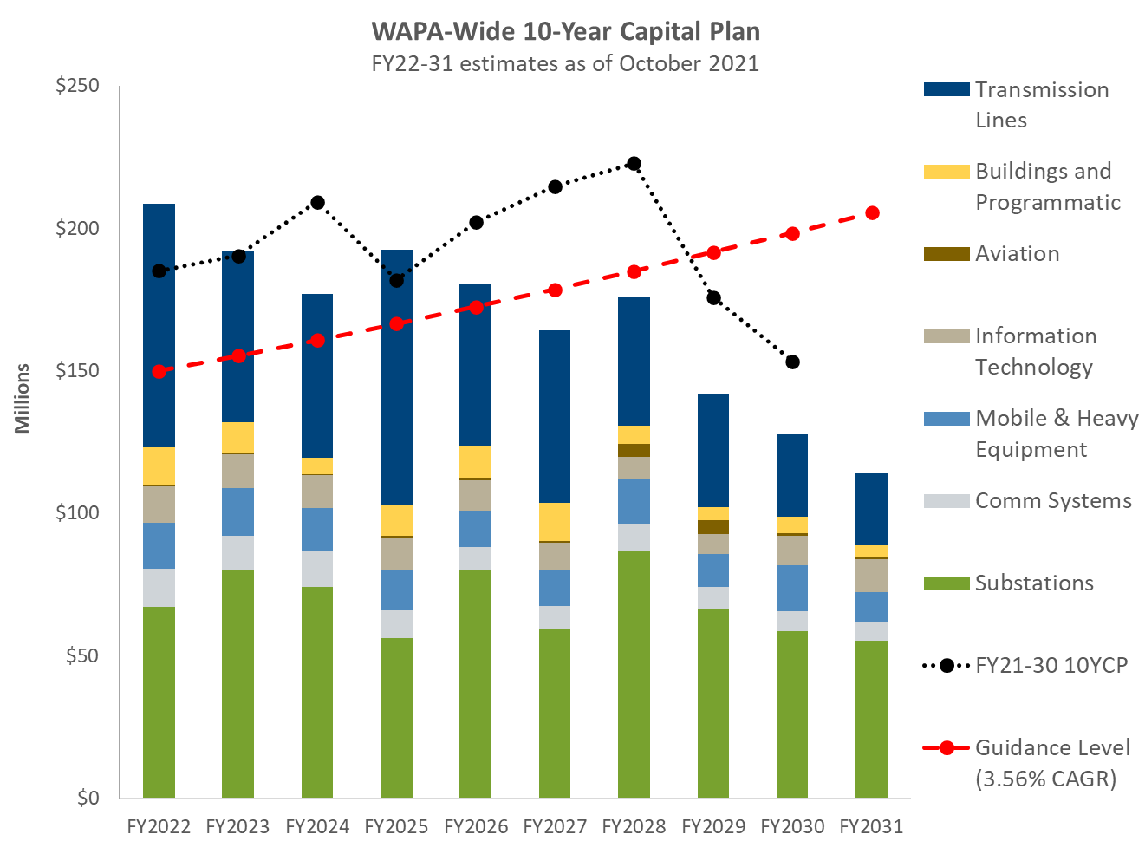
Budget formulation & performance strategy
FY24 enhancements include peer review, feasibility & rate assessments
10-year plan totals
$2B investment (including SLTP)
Decrease of $242M from previous plan
FY22 – 13% above previous plan
FY24 – 15% lower than previous plan
Rate window
Rate window is 3% lower than previous plan
Appropriations
Assumes levels consistent with FY22 President’s Budget

Slide 9
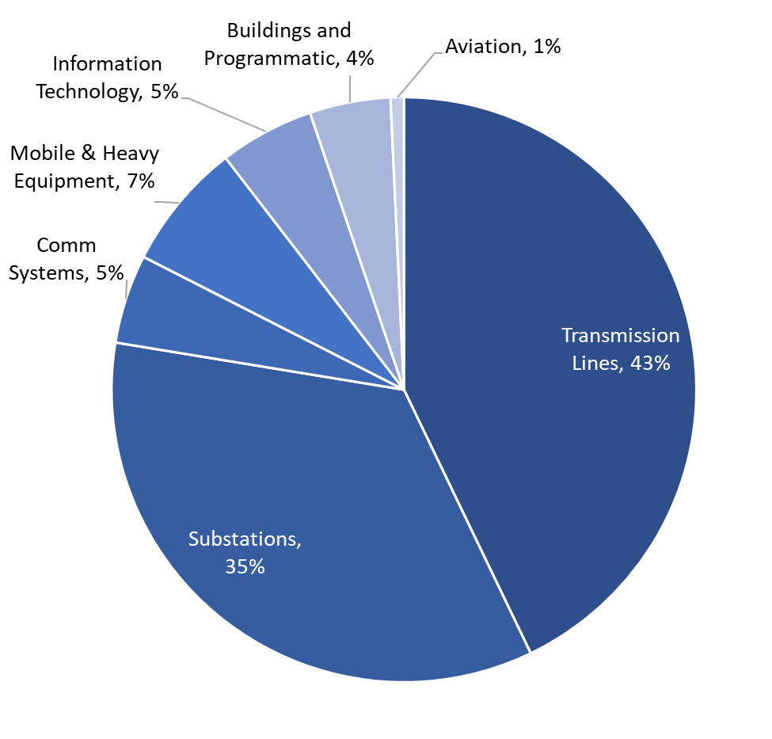
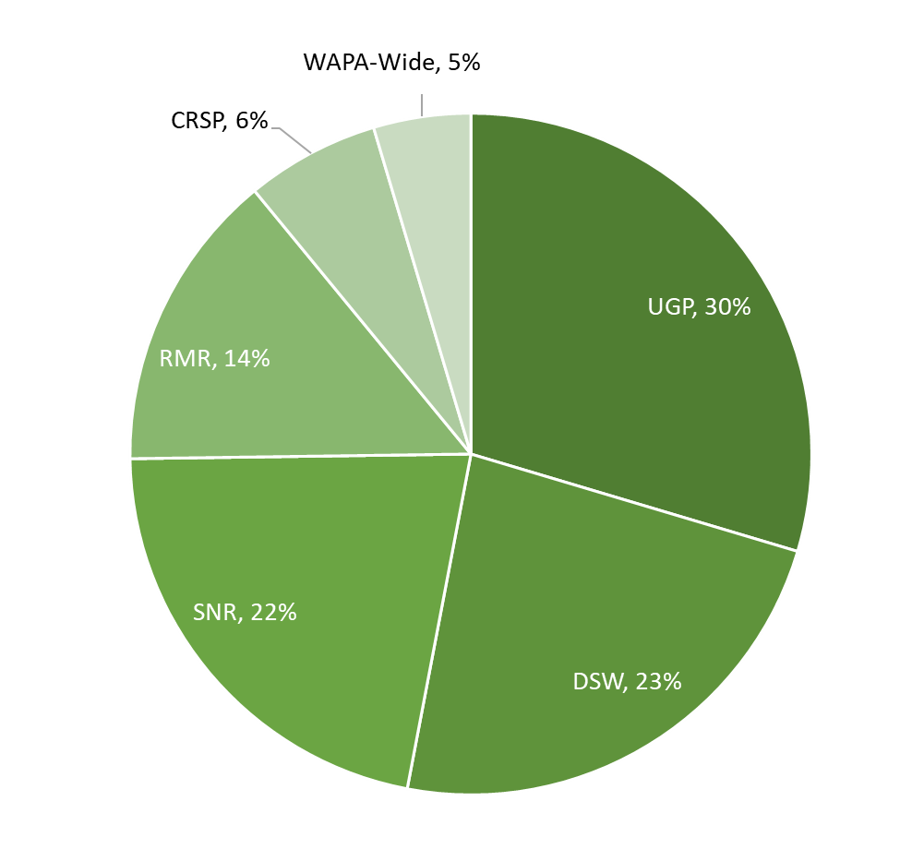
Composition of the WAPA 10-Year Capital Plan
Transmission lines, substations & communications comprise 83%
by Category by Region

Slide 10
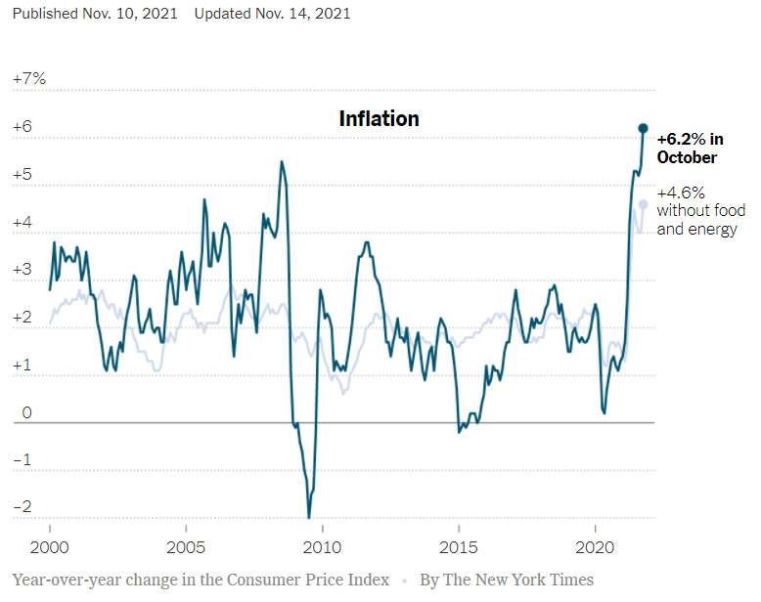
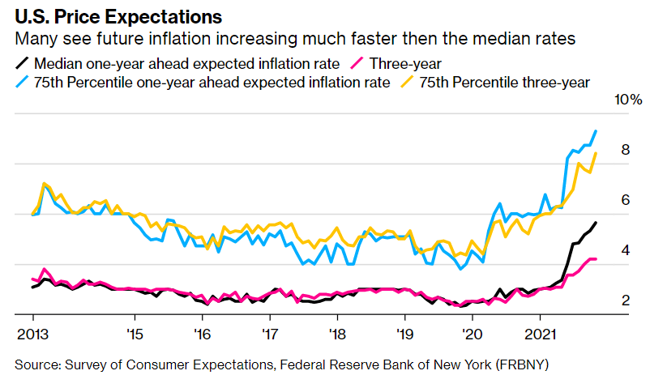
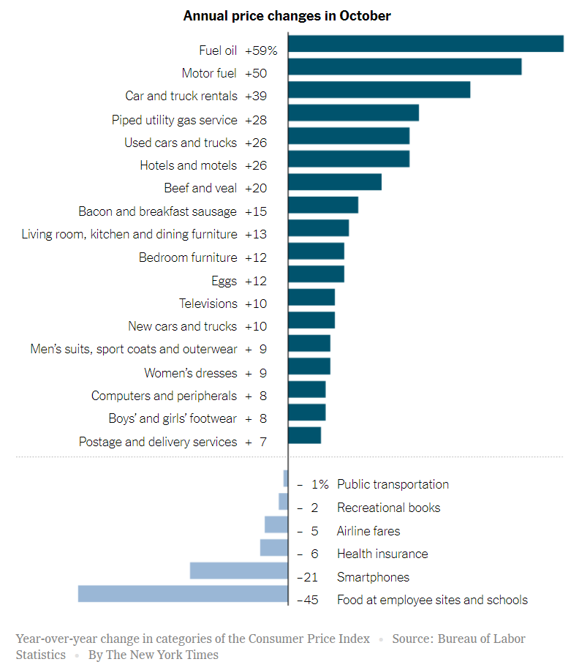
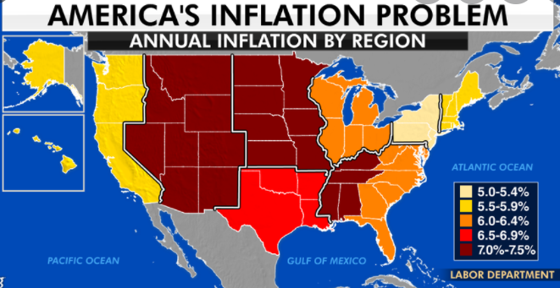
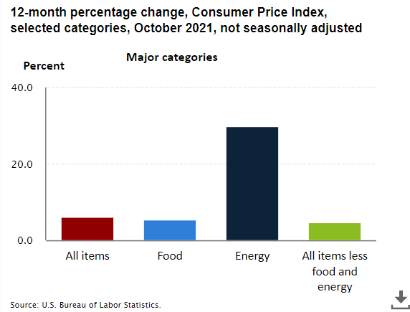
Inflation
Eroding buying power combined with sector-specific pressures merit concern
xxx
ccc

Slide 11
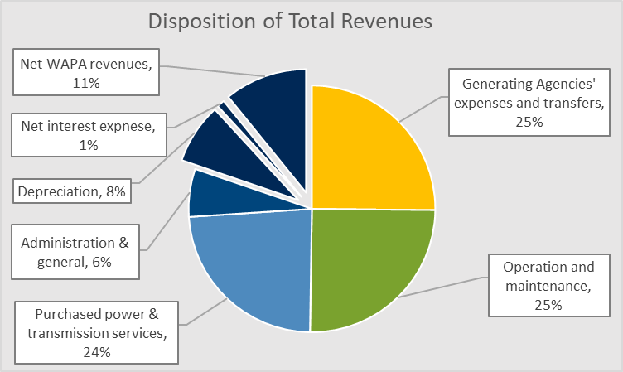
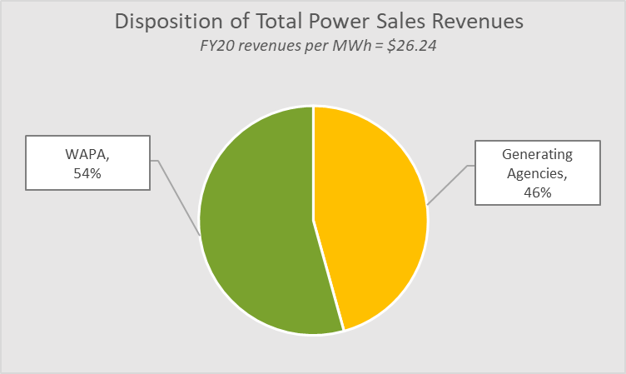
WAPA’s value proposition
Maintaining reliability & system integrity while holding the line on costs

Slide 12
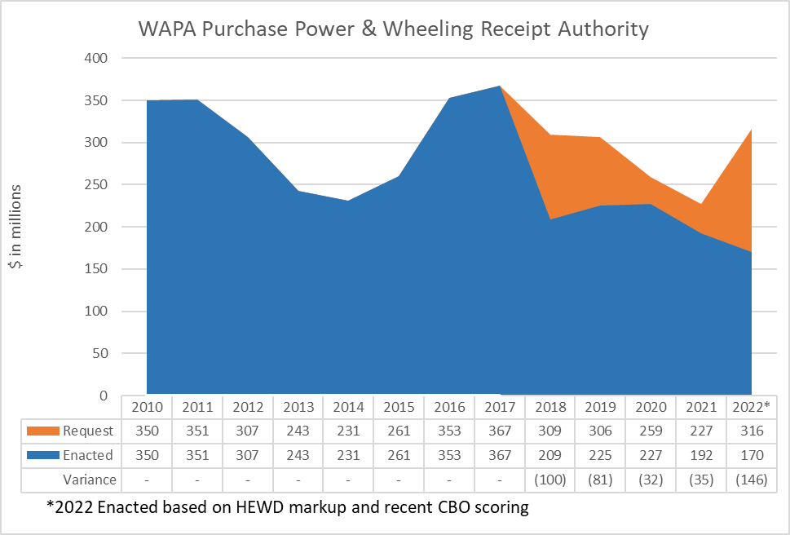
Purchase Power & Wheeling (PPW)
Infrastructure Act provides emergency funding to secure FY22 and FY23
Purpose of PPW
To firm WAPA’s contractual power delivery commitments when the generating assets (federal dams) are unable to provide sufficient power to meet WAPA’s contractual obligations.
History of PPW Receipt Authority
Instituted at WAPA over two decades ago
Has always been reimbursable
Until four years ago, was scored at net zero

Slide 13
Purchase Power & Wheeling (PPW)
Infrastructure Act provides emergency funding to secure FY22 and FY23
Infrastructure Investment & Jobs Act
Provided $500 million of reimbursable funding for WAPA’s PPW reserves to be used exclusively for PPW costs incurred throughout WAPA’s footprint
This emergency provision addresses WAPA’s estimated PPW funding needs through fiscal year-end 2023

Slide 14
Purchase Power & Wheeling (PPW)
Infrastructure Act provides emergency funding to secure FY22 and FY23
Current PPW Funding Issues
Congress has been limiting PPW funding levels since 2018 due to CBO scoring
Targeted PPW reserves, established in 2016, total $477 million
Re-assessment of PPW reserve targets will commence in 2022, power system by power system
At fiscal year-end 21, WAPA’s PPW reserves were at 48% of targeted levels ($228 million)
WAPA incurred $457 million in PPW costs in FY 2021

Slide 15
Thank you for your time and interest.

