Slide 1
Power Marketing Administrations and the U.S. Department of Energy
Mid-West Annual Meeting
Melissa Ardis Senior Advisor, Power Marketing Administrations, Office of the Under Secretary for Infrastructure

Slide 2
The Office of the Under Secretary for Infrastructure

Slide 3
The Office of the Under Secretary for Infrastructure (S3)
S3 focuses on deploying clean energy infrastructure in pursuit of national goals for affordable and reliable energy, creating high quality jobs, enhancing U.S. manufacturing, and addressing the climate crisis.
S3 delivers energy planning; energy security; infrastructure financing; project development; project management; clean energy supply chains; state, community, and tribal engagement; and other key areas, critical to the success of demonstration and deployment efforts as appropriated through the historic Bipartisan Infrastructure Law, the Inflation Reduction Act, and annual appropriations.

Slide 4
S3 Departmental Elements:
The Office of the Under Secretary for Infrastructure includes 12 Departmental Elements:
Office of Clean Energy Demonstrations
Office of Cybersecurity, Energy Security, and Emergency Response
Grid Deployment Office
Office of Federal Energy Management Programs
Office of Indian Energy
Loan Programs Office
Office of Manufacturing and Energy Supply Chains
Office of State and Community Energy Programs

Slide 5
S3 Departmental Elements:
The Four Power Marketing Administrations:
Bonneville Power Administration
Southeastern Power Administration
Southwestern Power Administration
Western Area Power Administration

Slide 6
S3 Leadership
Kathleen Hogan, Principal Deputy Secretary for Infrastructure*
Jeremiah Baumann, Chief of Staff

Slide 7
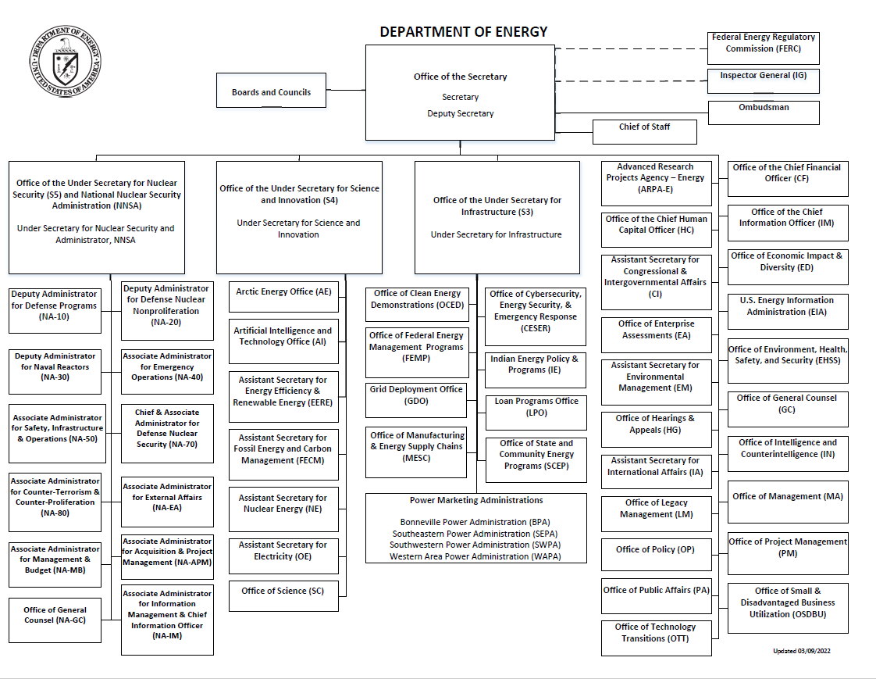

Slide 8
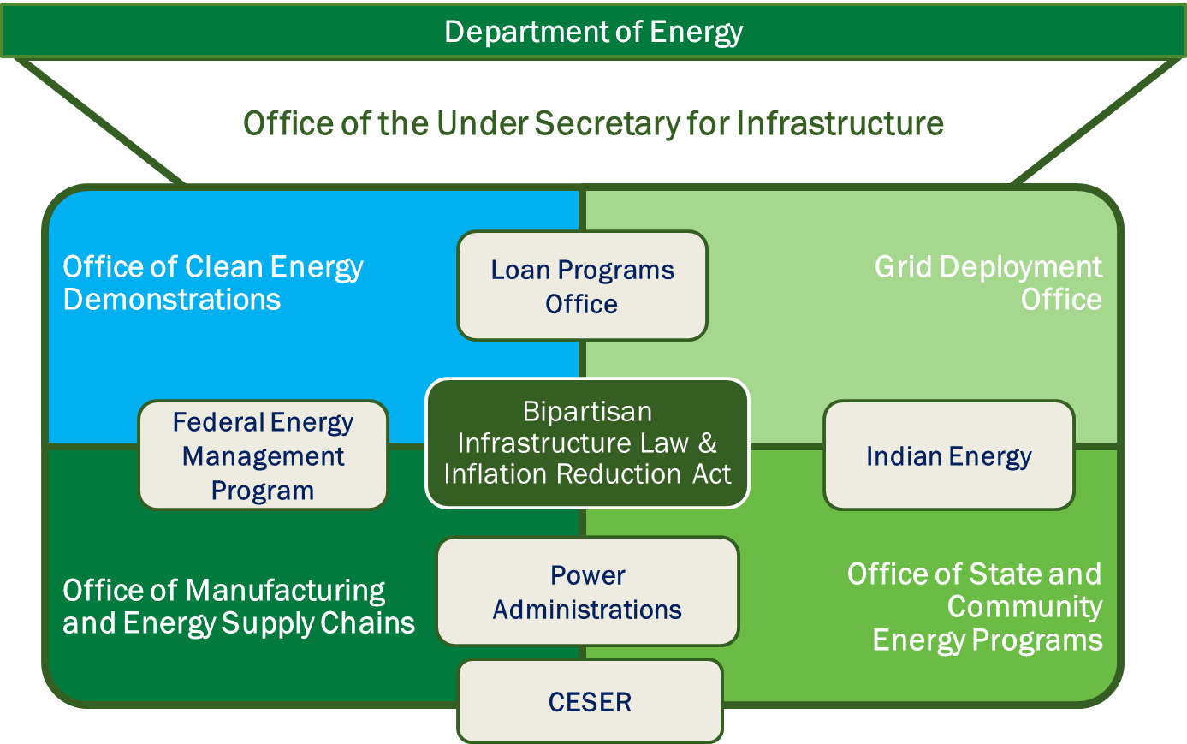

Slide 9
The Department of Energy’s Four Power Marketing Administrations

Slide 10
Power Marketing Administrations

Slide 11
Bonneville Power Administration
About:
Administrator John Hairston
Bonneville Delivers reliable, affordable, and carbon-free hydropower produced in the Columbia River Basin to communities across the Northwest. BPA maintains 15,000+ circuit miles of high-voltage power lines, with 28% market share of the electric power in the northwest, powering 3 million people in the northwest.
For more than 80 years, BPA has been an engine of the Northwest’s economic prosperity and environmental sustainability. The agency provides reliable, clean energy at cost-based rates and brings the power of the river, from water drop to energy watt, to communities across the region.

Slide 12
Southeastern Power Administration
About:
Administrator Virgil Hobbs
Southeastern Power Administration is responsible for marketing electric power and energy generated at reservoirs operated by the United States Army Corps of Engineers.
This power is marketed to more than 491 preference customers in the states of Georgia, Florida, Alabama, Mississippi, southern Illinois, Virginia, Tennessee, Kentucky, North Carolina, and South Carolina.

Slide 13
Southwestern Power Administration
About:
Administrator Mike Wech
Southwestern Power Administration markets cost-based, wholesale power and energy generated from 24 Federal, multi-purpose hydropower projects owned by the U.S. Army Corps of Engineers. SWPA’s power is marketed and delivered primarily to public bodies such as rural electric cooperatives and municipal utilities. Southwestern has over one hundred such "preference" customers, and these entities ultimately serve over 10 million end-use customers.
Service territory includes Arkansas, Kansas, Louisiana, Missouri, Oklahoma, Texas.

Slide 14
Western Area Power Administration
About:
Administrator Tracey LeBeau
Western Area Power Administration’s role is to market wholesale hydropower generated at 57 hydroelectric federal dams operated by the Bureau of Reclamation, United States Army Corps of Engineers and the International Boundary and Water Commission. WAPA delivers this power through a more than 17,000-circuit-mile, high-voltage power transmission system to more than 700 preference power customers across the West. Those customers, in turn, provide retail electric service to more than 40 million consumers. WAPA is headquartered in the Denver, Colorado suburb of Lakewood, Colorado.
WAPA’s service territory spans 15 central and western states, including Arizona, California, Colorado, Iowa, Kansas, Minnesota, Montana, Nebraska, Nevada, New Mexico, North Dakota, South Dakota, Texas, Utah, and Wyoming.

Slide 15
Federal Financing Tools

Slide 16
Federal Financing Tools
Grid Resilience Formula Grant Program
The Grid Resilience Formula Grant Program is designed to strengthen and modernize America’s power grid against wildfires, extreme weather, and other natural disasters exacerbated by the climate crisis.
The program will distribute up to $2.3 billion over five years and will provide grants to States and Tribes to support projects that provide clean, affordable, and reliable energy to everyone, everywhere, anytime.
Grid Resilience and Innovation Partnership Program
As part of the Bipartisan Infrastructure Law, the Grid Deployment Office is administering a $10.5 billion Grid Resilience and Innovation Partnership Program to enhance grid flexibility and improve the resilience of the power system against growing threats of extreme weather and climate change.

Slide 17
Federal Financing Tools
Loan Program Office
DOE's Loan Programs Office (LPO) administers several programs that can provide loan guarantees to help deploy large-scale energy infrastructure projects, including the construction and energization of a new transmission line.
Transmission Facilitation Program
The $2.5 billion Transmission Facilitation Program (TFP) is a revolving fund program that will provide federal support to overcome the financial hurdles in the development of new large-scale transmission lines and upgrading existing transmission.

Slide 18
Federal Financing Tools
Western Area Power Administration Transmission Infrastructure Program
TIP is a federal infrastructure development assistance and financing program that manages the Western Area Power Administration’s statutory $3.25 billion borrowing authority to provide debt financing and development assistance for qualifying transmission projects with at least one terminus in WAPA's 15-state service territory and that also facilitates delivery of renewable energy.

Slide 19
Who is eligible?
Communities
States and Tribes
Utilities
Industry
Manufacturers

Slide 20
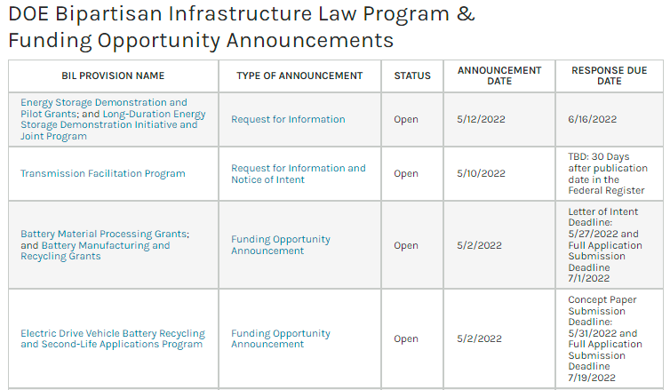
Stay Connected with DOE
Visit energy.gov/bil for announcements and sign up for Bipartisan Infrastructure Law email updates.
Find funding opportunities and access detailed program information.
Browse Frequently Asked Questions (FAQs) for answers to commonly asked questions.

Slide 21
Contact information
Stay connected with me:
Melissa Ardis
melissa.ardis@hq.doe.gov
303-868-9934
LinkedIn

