Slide 1
How Much is the Recent High Missouri River Flow Due to Climate Change?
Andrew Hoell
NOAA Physical Sciences Laboratory
andrew.hoell@noaa.gov

Slide 2
The Missouri River Basin (MRB)

Slide 3
Outline
Importance of MRB Water Resources
National Integrated Drought Information System
Recent High MRB Flows and Climate Change

Slide 4
Outline
Importance of MRB Water Resources
National Integrated Drought Information System
Recent High MRB Flows and Climate Change

Slide 5
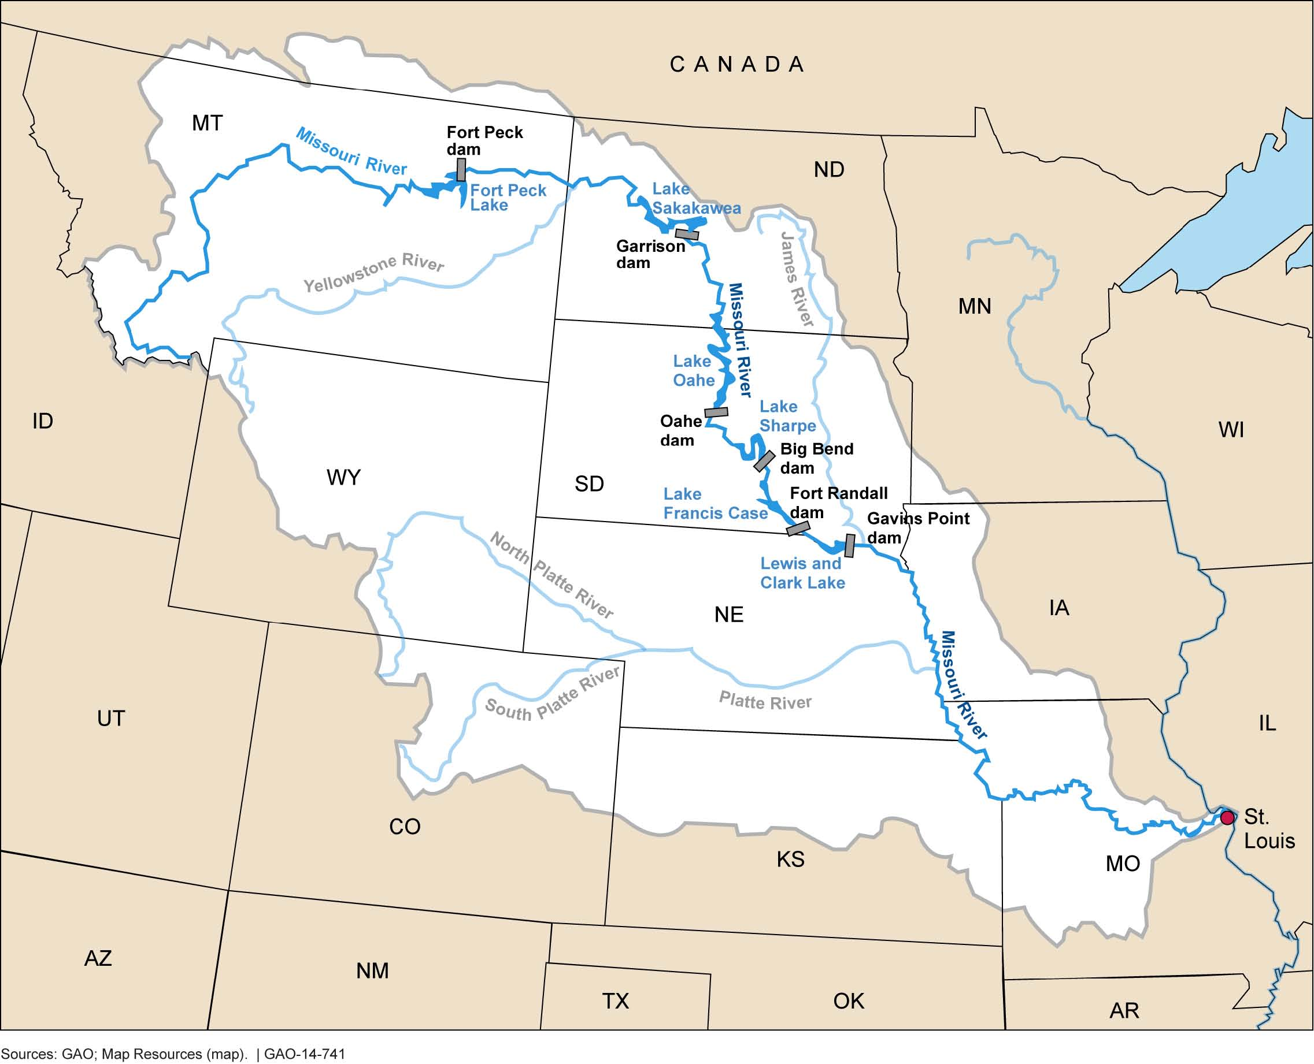
Missouri River Flow Underpins Economic Vitality
https://www.gao.gov/assets/gao-14-741.pdf

Slide 6
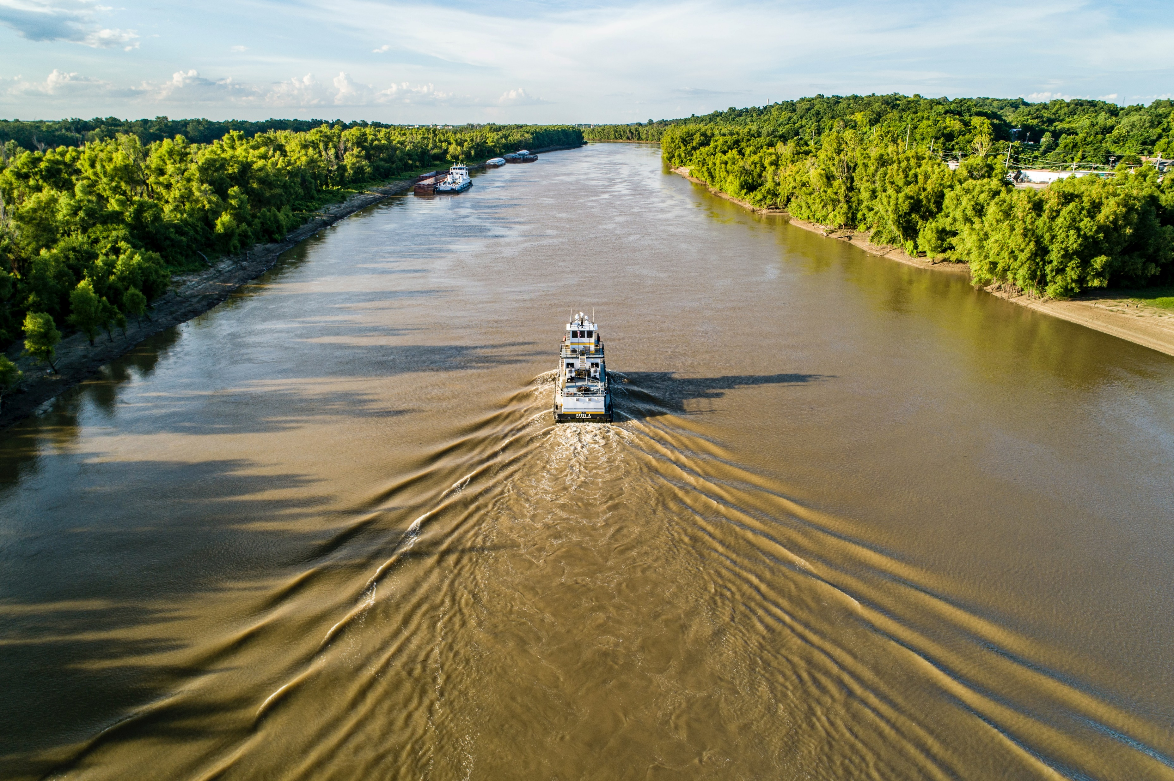
Missouri River Flow Underpins Economic Vitality

Slide 7
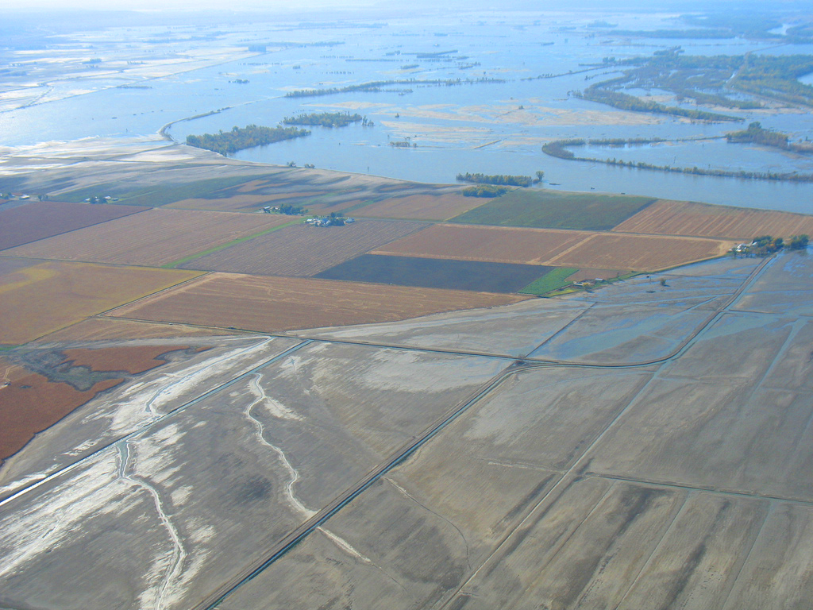
Missouri River Flow Underpins Economic Vitality

Slide 8
Outline
Importance of MRB Water Resources
National Integrated Drought Information System
Recent High MRB Flows and Climate Change

Slide 9
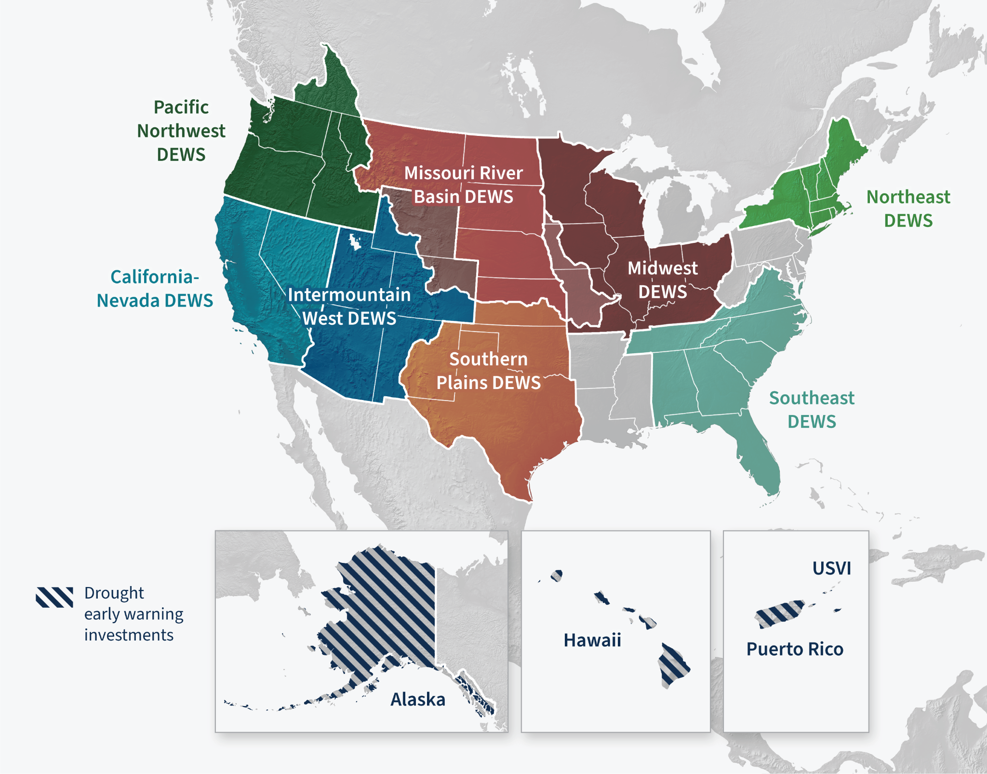
National Integrated Drought Information System (NIDIS)
Act of 2006 (P.L. 109-430) prescribed a comprehensive, interagency approach for drought monitoring, forecasting, and early warning planning and preparedness to help states and local communities cope with the impacts of drought.
NIDIS Drought Early Warning System Regions
NIDIS fulfills this mandate by…
Advancing Regional Drought Early Warning Systems (DEWS)
Improving drought prediction and forecasting
Supporting drought planning and preparedness
Supporting drought impact assessments
Strengthening collaboration
Leading the U.S. Drought Portal
Notes:
A brief background about NIDIS: NIDIS was created by Congress in 2006 with a mandate to help the nation prepare for, mitigate, and respond to the effects of drought
NIDIS does this through a series of activities, including the development of regional drought early warning systems – shown on the map here – and through support to improve drought predictions and forecasting, effective drought planning and preparedness, and assessing the impacts of drought.
All of NIDIS’s work is done in collaboration with a wide range of partners at all levels.
In addition, NIDIS hosts the U.S. Drought portal at Drought.gov, which contains a wealth of information on drought research and conditions - including information on Flash Drought.

Slide 10
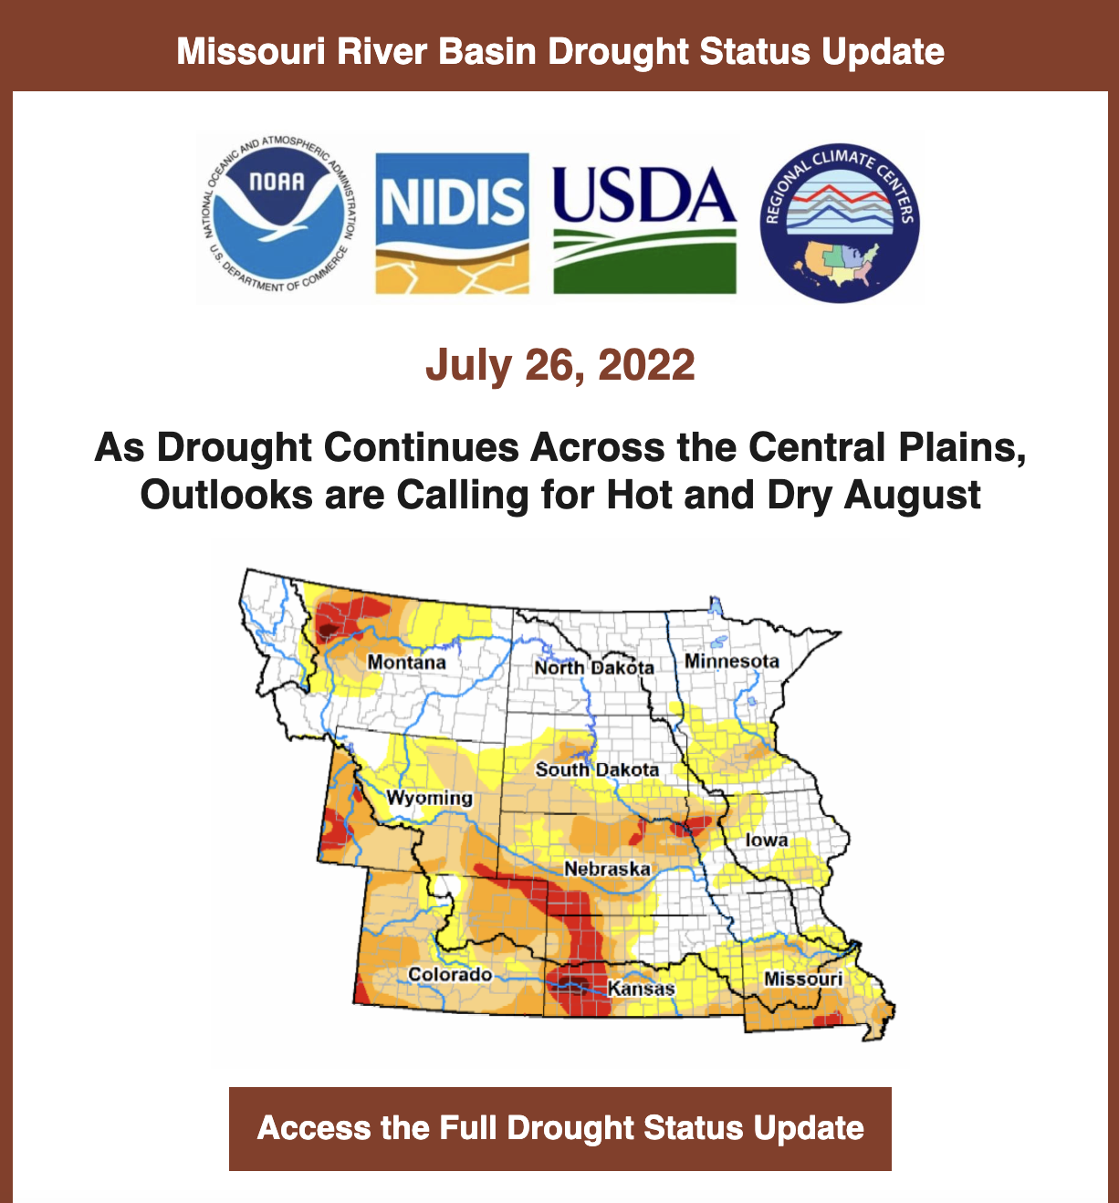
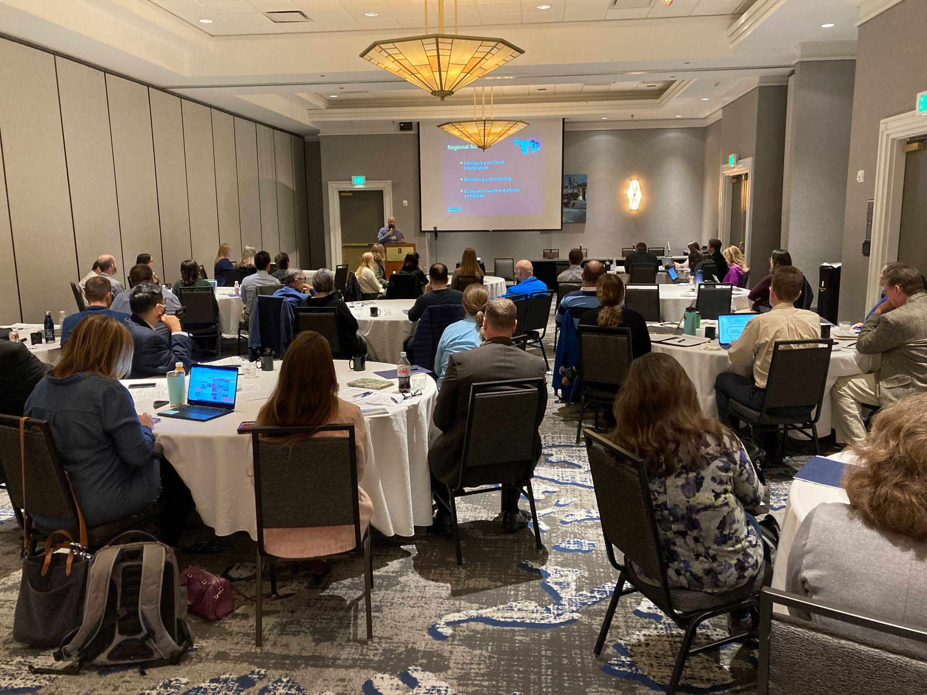
Missouri River Basin
DEWS In Action
Key Priorities
Drought indicators & impacts to inform planning
Proactive drought management actions
Integrated/applied research
Collaboration, network building, communication
Omaha, Oct 2022
Notes:
What to emphasize on this slide:
We have a Strategic Action Plan - available on Drought.gov. Our key priorities for the next few years include identifying appropriate drought indicators for the region, collecting drought impacts, and identifying proactive drought management actions - all with a goal to inform better drought planning. Also, applied research as well as collaboration, network building and communication of drought information across the region.
This Strategic Action Plan was developed with partners across the region - ranging from a variety of entities including federal, state, local agencies, academic institutions and the private sector.
The MRB DEWS is a network of people - we convene in-person meetings, most recently held one in Omaha in October.
Also, we communicate drought conditions, impacts and outlooks through Drought Status Updates and webinars. Scan the QR code on the last slide if you want to subscribe to the email listserv to get these updates straight to your inbox.

Slide 11
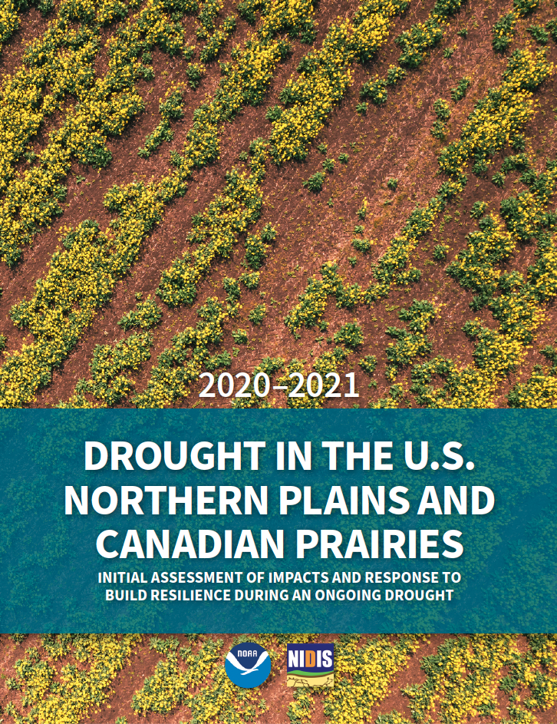
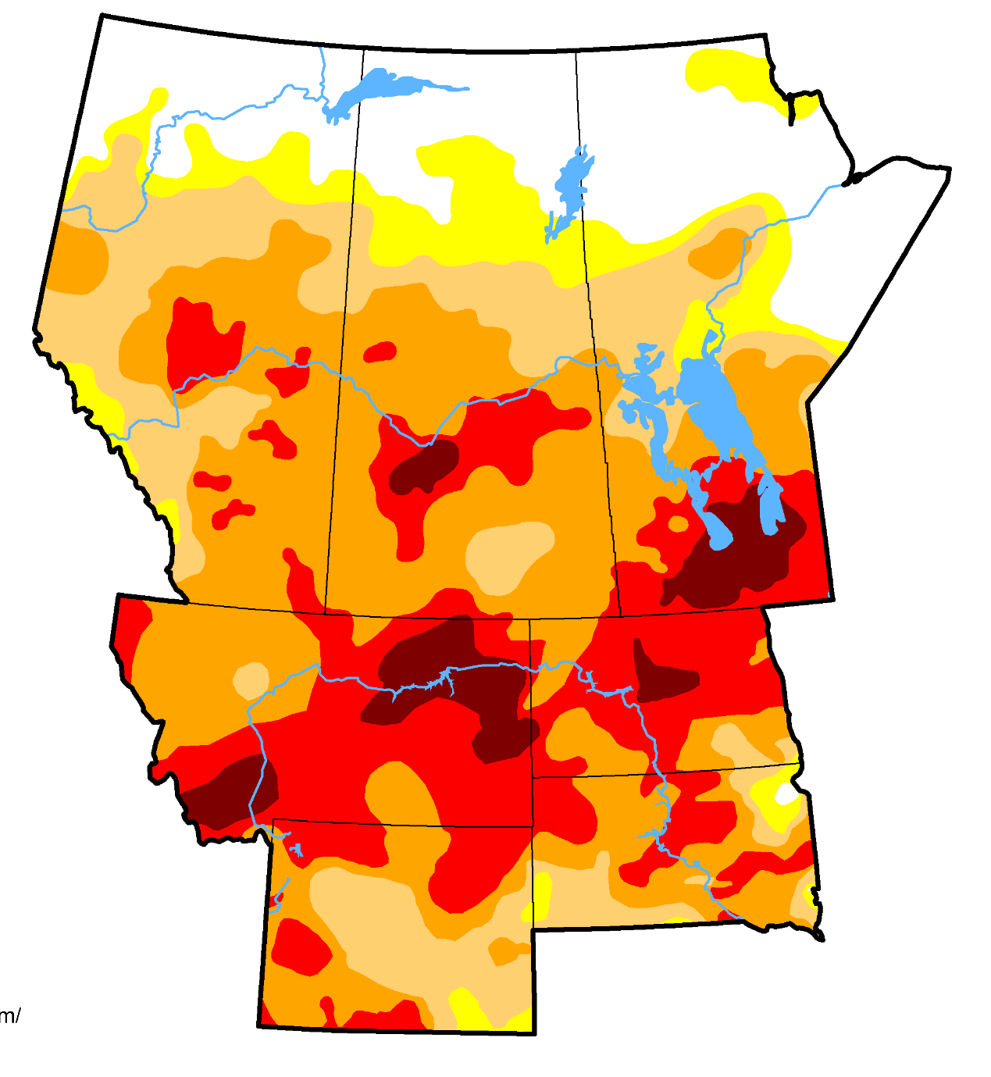
2020-2021
MRB Drought Assessment
COMING SOON!
Overview of…
Evolution
Impacts
Response
New/ongoing needs and gaps
August 31, 2021
Notes:
One thing that the MRB DEWS is just wrapping up is an assessment of the drought in the US northern plains and canadian prairies from 2020 to 2021. The Assessment includes an overview of the evolution and impacts, as well as the response at the local, state, and regional level. We also have a section on new and ongoing needs and gaps related to improving drought preparedness in the region.
The drought did continue into 2022 and in some areas is still persisting, so we are planning to continue this drought assessment to cover 2022 as well. But, the first part recapping the 2020-21 drought will be released very soon.

Slide 12
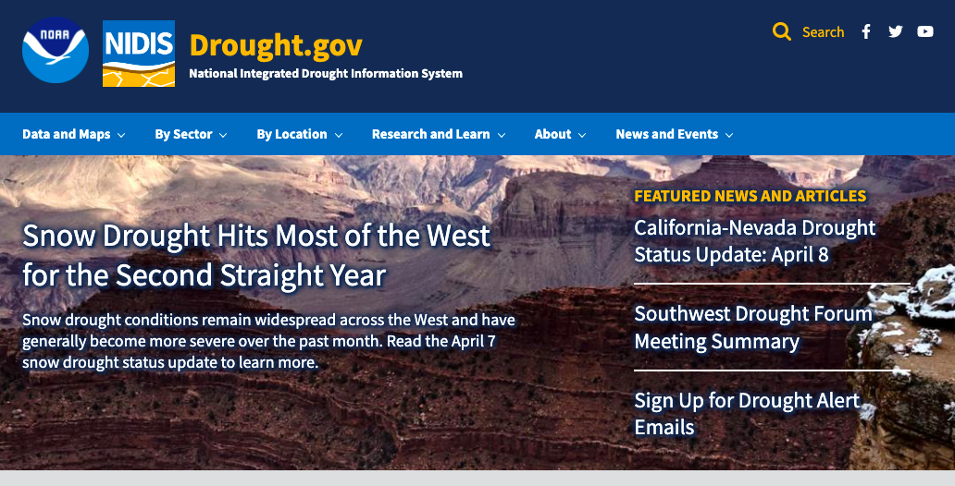
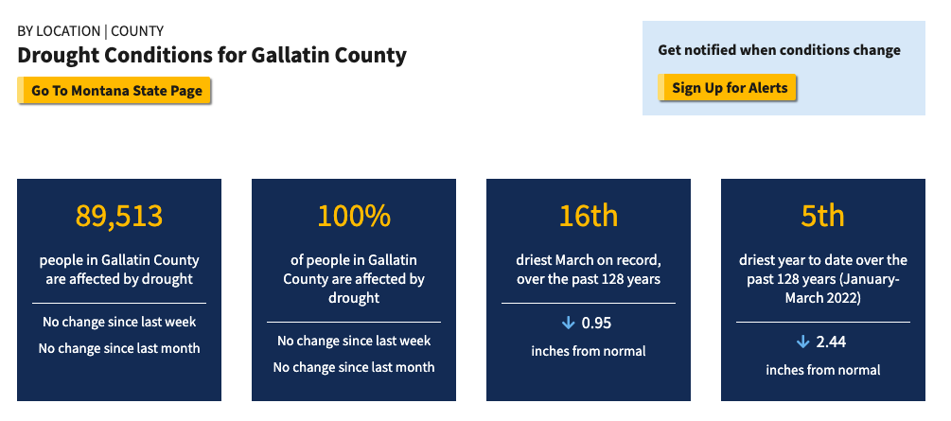
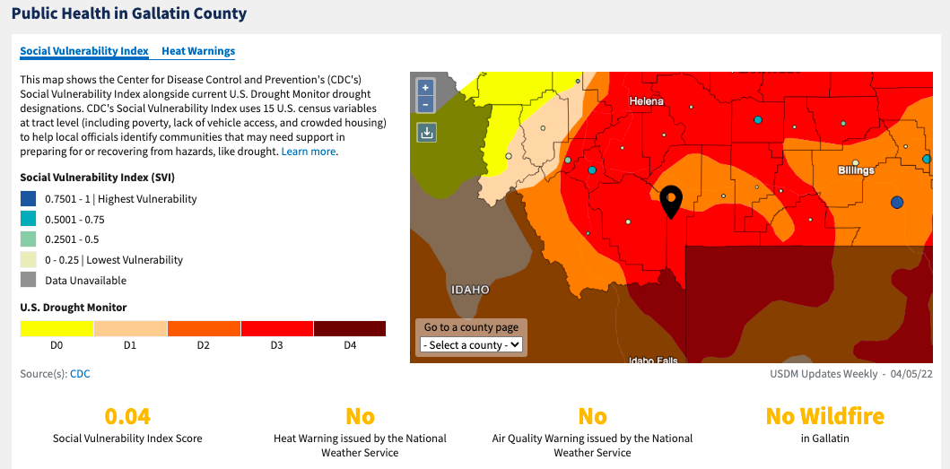
U.S. Drought Portal: Drought.gov
NIDIS RESOURCES
Up-to-date drought conditions from the city and county level to across the globe
Interactive maps and data that show drought in new ways
New “By Sector” section, showing drought impacts on different economic sectors
Research and Learn section where you can “go back to the basics” on drought
Notes:
NIDIS hosts the US Drought Portal, or Drought.gov. The website provides up to date drought conditions from the city and county level to across the globe. The website has a lot of interactive maps and data, as well as sector-based information and drought 101 research and learn sections.

Slide 13
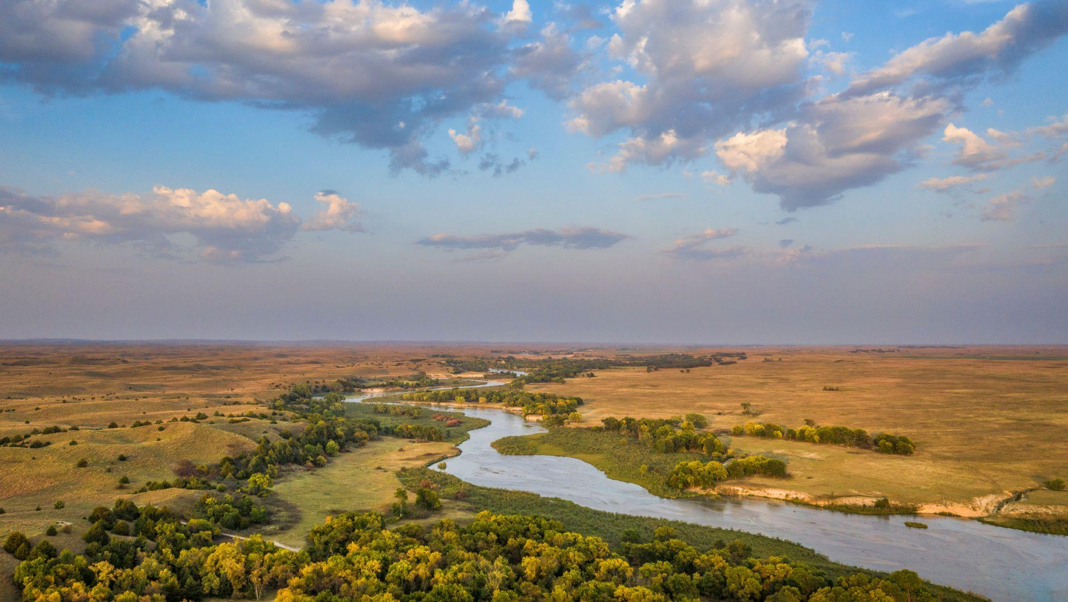
Please subscribe to receive emails from MRB DEWS
MRB DEWS Coordinator
Molly Woloszyn
molly.woloszyn@noaa.gov
www.drought.gov
@DroughtGov
@DroughtGov
National Integrated Drought Information System
Notes:
Scan QR code on screen to sign up for the Missouri River Basin regional emails and updates.

Slide 14
Outline
Importance of MRB Water Resources
National Integrated Drought Information System
Recent High MRB Flows and Climate Change

Slide 15
Potential Threats of Climate Change Aridification would lead to reduced water resources
Cook, B. I., T. R. Ault, and J. E. Smerdon, 2015: Unprecedented 21st century drought risk in the American Southwest and Central Plains. Science Advances, 10.1126/sciadv.1400082.

Slide 16
MRB Flow Increased! 1990-2019 (Recent Climate) Compared to 1960-1989 (Past Climate)

Slide 17
Abundant Precipitation Led to High River Flows

Slide 18
Abundant Precipitation Led to High River Flows

Slide 19
Did Climate Change Affect High Missouri River Basin Flows? Compare Recent (1990-2019) and Past (1960-1989) Climates

Slide 20
The Observed Runoff Increases Were an Unlikely Occurrence

Slide 21
The Most Likely Runoff Change Was a Decrease

Slide 22
The Observed Runoff Increases Were Caused by Unlikely Precipitation Increases

Slide 23
Meanwhile, Temperatures Warmed, but Below Expectations

Slide 24
Runoff Increases Caused by Unlikely Precipitation Increases Local to the Missouri River Basin

Slide 25
Runoff Increases Were Much Larger Than Attendant Precipitation Increases Due to Precipitation Elasticity of Runoff
Upper Basin
Lower Basin
Model | Upper Basin | Lower Basin
CMIP6 | 1.8 | 2.4
SPEAR | 1.1 | 2.7
CESM2 | 2.2 | 3.7
MPI | 2.6 | 4.2
CESM1 | 3.0 | 3.7
Precipitation Elasticity of Runoff
Past to Recent Climate

Slide 26
The Models Indicate Runoff Decreases Absent Precipitation Increases
Upper Basin
Lower Basin
Model | Upper Basin | Lower Basin
CMIP6 | -6.2% | -9.5%
SPEAR | -7.8% | -15.6%
CESM2 | -10.0% | -12.6%
MPI | -3.7% | -15.5%
CESM1 | -7.9% | -9.4%
Runoff Decrease
Past to Recent Climate

Slide 27
A Decrease in Water Resources is Most Likely in the Future

Slide 28
How Much is the Recent High Missouri River Flow Due to Climate Change?
Andrew Hoell
NOAA Physical Sciences Laboratory
andrew.hoell@noaa.gov

